Slide 1
Heritage Farm Headwater Wetland Restoration Project
Clark County Public Works – Clean Water
September 24th, 2020

Slide 2
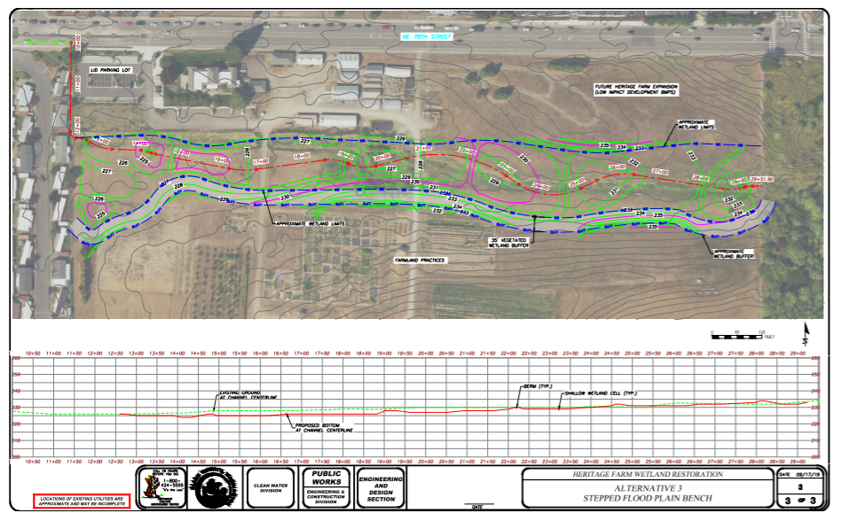
Heritage Farm Headwater Wetland Restoration 15% Design

Slide 3
Project
Heritage Farm Wetland Restoration
  Floodplain bench to restore wetlands, channel, and riparian zone at 78th Street Heritage Farm
This project:
Address water quality problems and habitat degradation associated with stormwater runoff
Implements a portion of the Heritage Farm Master Plan
Support the goals of Clark County’s Stormwater Management Plan to protect surface water and groundwater resources from polluted stormwater.

Slide 4
Funding
Ecology Grant: $500,000 combined funding awarded from both the Centenial Clean Water Program and Clean Water Act Section 319 Program
The rest of the project will be funded by Clark County Clean Water Program
Ecology Stream Flow Restoration Grant Application

