Slide 1
UCPB Agenda 1/11/2021
(info) I. Introductions
(action) II. Election of new vice chair
(action) III. Approval of December 14, 2020, minutes
(action) IV. CARES Act –CDBG-CV3 updates and recommendation
(info) V. Neighborly scoring refresher
(info) VI. Program updates
(info) VII. Other
Public Comment
Meeting time

Slide 2
Agenda Item IV. CARES Act – CDBG-CV3 Update
The third and final CDBG-CV allocation was announced September 11, 2020.
$1,168,791 | CV3 Allocation
-$133,758 | 20% administration, less $100,000 to award
-$627,858 | Battle Ground HealthCare COVID rehabilitation
$407,175 | Remaining to allocate
Previous Request Submitted
New Heights Clinic Modular Estimate | $665,000
Additional Request Submitted
Battle Ground HealthCare Phase 2 Request | $222,412
Requests detailed on following slides Possible Washington State CDBG-CV funding availability

Slide 3
Agenda Item IV. CARES Act – CDBG-CV3 Update
Battle Ground Free Clinic Phase 2 request
Item | Original Approved Request | Updated Amounts + Tax
Roof | 208,516 | 269,205
HVAC – clinic | 349,495 | 360,458
Equipment | 16,897 | 26,916
Space Renovation | 72,949 | 95,961
HVAC east-side | 0 | 117,729
Total | 647,858 | 870,271
Phase 1
Phase 2
UCPB awarded $627,858 with BGHC adding $20,000 match. Current gap is $222,412.
Cost increases included: Davis Bacon, taxes, payment and performance bond costs, permitting. Vaccine refrigerator estimated at $2,500 actually $11,000.
Propose to break work into two phases and get started with most necessary repairs first.

Slide 4
Agenda Item IV. CARES Act – CDBG-CV3 Update
New Heights Free Clinic Update
Land use attorney advised that there are key provisions in existing conditional use permit that would make the new clinic consistent with the uses already authorized by the county.
Still trying to get a response/concurrence from county as of 1/8/21.
Now that it appears that the building can be located on the campus, they are developing a plan for permanent siting of the facility, rather than a temporary installation.
New Heights has not started other fundraising yet, and probably won’t pursue that until the siting/zoning issue is better resolved.
Item | Estimated Cost
Real Estate – owned by New Heights | $0
Building – 3,000 SF @ $165/SF | $495,000
Transportation to site | $10,000
Site prep, including utilities | $160,000
Total | $665,000

Slide 5
Agenda Item V. Neighborly scoring refresher
When you are given access to an application, you will get an email notification with a link:
https://portal.neighborlysoftware.com/clarkcountywa/Reviewer
If you don’t remember your password, Sam can reset it.

Slide 6
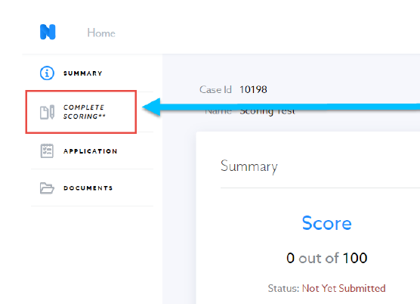
Agenda Item V. Neighborly scoring refresher
The “Complete Scoring” tab on the left-hand side allows you to start the scoring process.

Slide 7
Agenda Item V. Neighborly scoring refresher
Score Report will show points awarded and points available.

Slide 8
Agenda Item VI. Program updates
Treasury Emergency Rental Assistance program forthcoming
HOME HQS inspections and self-certification of income waivers extended through September 2021
Hiring 12-month project position to help coordinate homelessness and behavioral health programs
RFA for shelter operations of non-congregate shelter is open

Slide 9
Wrap Up
VII. Other
Public Comment
UCPB meeting time
Save the Date - next UCPB:
February 8, 2021
February Presentation Schedule
8:40 | City of Battle Ground
8:50 | City of Camas
9:00 | City of Washougal
9:10 | City of Woodland
9:20 | Lifeline Connections
9:30 | Hispanic Chamber
9:40 | Mercy Corp NW
9:50 | Proud Ground
10:00 | Ten-minute break
10:10 | VHA, with Fred Dockweiler, consultant
10:20 | Second Step Housing
10:30 | Janus Youth (5-minute Q&A only)
10:35 | Lifeline Connections (5-minute Q&A only)
10:40 | Share (5-minute Q&A only)

