Slide 1
UCPB January 10, 2022 – Agenda
(info) I. Introductions
(action) II. Approval of September 13, 2021 minutes
(action) III. Election of Vice-Chair
(action) IV. CDBG-CV Battle Ground HealthCare financing modification
(info) V. 2022 CDBG and HOME Application Updates
Overview of 2022 submitting agencies
Application review and scoring refresher
(info) VI. Program updates
Section 3 changes
(info) VII. Other
Public Comment

Slide 2
Agenda Item IV. CDBG-CV Battle Ground HealthCare
Battle Ground HealthCare was awarded total of $1,491,893 as forgivable loan
Request to split the financing to 50% forgivable loan and 50% grant
Staff recommends approval

Slide 3
Agenda Item V. 2022 CDBG and HOME Applications
Applicant | Project | CDBG Request | HOME Request
Public Facilities and Neighborhood Improvements
City of Camas | NW 14th improvements | $212,000
New Heights Clinic | Primary Care Clinic new construction | $600,000
Recovery Café | Recovery Navigator Program acquisition | $200,000
City of Ridgefield | Gee Creek Loop improvements | $195,000
Vancouver Tool Library & Community Center | Tool library and access center acquisition | $300,000
City of Washougal | Hamllik 1/2 basketball court | $50,000
Asset and Economic Development
Greater Vancouver Chamber | Pathways to Opportunity & Dev. | $90,000
Hispanic Chamber | Latinx Business assistance | $78,600
Mercy Corps NW | Business IDA program | $289,100
Micro Enterprise Services of Oregon | Micro-Enterprise assistance | $50,400
Proud Ground | Homeownership assistance | $300,000
Affordable Housing and Homelessness
Janus Youth | The Nest TBRA | $20,000 | $100,000
Lifeline Connections | Recovery TBRA | $25,100 | $125,400
Salvation Army, The | Pathway of Hope TBRA | $18,000 | $72,000
Second Step Housing | Market-Rate Unit acquisition |  | $400,000
Share | ASPIRE TBRA | $50,000 | $250,000
VHA | Weaver Creek Commons new construction |  | $750,000
YWCA | Domestic Violence TBRA | $28,800 | $151,200
Estimate of $2 million in CDBG and HOME funds available

Slide 4
Agenda Item V. Neighborly scoring refresher
When you are given access to an application, you will get an email notification with a link:
https://portal.neighborlysoftware.com/clarkcountywa/Reviewer
Neighborly scoring step-by-step instructional guide available on the UCPB website

Slide 5
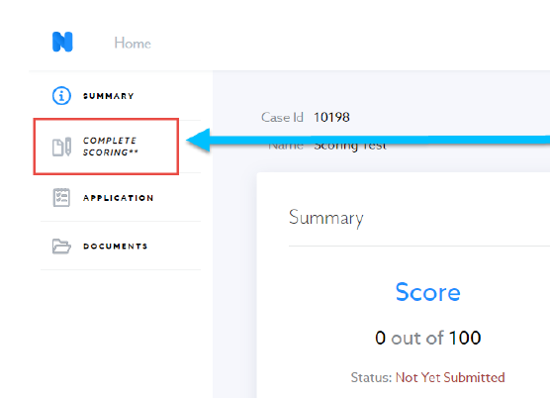
Agenda Item V. Neighborly scoring refresher
The “Complete Scoring” tab on the left-hand side allows you to start the scoring process.

Slide 6
Agenda Item V. Neighborly scoring refresher
Score Report will show points awarded and points available.

Slide 7
Agenda Item VI. Program Updates
Overview of Section 3 changes
Applies to construction projects with $200,000 or more in HOME or CDBG funds (unchanged)
Section 3 regulations now under 24 CFR Part 75
Reporting has changed from new hires to all labor hours
New Benchmarks
25% of labor hours must be Section Workers
5% must be targeted Section 3 workers
Requires input from contractor when benchmarks not met
Existing contracts with Section 3 language will be updated – contractors are being notified
County staff designing reporting tool
Trainings to follow
Community training
Mini-training at pre-construction conferences

Slide 8
Agenda Item VII. DRAFT 2022 Work Plan
January | Elect Vice Chair Overview of 2022 CDBG and HOME applications Program Updates Review Annual Work Plan
February | CDBG & HOME 2022 application presentations (9:30 AM – 12:30 PM)
March | HUD funding updates October-December 2021 Quarterly Report 2022 Scoring Review and Funding Awards (April 18 – 22 is National Community Development Week)
June | Update on HUD Action Plan submission January-March 2022 Quarterly Report Review Point in Time Count and Homeless Connect data Homeowner Rehabilitation Program presentation
October | Consolidated Annual Performance Evaluation Report – outcome review April-July 2022 Quarterly Report 2023 Application Released

Slide 9
Wrap Up
VII. Other
Public Comment
Save the Date - next UCPB meeting:
February 14, 2022, 9:30am – 12:30pm
Will have presentations from 2022 funding applicants – schedule will be provided

