Slide 1
VAB Agenda – 1/13/2022
(info) I. Call to Order/Invocation/Roll Call
(action) II. Approval of December 9, 2021 minutes
(info) III. Committee Reports – Appeals/Policies
(info) IV. November 2021 Contractor & Fund reports
(info) V. Veterans Assistance Center Update
(info) VI. Old Business – HUD VASH, food cards, LOIs
(info) VII. New Business
(info) VIII. Open Forum

Slide 2
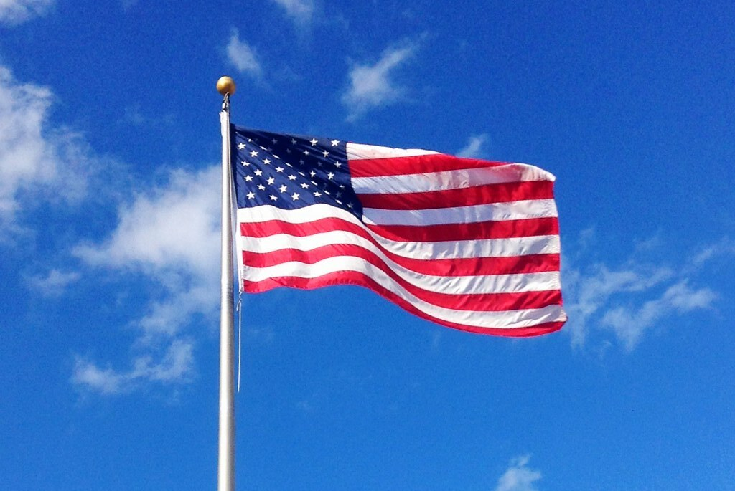
Agenda Item I. Call to Order/Invocation/Roll Call

Slide 3
Agenda Item II. Approval of December 9 minutes
The October 14, 2021 minutes were approved with a motion from Shannon Roberts, seconded by Steve Slegers.
SWACH Navigation Program
SWACH received two referrals that did not engage in services, so they have not expended any contract funds to date. They are creating a website to facilitate referrals.
Committee Reports
Appeals: None.
Policies and Procedures:
Veterans qualify for HUD VASH vouchers if discharged other than in lieu of court martial. Additional discussion on possible Veteran Center assistance will occur at next meeting.
Veteran who refuses to provide photo identification for services will be denied services.
It is requested to increase the food allowance $50-$100 per category. It has not changed since 2014. Food vouchers are currently used at Fred Meyers, only to the amount of the purchase. Family-friendly gift cards from WinCo and Safeway are preferred. VAC must maintain logs and cannot be reimbursed until cards are handed out. Mike Gibson moved to increase food categories $100 each; Steve Slegers seconded. Motion passed.
Nominations/Election of 2022 Officers
Michael Harding has been nominated for chair. Shannon Roberts and Bruce Maas were nominated for vice chair and secretary, respectively. Nominations received unanimous approval.
A motion was made by Darren Wertz and seconded by Shannon Roberts to approve Kevin Lawson, Kelly Jones, and Bryan McGillis as Members at Large for 2022.
September and October 2021 Contractor Reports & Fund Report
The fund assisted 46 Veteran households in September and 46 in October. The Veterans Assistance Center received 209 Veteran visits in September and 188 visits in October. The Free Clinic served 2 Veterans. The Fund balance at the end of October was $950.238.
Veterans Assistance Center (VAC) Update
Christmas toy shop open by appointment only.
Preparing food boxes.
Old Business: No discussion.
New Business: 2022 Letters of Interest need to be returned by end of year, please send to: janet.snook@clark.wa.gov
Open Forum
Check VA registry for Burn Pit list.
Gold Star scholarship
Women’s Veterans Call Center informing of benefits available to women veterans. Call 855-829-6636 for more information.
Lifeline has taken over the Windhaven Equine counseling sessions. Conducting intake interviews now. Veterans being funded through scholarships. Working on getting VA funding. This is in conjunction with Lifeline becoming a SAMHSA Certified Community Behavioral Health Center.
Post 4278 hosting ceremony for Wreaths Across America, Saturday, December 11.

Slide 4
Agenda Item III. Committee Reports
Appeals
Policies and Procedures

Slide 5
Agenda Item IV. November Contractor & Fund Reports
CCVAC
62 Veterans served in November, services totaling $33,341
50 men, 9 women Veterans and 3 widows served
192 visits to the center for essentials and food
547 Volunteer hours, totaling $13,505 value
Free Clinic
One served in November: dentures, partials.
Value: $2,100, billed $3,380
Fund
Revenue: $69,296. Expenses: $69,466. Balance: $950,067.

Slide 6
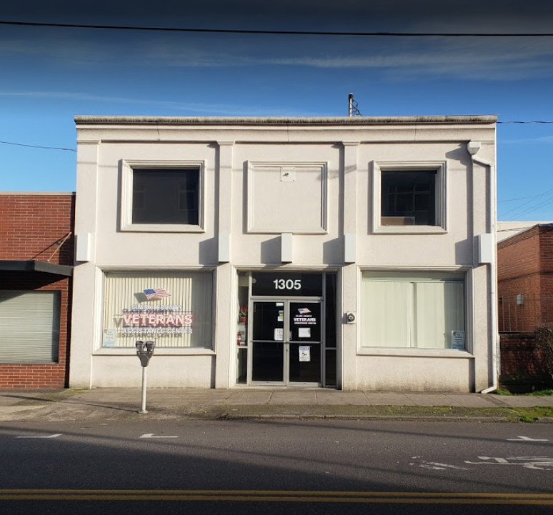
Agenda Item V. CCVAC updates

Slide 7
Agenda Items VI. – IX.
Old Business
2022 LOIs
Food cards
HUD VASH eligibility
New Business
Open Forum
Adjourn
Next meeting: February 10, 2022

