Slide 1
UCPB Agenda 3/14/2022
(info) I. Introductions
(action) II. Approval of February 14, 2022 minutes
(info) III. HUD funding updates
(action) IV. 2022 HOME & CDBG awards
(action) V. HOME-ARP awards
(info) VI. October – December 2021 reports
(info) VII. Other
Community Development Week April 11 – 15.

Slide 2
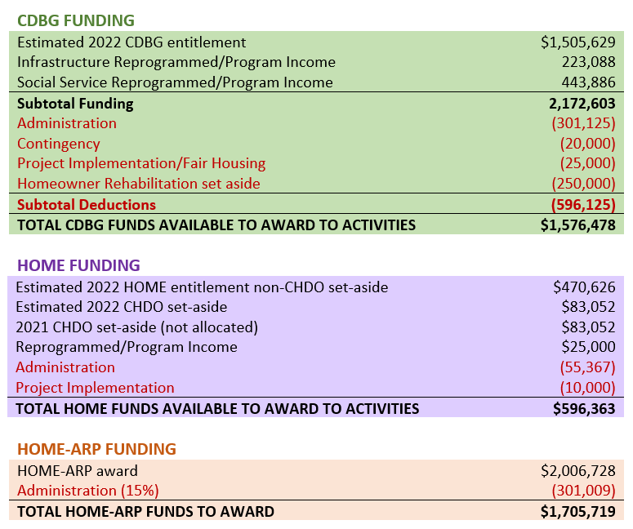
Agenda Item III HUD funding updates

Slide 3
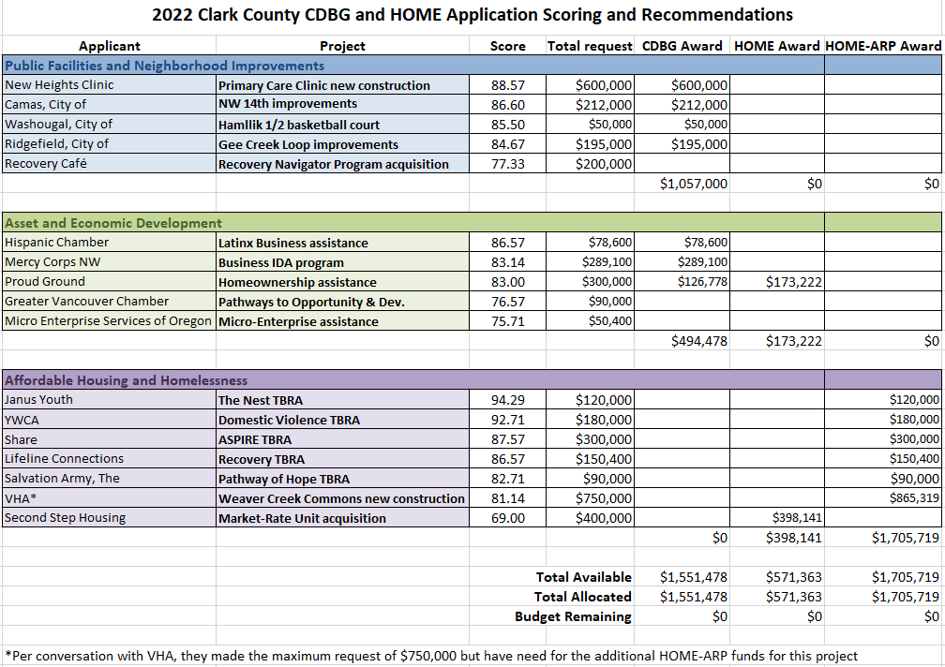
Agenda Items IV & V. 2022 CDBG, HOME & HOME-ARP awards

Slide 4
Agenda Item VI. Oct – Dec 2021 Quarterly Reports
Public Facilities and Neighborhood Improvements
 |  | Infrastructure
Contract | IDIS | Project | Funding | Expended | Narrative | On Schedule
1901 | 1422 | Battle Ground - SW 3rd St & SW 19th Avenue Improvements. Construct sidewalks and stormwater improvements. | $193,000 | $193,000 | Construction complete. Working on project close-out. | No
2001 |  | Battle Ground - SE Clark Avenue Improvements. Construct 150' section to create through road. | $129,200 | $0 | Project environmental must be aggregated with new VHA housing project, in predevelopment. | N/A
2002 | 1464 | Camas - NW 12th Avenue Improvements. Water, street and sidewalk improvements on NW 12th between Division and Benton Streets. | $255,000 | $226,940 | Construction complete. Waiting for close-out documents. | No
2003 |  | Ridgefield - Simons Street Improvements. Water and stormwater improvements and construct sidewalks with ADA ramps. | $255,000 | $0 | Environmental underway. | N/A
2102 | 1488 | Camas - NE 2nd Avenue Improvements. Water, street and sidewalk improvements on NE 2nd Ave between Everett and Garfield Streets. | $170,000 | $0 | Environmental complete. Contract drafted. | Yes
2104 | 1483 | Washougal - Hamllik Park Improvements. New paint, benches, playground, picnic tables and irrigation replacement. | $85,043 | $58,262 | Subcontract executed, playground equipment received. | No
 |  | Social Service
1913 | 1421 | Share - Share House Elevator Replacement. Replace non-operational elevator in facility housing homeless single men. | $40,000 | $20,677 | Acquiring completion paperwork to close out project. | No
2004 | 1467 | Washougal - Social Service Building Repairs. Building exterior and window repairs at 1702 C Street. | $227,000 | $0 | Design phase 50% complete. | Yes
2103 |  | Lifeline Connections Mothers Recovery House. Acquisition of single-family home for sober living for 6 women and children. | $200,000 | $0 | Project awarded funding, no property identified yet. | Yes

Slide 5
Agenda Item VI. Oct – Dec 2021 Quarterly Reports
Asset and Economic Development
Contract | IDIS | Project | Funding | Expended | Narrative | On Schedule
2007 | 1463 | Hispanic Metropolitan Chamber – Business Technical Assistance. Bilingual assistance to support small businesses in Clark County. | $73,200 | $68,639 | Serving 50 businesses; added 3 new business clients in Q4. Focused on increasing outreach. | Yes
2008 | 1468 | Mercy Corps NW - Small Business Development. Technical assistance to support small businesses in Clark County. | $50,000 | $15,840 | Program underway. Focused on loan technical assistance and Farmer's Market TA | Yes
2012 20H8 | 1461 / 1462 | Proud Ground - Homeownership Assistance. Home buying opportunities using a land trust model, buyers under 80% AMI. | $147,000 $153,000 | $147,000 $153,344 | Three clients closed on homes in Q4. | Yes
2106 |  | Hispanic Metropolitan Chamber – Business Technical Assistance. Bilingual assistance to support small businesses in Clark County. | $73,200 | $0 | Project awarded 2021 funding to start Jan 1, 2022. | N/A
2107 |  | Mercy Corps NW - Business IDA program. Classes, credit repair, loans and matched savings for small businesses in Clark County. | $250,000 | $0 | Project awarded 2021 funding. | N/A
2108 21H5 | 1484 / 1485 | Proud Ground - Homeownership Assistance. Home buying opportunities using a land trust model, buyers under 80% AMI. | $300,000 | $0 $0 | Contracts executed. Working with three eligible homebuyers. | N/A

Slide 6
Agenda Item VI. Oct – Dec 2021 Quarterly Reports
Affordable Housing and Homelessness
 |  | Affordable Housing
Contract | IDIS | Project | Funding | Expended | Narrative | On Schedule
19H4 | 1451 | VBT Grand Blvd LLC - The Grand Pacific Apts. Construct 26-unit affordable mid-rise housing. | $100,000 | $100,557 | Project 96% complete. | Yes
20H5 | 1471 | Mercy Housing - Mercy PeaceHealth Housing - Construct 70 affordable family units near PeaceHealth campus. | $250,000 | $225,236 | Construcion 35 % complete, including all foundations and utilities. | Yes
20H7 | 1489 | VHA - Central Park Place Rehab - Replace building exterior and systems; increase accessiblity and parking; reconfigure to add units. | $180,000 | $0 | Executed contract with general contractor and issued notice to proceed in Dec. | Yes
 |  | Tenant-Based Rental Assistance
2009 20H1 | 1455 / 1456 | Janus Youth – The Nest. Provide TBRA and case management for approximately 15 youth households (ages 18-24) households. | $20,000 $100,000 | $20,000 $93,500 | Program underway, 22 households assisted. | Yes
2010 20H2 | 1457 / 1458 | Lifeline – Recovery Rental Assistance. Provide TBRA and case management for 15 households engaged in recovery supports. | $9,370 $47,500 | $6,228 $47,500 | Program underway, 4 households assisted. | Yes
2011 20H3 | 1454 / 1453 | Share – ASPIRE. Provide TBRA and case management for 40 individuals and families experiencing homelessness. | $50,000 $250,000 | $50,000 $139,300 | Program underway, 37 households assisted. | Yes
2109 21H1 | 1490 1491 | Janus Youth – The Nest. Provide TBRA and case management for approximately 20 youth households (ages 18-24) households. | $20,000 $100,000 | $0 $0 | Project awarded 2021 funding to start Jan 1, 2022. | N/A
2110 21H2 | 1496 1497 | Lifeline – Recovery Rental Assistance. Provide TBRA and case management for 20 households engaged in recovery supports. | $20,000 $100,000 | $0 $0 | Project awarded 2021 funding to start Jan 1, 2022. | N/A
2111 21H4 |  | Share – ASPIRE. Provide TBRA and case management for 20 individuals and families experiencing homelessness. | $50,000 $166,948 | $0 $0 | Project awarded 2021 funding to start Jan 1, 2022. | N/A

Slide 7
Agenda Item VI. Oct – Dec 2021 Quarterly Reports
Community Development Block Grant COVID Response (CDBG-CV)
Contract | IDIS | Project | Funding | Expended | Narrative | On Schedule
CV01 | 1452 | Mercy Corps NW - Microenterprise Grants. Provide technical assistance and grants to small businesses affected by the coronavirus. | $1,033,932 | $969,633 | Held holiday market, ran 4-week business plan workshop, provided technical assistance to 13 businesses in Q4. | Yes
CV04 | 1447 | Janus -TBRA Case Management - COVID. Increased housing support for TBRA households affected by coronavirus. | $20,000 | $20,000 | Program ongoing. Funds being used to pay staff hazard pay. | Yes
CV06 | 1449 | Share - TBRA Case Management - COVID. Increased housing support for TBRA households affected by coronavirus. | $30,000 | $30,000 | Program ongoing. Funds being used to support housing case management services. | Yes
CV07 | 1465 | Battle Ground Healthcare - Clinic Acquisition. Funds to acquire and improve free clinic for coronavirus response. | $1,087,043 | $1,087,042 | Construction complete and clinic is serving clients. Working on project close-out. | Yes

Slide 8
Wrap Up
VII. Other
Public Comment
National Community Development Week: April 11 - 15
Next meeting: April 11, 9:30am, if needed

