Slide 1
Agency Overview
Communityinmotion.org

Slide 2
Our mission is to connect our neighbors with access to reliable transportation options that support healthy, independent living.

Slide 3
Non-Emergency Medical Transportation

Slide 4
Through a contract with Health Care Authority (HCA), we schedule transportation for low-income individuals who need help accessing their Washington Medicaid medical appointments.
Serves: Clark, Cowlitz, Klickitat, Skamania and Wahkiakum Counties
Transportation provided to most Washington Medicaid eligible clients who are accessing covered medical appointments within their local community.
If a medical service is not available in the client’s local community, transportation to the next closest provider may be arranged with proper documentation.
Transportation for Washington Medicaid client who have no means of transportation.
Notes:
Transportation for Medicaid (Apple Health – in Washington) patients who have no means of transportation to get to Medicaid covered medical appointments. Serves: Clark, Cowlitz, Klickitat, Skamania, and Wahkiakum Counties.
To be eligible you have to have a current Medicaid Assistance ID Card and are going to a Medicaid covered medical service within your community.
Transports to closest medical provider of type in community.
Cannot transport to services not covered under your specific Medicaid program.
Typical services include Physicians, Medical Clinics, Urgent Medical Care, Mental Health, and Dialysis.
Operates under Most Appropriate, Least Costly.
Provides Public bus tickets and passes, Gas vouchers, Mileage reimbursement, Volunteer Drivers, Wheelchair van/cabulance, Taxi.
To schedule a ride, call office at least 2 days in advance, we can set up rides up to 14 days out.
Information to have ready when you call: DSHS Medicaid ID Card, complete pick-up address, name-complete address-phone number of medical provider, exact appointment time and date, type of medical appointment, return time if known,
First time callers will be asked additional screening questions.

Slide 5
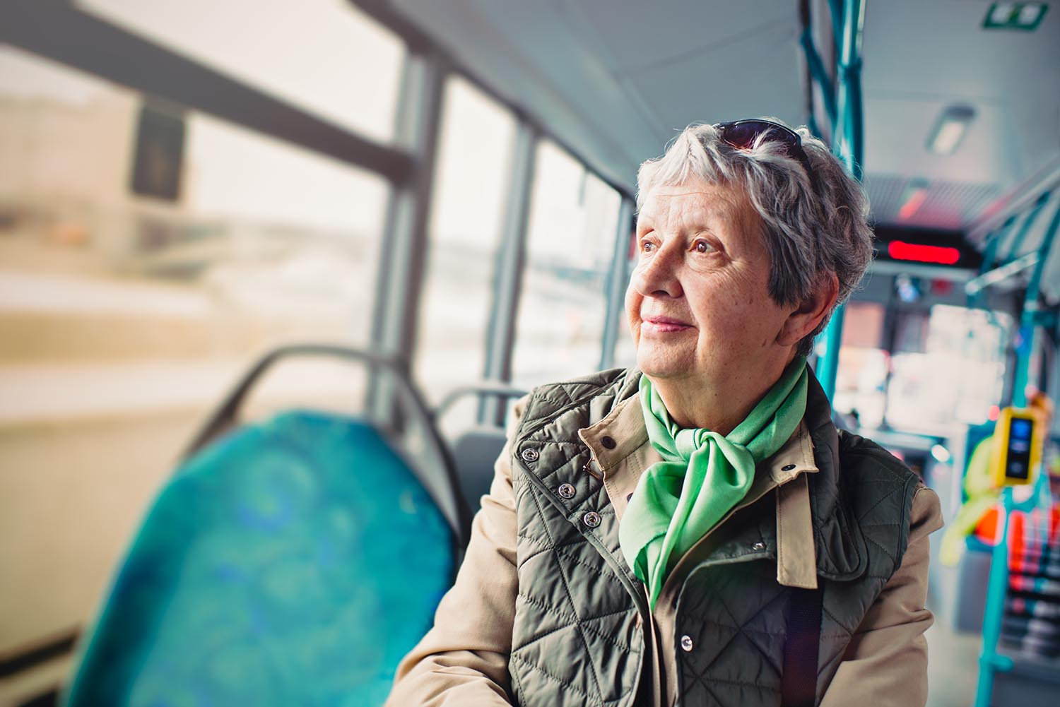
Transportation Modes
Bus Passes
Gas Vouchers/Mileage Reimbursement
Client must provide the agency with copies of current vehicle information (Driver’s license, Vehicle registration and Vehicle insurance)
Volunteer Drivers
Door-to-door (taxi/wheelchair accessible van)
Train tickets
Occasional plane trips
Notes:
Transportation can mean many different modes. We provide the Most Appropriate, Least Costly option

Slide 6
Mobility Management

Slide 7
Serves: Clark county
Focus on increasing access to service and transportation for seniors and those with a disability by advocating for accessibility and working with community organizations, businesses and local government
Focus is on all transportation needs
Funded through Enhanced Mobility of Seniors & Individuals with Disabilities section of 5310 grant through the Federal Transit Administration

Slide 8
Trip Resource Center
Notes:
The Trip Resource Center is a service offered by Community in Motion that compiles known community transportation resources (for the five counties of Clark, Cowlitz, Klickitat, Skamania and Wahkiakum counties) into one online location (tripresourcecenter.org) and phone number

Slide 9
Trip Resource Center is an interactive website with transit and other transportation resources for SW Washington
Our Mobility Coordinator provides information to approximately 1,000 people about our services at outreach events a year
The programs flexibility allows the Coordinator to focus on several areas in order to make the most impact on local transportation accessibility

Slide 10
North County Shuttle Service

Slide 11
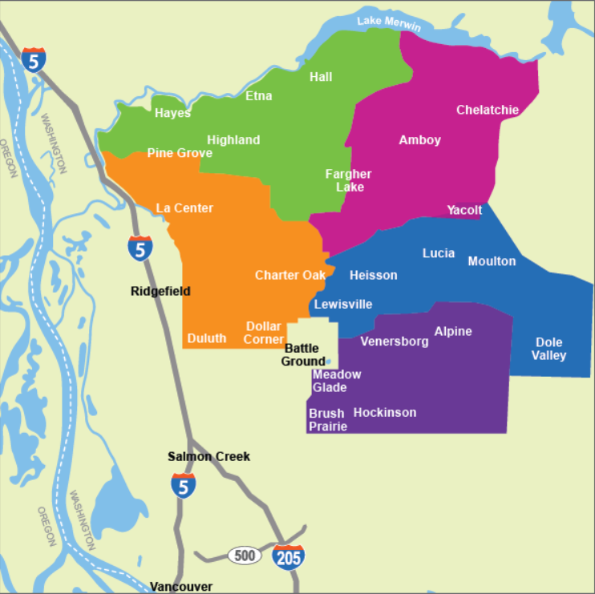
Serves north Clark County
North County Shuttle Service provides free weekly trips into Battle Ground for north Clark County residents who are seniors, persons with disabilities, and/ or socially isolated.
The shuttle enables mobility, socialization, and independence for those who lack reliable transportation.
Passengers can schedule trips based on route schedules
Routes are determined by day
of the week

Slide 12
Volunteers in Motion

Slide 13
Serves: Clark County
Providing a direct service, through rides, to those 65 or older or a person with a physical disability
Rides can be for medical or social events
Our volunteers are able to provide approximately 900 trips a year
Volunteers may use their own vehicle or one of the agencies three vehicles, including an accessible van
Volunteers are reimbursed miles if using their vehicle
Other local non-profits may use one of the agency vans for their transportation needs
People wanting a career in transportation can volunteer with us getting training and assistance to get a job with a vendor, C-Tran, etc.

Slide 14
Reserve A Ride

Slide 15
Serves Clark, Cowlitz and Wahkiakum counties
Transportation for clients not eligible for Medicaid Medical Transport
Limited funding restricts transportation to life sustaining appointments such as, Dialysis, Chemo, Radiation Treatments, etc.
Typically has people on the waiting list for service
FY20 provided over 5,700 trips in Clark County and 3,100 trips in Cowlitz County
Funded through Enhanced Mobility of Seniors & Individuals with Disabilities section of 5310 grant
Notes:
Transportation for individuals who do not qualify for NEMT to get to life sustaining medical appointments, medical care, and other basic services.
To be eligible you have to reside in Clark, Cowlitz, or Wahkiakum Counties.
Provides rides to Life-sustaining medical appointments (priority service), general medical appointments, if funding is available – group trips to shopping centers, rec activities, and meal sites.
Matches people with the trans. provider that can best meet their needs: Passenger car/taxi/van, wheelchair van/minibus, individual/group transports.
To schedule a ride, call office at least 2 days in advance, we can set up rides up to 14 days out. M-F 8am to 430pm.
Information to have ready when you call: Name, DOB, pick-up address and phone number, destination name-address-phone number, appointment date and time, return pick-up time if known, information on assistive equipment or mobility device you use.

Slide 16
Employment Transportation

Slide 17
Serves Clark county
Referrals come through partnering agencies, such as Goodwill Job Connections and WorkSource
Bus passes or door to door transportation for low income individuals who need to get to work and work related activities
FY20 provided over 78,000 trips
Bike to Work
Serves Clark County
Part of Employment Program
Clients are referred by partnering agencies
Classes are offered at the agency during the spring- late summer months
Wheels Deals bicycle shop partners to provide a bicycle and a fitting for each participant
Partnerships with Molina, Bike Clark County and others allow us to provide accessories including helmet, locks, and gloves
*Current grant ends - 6/2025

Slide 18
Sponsor A Ride

Slide 19
This isn’t program funded through a grant, it is a way for people to put in funds that can be used to pay for rides
Money can be put into a particular persons’ account (family can pay for Mom’s rides)
General donations made to Sponsor-A-Ride allows us to pay for the rides through the best program (Volunteer, Employment, Reserve-A-Ride etc.)
During FY21 we were able to assist in 34 trips
Notes:
Transportation for Clark County residents over 55 or individuals with disabilities to get to medical, education, shopping, recreational activities, and other basic services. Through the ride sponsor-a-ride program, family, friends, neighbors, and the community can make donations to a transportation account established on behalf of the older adult. Allows individuals to maintain an interactive lifestyle within their community, while promoting independence and dignity. Serves: Clark County.
To be eligible you are an adult that lives in Clark, age 55 or over, or have a disability. Have an individual sponsor account or are not other eligible for transportation assistance.
Funding is provided by contributions to your individual account, or from general donations from the community. Admin costs are included within trip cost.
We find the transportation that is best suited to your needs: Passenger car/taxi/van, Bus Passes, Individual/group transports, wheelchair van/minibus.
We provide trips to healthcare appointments, education facilities, shopping centers, recreational activities, and more – unless specified by donor.

Slide 20
Transportation is what holds our community together. Having a lot of social and medical services are great, but without access and transportation, they are meaningless for the populations who need them most.
Social isolation and accessibility issues are major overlooked problems existing in our community right now. Engaging and educating elected officials could pose solutions to these issues.

