Slide 1
2022 Clark County Point In Time Count

Slide 2
PIT Count – What is it?
Single Night Snapshot – normally last Thursday in January
Required by HUD & WA Dept. of Commerce
Trends
New tools and increased effectiveness in counting each year
Enables better planning and funding determinations
Best available data

Slide 3
Data Sources
Sheltered Count
Homeless Management Information System
Non-HMIS (Domestic Violence shelters)
Unsheltered Count
Non HMIS – Service Locations
SafePark Program
School District Homeless Liaisons
Street Count
Project Homeless Connect Event

Slide 4
2021/2022 Covid Complications
No Project Homeless Connect event or unsheltered count in 2021.
2022 count was originally scheduled during peak of Omicron surge in January. HUD provided a waiver to hold the count on February, 24 2022.

Slide 5
2022 Process Highlights
Expanded professional outreach team participation
1st year count occurred in February instead of January
1st year that the count occurred during a “severe weather” day
Conducted surveys using mobile app – “Counting Us” for 3rd year
Safely held an in-person Project Homeless Connect event

Slide 6
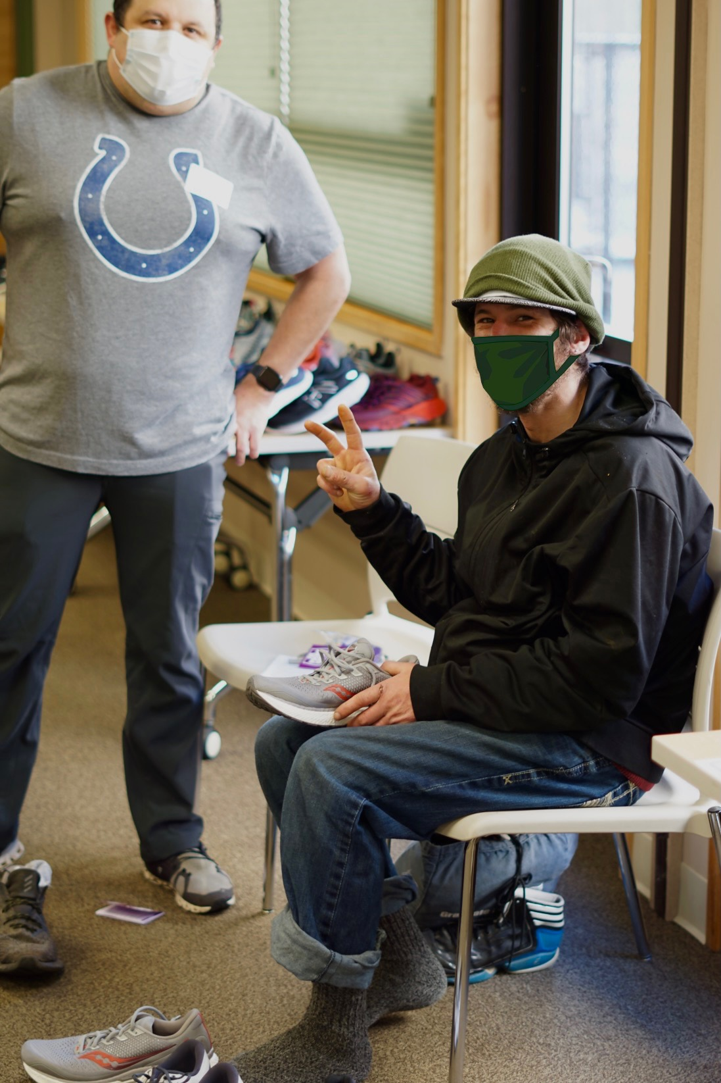

Slide 8
Increase in people within Sheltered count
389 people counted in ES in 2022. 213 in 2021.
+45% in sheltered clients largely due to increased number of year-round ES bed capacity.
Bertha’s Place, Bertha’s Too and safe living outpost community
Family shelters were able to fully re-open
Severe weather night added overflow beds
39% more people in Transitional Housing

Slide 9
More family shelter beds. Less unsheltered family members.
In comparison to 2020 count:
42 more people staying in family emergency shelters in 2022
49 less people in families with children experiencing unsheltered homeless in 2022.

Slide 10
Shelters and a stemmed growth in unsheltered senior numbers
Since 2017, we’ve seen a consistent annual growth in the number of seniors age 62+ experiencing unsheltered homelessness.
3 in 2017. Gradually increased to 37 by 2020.
Early 2022 Bertha’s Place was open and prioritizing seniors age 55 and up.
In the 2022 PIT count unsheltered seniors age 62+ remained at 37; same as two years prior.

Slide 11
Unsheltered increase in singles or couples without children and unaccompanied youth populations.
45% increase in number of unsheltered single individuals or couples without children. 457 in 2022 compared to 315 in 2020.
Unaccompanied youth also increased from 2 in 2020 to 18 in 2022.

Slide 12
Nearly 2 out of 3 people experiencing homelessness do not sleep outside.
36% of people surveyed indicate they sleep outside.
33% of people stayed in Emergency Shelter.
15% of people in Transitional Housing.
16% of people surveyed slept in their vehicle.

Slide 13
Affordable housing crisis in Clark County:
Spring 2022 apartment market report shows a 2.7% vacancy rate for one-bedroom apartments. 2.9% for two-bedroom. Source: University of Washington Center for Real Estate Research’s Apartment Market Survey report
https://wcrer.be.uw.edu/archived-reports/
Housing wage needed to afford the average one-bedroom apartment in Clark County is $29.08/hr Source: National Low Income Housing Coalition Out of Reach 2021 report
https://reports.nlihc.org/oor/washington

Slide 14
Q & A:

Slide 15
Thank You
Dale Whitley, HMIS Administrator
360-993-9571
dwhitley@councilforthehomeless.org
www.councilforthehomeless.org
Housing Hotline: 360-695-9677

Slide 16
Visit councilforthehomeless.org for more info

