Slide 1
VAB Agenda – 9/8/2022
(info) I. Call to Order/Pledge/Invocation/Roll Call
(action) II. Approval of August 11, 2022 minutes
(info) III. Kara Seibert, Life Connections
(info) IV. Committee Reports – Appeals/Policies
(info) V. July 2022 Contractor & Fund reports
(info) VI. Veterans Assistance Center update
(info) VII. Old and New Business
(info) IX. Open Forum

Slide 2
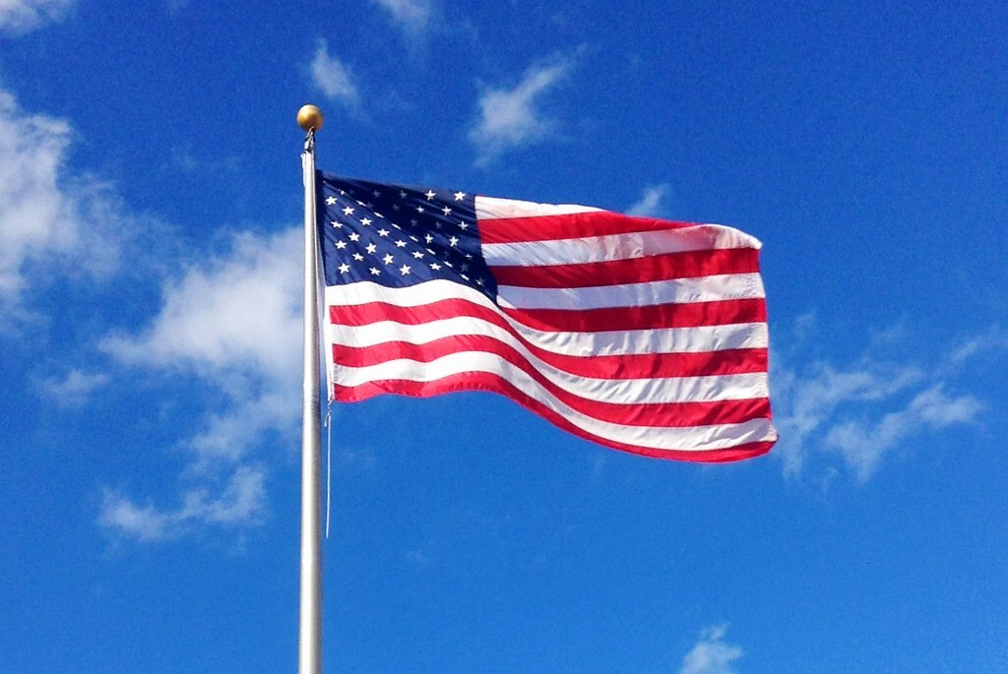
Agenda Item I. Call to Order/Pledge/Invocation/Roll Call

Slide 3
Agenda Item II. Approval of August 11 minutes
Approval of July 14, 2022, meeting minutes: The minutes were approved following a motion from Shannon Roberts that was seconded by Steve Slegers.
Committee Reports: Appeals: None. Policies and Procedures: No discussion.
June 2022, Contractor & Fund Reports
The fund assisted 39 Veteran households. The Veterans Assistance Center received 387 veteran visits. The Free Clinic served 2 veterans. WDVA processed 602 claims with 86 percent acceptance. The Fund balance at the end of April was $830,340.
Veterans Assistance Center (VAC) Update
• In-person Stand Down September 9, 9am-3pm, at River City Church. Many donations have been received. To volunteer, call 360.793.7030.
• Client services in office have increased. VSO backlog has also increased.
Old Business
• A meeting to review all Policies and Procedures and Board Bylaws is 1:30-3pm, September 1
• Veterans now qualify for free parking at County parks
New Business No discussion
Open Forum
• National Veteran Wheelchair Games (NVWG) Tournament coming to Portland July 4-29, 2023. Contact Shawn.Benson@va.gov for more information or to volunteer.
• Building 24 on VA campus to be renovated in 2024. Imaging building nearly complete.
• VA needs volunteer drivers for veteran transportation, and/or to stay with patients for outpatient surgery. Community in Motion and C-Tran C-Van may be available for transportation. Social workers may be available for in-person supports. Clark County does not have a DAV van, which can be purchased by WDVA.
• Lifeline is expanding veteran services through group therapy and equine therapy for PTSD. Will provide more information at Stand Down and at the next VAB.
• Post 4278 annual picnic, 12pm, August 21, at Fallen Leaf Park.
Adjourn Meeting adjourned.

Slide 4
Agenda Item III. Lifeline Connections Overview
Kara Seibert, LICSW
Healing Animal Partners Program Director
Lifeline Connections

Slide 5
Agenda Item III. Lifeline Connections Overview

Slide 6
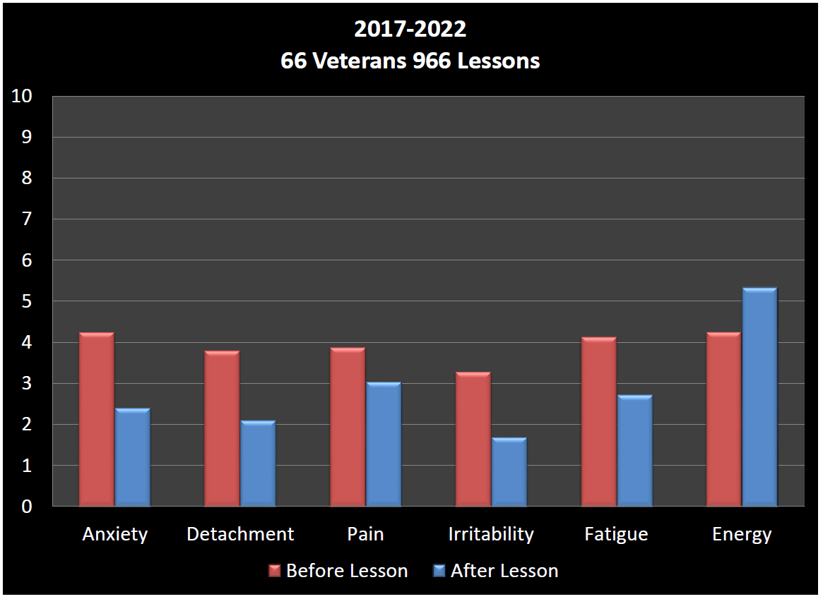
Agenda Item III. Lifeline Connections Overview

Slide 7
Agenda Item III. Lifeline Connections Overview
Lifeline website information about Veterans Services:
https://lifelineconnections.org/services/veterans-services/

Slide 8
Agenda Item IV. Committee Reports
Appeals
Policies and Procedures
Met September 1
Will meet again September 29, 1:30-3pm to discuss VAB Bylaws and other policy recommendations. Send discussion points to Emily prior to the meeting.
At the October 13 regular VAB meeting, the Board will vote on recommendations to send to County Council. Amended policy language will be distributed to the Board for review prior to this meeting.

Slide 9
Agenda Item V. July Contractor & Fund Reports
CCVAC
36 Veterans served in July, services totaling $24,556.98
33 men, 3 women
388 visits to the center for essentials and food; 416 meals served
671 Volunteer hours, totaling $16,567 value
Free Clinic Dental Program
Not yet available
Veterans Assistance Fund
Revenue: $5,316.47; Expenses: $67,171.19; Balance: $768,485.43.

Slide 10
Agenda Item VI. CCVAC updates

Slide 11
Agenda Items VII. – X.
Old Business
New Business
Open Forum
Adjourn
Next full VAB meeting: September 8, 2022

