Slide 1
Clark County I/DD Housing Update
Report to DDAB
January 2023
PreSentation BY Martha Maier,
Parent Advocate
Convener of PEACE Housing Committee
Persons with Disabilities Advocate on the CC Housing Options Study ProJect advisory Group

Slide 2
The Problem: Not enough housing
From:
Report to the Legislature
Housing fund priority study report
October 1, 2022
Full report at: tinyurl.com/yf38j9hh
Notes:
Full report at tinyurl.com/yf38j9hh . Final report at Housing Needs for Individuals with Intellectual and Developmental Disabilities in Washington State.pdf

Slide 3
From the report
Developmental Disabilities Administration does not have a housing strategic plan.
An estimated 37,000 adults with IDD in Washington state are facing housing insecurity. This assumes that all adults with IDD who live with an elderly family caregiver (aged 60+) and about one-third of those living independently or with a roommate face housing insecurity.
Many IDD individuals are below 15% Area Median Income (households earning less than 30% AMI are considered extremely low income).
Notes:
As we know, the housing shortage is not just an IDD issue – it’s a local, state and national issue, that needs to be addressed at all issues. Trish asked me to report on a couple of local responses I’ve been a part of.

Slide 4
Clark Co. Housing Options Study Project Advisory Group
From the charter (January 2021): “The Clark County Housing Options Study and Action Plan will identify housing challenges within the unincorporated Vancouver Urban Growth Area and opportunities to encourage development of housing that is affordable to a variety of household incomes through the removal of regulatory barriers and/or implementation of other strategies. These strategies are needed to help ensure future generations have access to affordable, quality and diverse housing opportunities.”

Slide 5
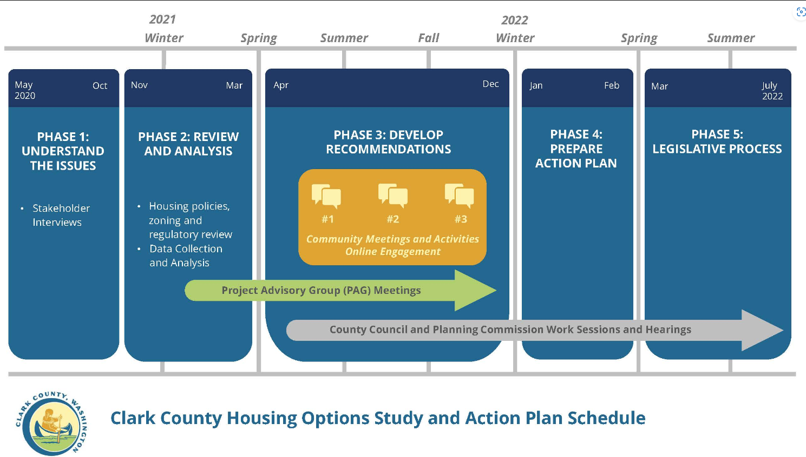
PAG had 18 members representing a broad spectrum of the county, including:
Schedule
City of Vancouver
County council liaison
Communities of color
Community/neighborhood groups
For-profit housing
Unhoused community
Nonprofit housing
Schools
Persons with disabilities
The project advisory group (PAG) started meeting in January 2021.
Notes:
For complete list of members, see: https://clark.wa.gov/community-planning/housing-project-advisory-group-members
Schedule at: https://clark.wa.gov/sites/default/files/media/image/2021-08/ClarkCo%20Graphic%20Project%20Schedule%202021-08-24.jpg

Slide 6
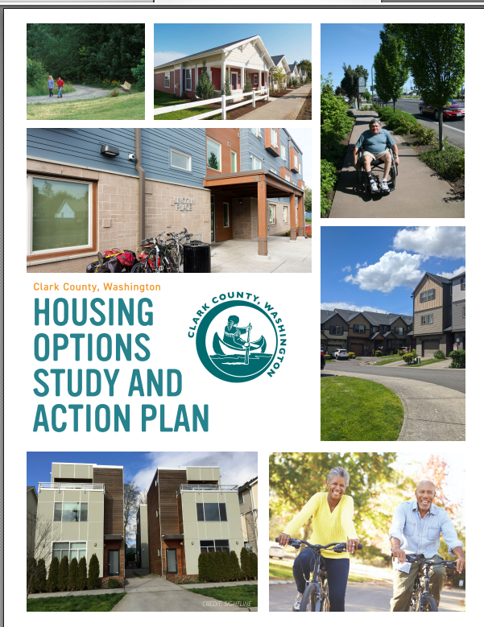
The final plan is 306 pages long (but most of that is appendices).
On May 17, 2022, the Clark County Council voted unanimously to approve the Housing Options Study and Action Plan and directed staff to begin implementation of the plan.
PAG developed objectives for evaluating strategies:
Encourage housing development that meets the needs of middle-income households.
Develop strategies to support the development of housing that is affordable to low, very low, and extremely low-income households.
Encourage diversity in housing types including expanding middle housing options and increasing multifamily feasibility.
Encourage the creation of a broad range of housing sizes to match the needs of all types of households with a focus on 1-2 person households.
Guide development of diverse housing options to areas with access to transportation and services and support the development of these amenities in areas where more housing is added.
Notes:
Find the whole plan here: Housing Options Study and Action Plan | Clark County (wa.gov)
The objectives are in-line with what individuals with IDD need.

Slide 7
May 17, 2022 – the Council approved the Study and Action Plan and directed staff to begin implementing the plan.
Some items in this plan that could benefit the IDD community:
Minimum lot sizes in some zones would be reduced
Middle housing* would be expanded
Less parking and more housing
Encouragement of ADUs
Protection of mobile and manufactured home parks
Adoption of a “visitability” program
Redefining the definition of a “household’ to remove the numbers of unrelated persons that may define a household
Adopt housing affordability metrics as part of the next Comprehensive Plan update per state mandate
Allow more residential uses in commercial zones
Review impact fees and consider reducing for affordable housing
Explore a County Tax increment Financing tool to support affordable housing
Working with aging and disabilities advocates to develop a universal design program
*Middle housing is often “missing” from our neighborhoods. Middle housing includes accessory dwelling units (ADUs), duplexes, triplexes, quadplexes, townhouses, cottage clusters, and courtyard apartments. It provides alternatives to single-family detached dwelling and multi-unit apartment complexes that are in the “middle” in terms of density, scale and size of units.
Notes:
Zoning is a way to discriminate… replaces redlining, by keeping lower income people out of certain neighborhoods.
Visitability allows people with mobility limitations to visit by requiring a no-step, barrier free entrance, bathroom and living area accessible to the main entrance with wheelchair accessible doorways

Slide 8
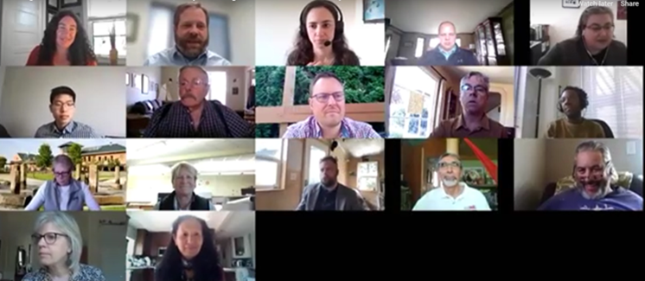
A few other thoughts/ take-aways:
Community support is key and messaging is important. “Expanding housing options” is more appealing than “densification.” Parking is a hot-button issue.
There’s an overlap between the needs of seniors and those with IDD.
Zoning is a way to discriminate – it keeps people with lower incomes out of certain neighborhoods.
Those that show up to zoning meetings are largely those who live in detached single family housing.
I didn’t have a lot of specific input as an advocate for persons with disability (other than suggesting a couple of documents for the project library), but I did learn a lot, and it was helpful for building relationships with those in the housing field. Plus I got to go on a field trip to Wolf Industries and see tiny homes being manufactured! ☺
The PAG in action.
Notes:
The project library can be found at: Project Library | Clark County (wa.gov)

Slide 9
PEACE Housing Committee
In January, 2021 the PEACE Board approved the formation of this committee to raise the concerns of people who experience I/DD in conversations about affordable housing and to advocate for more housing options for those with I/DD.
Initial members:
Darla Helt – PEACE ED
Mona Fuerstenau – Parent and advocate
(and WASILC member)
Andy Silver - Vancouver Housing Authority
Kris Krohn – DSHS/DDA
Trish Buescher – Clark County DD
Mary Strehlow – Advocate
Martha Maier – Parent and advocate (committee facilitator)
Carley Meuchel – self-advocate

Slide 10
Some of what we’ve done:
Shared information about housing openings for those with IDD such as those at Teammates and Covington Commons.
Worked with the VHA so that PEACE is able to recommend up to 25 people for section 8 housing vouchers.
Met with Sheng Fang, Accessible/Affordable Housing Program Manager for DDA
Provided input to the city of Vancouver on the need for “deeply affordable” housing for those who depend on SSI, which will be included in the next tax levy for affordable housing
Other guests/members of the Committee who have joined over time:
Aruna Bhuta: parent, advocate, PEACE Board (from Spokane)
Darci Ladwig: PEACE housing coordinator
Kathleen Gregg: DSHS
Ricki Bournival: DSHS
Samantha Whitley: Housing Program Manager, City of Vancouver
Sheng Fang: Accessible/Affordable Housing Program Manager for DDA
Note: Kris Krohn has retired from DSHS, but asked to stay on this Committee

Slide 11
Other housing work by PEACE:
Created resources available on the PEACE website
Will begin roommate matching soon using partners4housing model and funding they received from the Dan Thompson grant
Building supports and wrap-around services for those seeking housing so they can be successful
Applied for a Dan Thompson grant to fund buying houses, roommate matching, a technology “library” and housing navigation.
Partnering with Ablelight (formerly Bethesda) who wants to offer supported living (and beyond) in Clark County
As of October 11, seven adutls with IDD were in process to get a voucher (or have one) and 20-25 people were in the housing process
Darci Ladwig is the PEACE housing coordinator for HOME. She lives in Spokane and has started a housing committee there similar to the one we have here.
For housing resources, see:
HOME (peacenw.org)

