Slide 1
VAB Agenda – January 12, 2023
(info) I. Call to Order/Pledge/Invocation/Roll Call
(action) II. Approval of December minutes
(info) III. Committee Reports
(action) IV. 2023 Committee Appointments
(info) V. November 2022 Contractor & Fund reports
(info) VI. Veterans Assistance Center update
(info) VII. Old Business
(info) VIII. New Business – 2023 Annual Work Plan
(info) IX. Open Forum

Slide 2
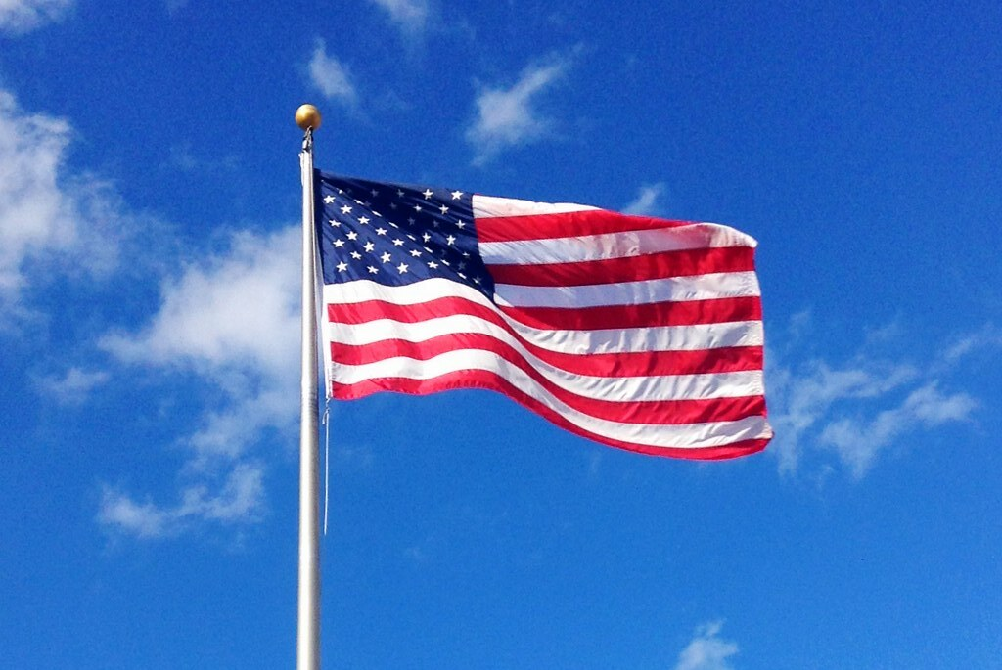
Agenda Item I. Call to Order/Pledge/Invocation/Roll Call

Slide 3
Board approval of Members-at-large
Tonya Wark

Slide 4
Agenda Item II. Approval of December 8 minutes
Approval of October 13, 2022, and November 10, 2022, meeting minutes
The October minutes were approved following a motion by Kelly Jones that was seconded by Tom Phillips.
The November minutes were approved with change to indicate a quorum was present for budget and policy votes, following a motion by Steve Slegers that was seconded by Shannon Roberts.
National Veterans Wheelchair Games July 4-9, DVA and Paralyzed Veterans of America will host 42nd National Veterans Wheelchair Games in Portland. Multiple locations are reserved for the various activities. Volunteers are needed. If interested, send name to nvwgvolunteers@va.gov to be first contacted when volunteer portal opens.
2023 Contract budget approvals CCVAC requests a modification increasing their 2023 recommended budget by $45,000 to $905,933 to cover salary for their outreach position. Motion to approve was made by Kelly Jones and seconded by Tom Phillips. Motion carried. WDVA requests $138,000, which is the same amount as 2022. Budget was approved following motion by Kelly Jones that was seconded by Bruce Maas.
Committee Reports: Appeals: None
Policies and Procedures:
A change to the quorum requirement to have only one of the three elected officers be in attendance was approved on a motion by Greg Whitson that was seconded by Tonya Wark.
Request to change bylaws section 2.3.3 to state that a member having two consecutive unexcused absences from meetings will be cause to be removed from the Board following 30-day notice for organization to submit new letter of intent.
Nominations and Elections of 2023 Officers
Michael Harding is nominated as chair. Shannon Roberts is nominated for vice chair. Bruce Maas is nominated as secretary. Motion was made by Kelly Jones that was seconded by Greg Whitson and approved.
Tamara Elam, Bryan McGillis, and Kelly Jones were approved as members at large on nomination by Tom Phillips that was seconded by Greg Whitson
October 2022, Contractor & Fund Reports
The fund assisted 60 Veteran households. The Veterans Assistance Center received 431 veteran visits. The Free Clinic served 3 veterans in September. The Fund balance at the end of October was $805,583.
Veterans Assistance Center (VAC) Update
Served Thanksgiving meals, including a hot meal and food boxes
Packing Christmas meals now. Juice boxes and fruit cups needed for meals
Toy Store open week before Christmas for parents of children to pick a gift. Volunteers needed
Stand Down served 151 veterans; 60 were homeless. Served 388 meals
Old Business Letters of Intent: All organizations and members at large must file a form by the end of the year
New Business Appeals, Policies and Procedures, and Nominations committees are supposed to have three members each, per bylaws. January meeting will discuss membership. State legislative session begins in January. WDVA website has summary of veteran-related bills
Open Forum
HVRP (Homeless Veteran Reintegration Program) grant now open for organizations to apply
Veterans benefit COLA posting soon
If exposed to burn pits, sign up for PACT
Vancouver VA has open claims date scheduled
Adjourn Meeting adjourned. Next meeting January 12, 2023

Slide 5
Agenda Item III. Committee Reports
Appeals
Policies and Procedures
Consideration of Bylaws amendment: Section 2.3.3 Termination
Nominations

Slide 6
Agenda Item IV. 2023 Committee Appointments
Policies and Procedures
Appeals
Nominations

Slide 7
Agenda Item V. November Contractor & Fund Reports
CCVAC
57 Veterans served in October, services totaling $27,465.12
48 men, 7 women, 2 widows
450 visits to the center for essentials and food; 375 meals served
615 Volunteer hours, totaling $15,184 value
Free Clinic Dental Program
October: 4 Veterans served, $3526 value; $708.63 billed
Veterans Assistance Fund
Revenue: $68,616; Expenses: $115,889; Balance: $758,311.

Slide 8
Agenda Item VI. CCVAC updates

Slide 9
Agenda Item VII. Old Business
Old Business: Letters of Intent

Slide 10
Agenda Item VIII. New Business
2023 Annual Work Plan

Slide 11
Agenda Items VIII. – X.
Open Forum
Adjourn
Next VAB meeting: February 9, 2023

