Slide 1
VAB Agenda – March 9, 2023
(info) I. Call to Order/Pledge/Invocation/Roll Call
(action) II. Approval of February 9, 2023 minutes
(info) III. Committee Reports
(info) IV. January 2023 Contractor Reports & 2022 year-end VAF report
(info) V. Veterans Assistance Center update
(info) VI. Old and New Business
(info) VIII. Open Forum

Slide 2
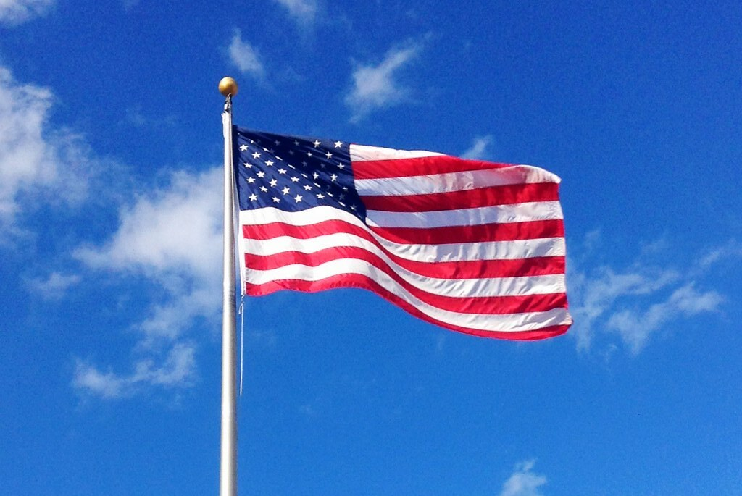
Agenda Item I. Call to Order/Pledge/Invocation/Roll Call

Slide 3
Agenda Item II. Approval of February 9 minutes
Approval of January 12,2023, meeting minutes
The minutes were approved following a motion by Shannon Roberts that was seconded by John Lovejoy.
Committee Reports
Appeals: None
Policies and Procedures:
• Request to change bylaws section 2.3.3 to state: “If a CCVAB member organization has more than two (2) consecutive unexcused absences from CCVAB scheduled business meetings, this may be cause for termination from the committee until a new Letter of Intent (LOI) is submitted appointing active member representatives. The organization shall be notified of termination from the CCVAB until the new LOI is submitted to Clark County.” Change was approved on motion by Mike Gibson and seconded by Kelly Jones.
Survey of Needs
Survey helps Clark County identify needs of families struggling financially in our community to inform future anti-poverty funding decisions. Surveys are available in English, Spanish, Russian, Vietnamese, and Chuukese. The Community Needs Assessment reports on the results. Clark County Veterans Advisory Board Meeting Minutes An advisory board to the Clark County Council February 9, 2023
Page 2 of 2
Member Roles and Responsibilities
As an advisory board to the County Council, members are to provide information to veterans, the Council, and the public. Members are expected to attend meetings and engage in discussions and decisions. Members must not speak for the board or make unilateral decisions for the board.
Update on Women’s Veterans Village
Permits are in process for constructing 32 tiny homes, then groundbreaking will begin.
December 2022, Contractor & Fund Reports
The fund assisted 64 Veteran households. The Veterans Assistance Center received 381 veteran visits. The Free Clinic served 5 veterans. WDVA filed 411 claims with 86 percent approval.
Veterans Assistance Center (VAC) Update
• CCVAC golf tournament June 6 at Tri Mountain golf course
• Stand Down will be September 29 at the Armed Forces Reserve Center
• When funds are withheld from a veteran’s income, this is not considered when determining eligibility, and is not able to be appealed
• Tony Sprague toured CCVAC yesterday and received a lot of information
Old Business
National Wheelchair games July 4-9. Volunteers needed
New Business
• WDVA Town Hall provided opportunity to share SW Washington needs and services
• Clark County may be added on to WDVA’s HPRP grant
• Central Park Place SRO expanding housing for veterans
Open Forum
• New WDVA director, David Holt, appointed
• Gold Star scholarships available to children of deceased veterans
• Honor flights to Washington DC available through PugetSoundHonorFlight.com
• Ret. Lt. Col. Robert Knight is honor guard this year
• VA ID Cards are by appointment only

Slide 4
Agenda Item VI. Committee Reports
Appeals – Ron Fryer
Policies and Procedures – Kelly Jones

Slide 5
Agenda Item VII. January Contractor & Fund Reports
CCVAC
43 Veterans served in January, services totaling $48,840
36 men, 5 women Veterans, 2 widows
355 visits to the center for essentials and food; 372 meals served
557.5 Volunteer hours, totaling $13,765 value
Fund
December: revenue: $2,548.65; expenditures: $173,288.77
2022 Year End: 2022 revenue: $848,314; expenditures $995,920; fund balance: $587,570

Slide 6
Agenda Item VIII. CCVAC updates

Slide 7
Agenda Items IX – X.
Old Business
New Business
Clark College – Eli Gonzalez
Open Forum
Camp Bonneville
Adjourn
Next meeting: April 13, 2023

