Slide 1
WELCOME! Community Action Advisory Board Meeting
This meeting is being recorded.
Please identify yourself when talking so we can capture accurate minutes.
“Chat” function is not available due to public disclosure rules.
Closed Captioning now available
Turn on Webex Assistant and follow the prompts to turn on closed captioning
Lock participant videos in Webex
Lock up to 6 participants to see them regardless of who is speaking
Each person can customize their own set of pinned participants
Hover over the thumbnail location you want to lock a participant to
Click on More and select Lock a participant to this location
Select the participant from the list you want to lock in that position

Slide 2
Agenda Items
Approval of July 2023 Minutes (action)
Melanie Green, Chair
Legislative Advocacy Committee Update (information)
Amy Roark
CNA Task Force Committee Update (information)
Rebecca Royce

Slide 3
Agenda Item
Eviction Prevention Rental Assistance Program (EPRAP) Update (information)
Kayla Williams
Received 12 applications
2 applications were removed from consideration
3 applications from By and For Organizations
Targeted Prevention |  |  | Anticipated: $3,781,094
Applicant | By & For | Score | Requested | Recommended
Native American Youth and Family Center | Y | 82.8 | $559,623 | $559,623
Pacific Islander Community Assoc of WA | Y | 81.6 | $485,000 | $485,000
Janus Youth | N | 81.2 | $561,467 | $561,467
Cascade AIDS Project | Y | 80.2 | $114,533 | $114,533
Impact Northwest | N | 78.6 | $768,778 | $768,778
Share | N | 75.0 | $977,500 | $977,500
YWCA | N | 74.0 | $390,000 | $314,193
Lifeline Connections | N | 68.6 | $509,226 | $0
Council for the Homeless | N | 63.6 | $1,500,000 | $0
Mullen-Polk Foundation | N | 20.8 | $1,854,802 | $0

Slide 4
Agenda Item
Emergency Housing Fund (EHF) Program Overview (action)
Kayla Williams
Funds provided to current Consolidated Housing Grant (CHG) grantees via Washington State Legislation
Legislation intent is to help local jurisdictions “maintain current levels of homeless subsidies and emergency housing services.”
Allowable activities are restricted to "emergency housing" activities, to include: street outreach, diversion, emergency shelter including hotel/motel leasing, sanctioned encampments, transitional housing, rapid re-housing, housing search and placement, and housing stability case management.
Allowable activities must have been provided as of February 2023, were previously funded through Clark County and have lost funding due to grants expiring.

Slide 5
Agenda Item: EHF continued
Funds are from a federal source to Commerce and therefore subject to competitive procurement requirements in 2 CFR 200.318.
Request: 5 CAAB members for a review committee with approval to recommend applications to County Council in preparation of not receiving the exemption.
RFA will be easier than the EPRAP RFA
RFA timeline:
Open to providers on 9/18 and closes 9/29
Staff will complete review by 10/6 and release to CAAB subcommittee
Subcommittee scoring due by 10/20
Contracts to start November 1, 2023

Slide 6
Agenda Items
July 2022 – June 2023 Outcomes Report
Rebecca Royce

Slide 7
2024-2028 Consolidated Plan
Ann Hawkins, Assistant Planner
Economic Prosperity and Housing

Slide 8
Community Participation & Consultation
Needs Assessment
Five-Year Strategic Plan
One-Year Action Plan
Annual CAPER
Consolidated Plan
Process
internal and external stakeholders, other plans and reports
research and collect data, conduct and review surveys
sets five-year goals and priorities for HUD programs
describes goals and activities for program year
report of program-year accomplishments and spending

Slide 9
Entitlement Funding History

Slide 10
Plan Development Process
Redesign of Community Participation Plan
Examination of Data
Alignment with City Comprehensive and Strategic Plans
Alignment with HUD goals

Slide 11
Community Participation Plan Participation Plan
Encourages community to participate in program:
planning
implementation
assessment
Outlines procedures for comments, objections, complaints

Slide 12
HUD Strategic Goals
Support Underserved Communities
Ensure Access to, and Increase Production of, Affordable Housing
Promote Homeownership
Advance Sustainable Communities

Slide 13
Priority Needs
Affordable Housing
Household stability, poverty reduction
Neighborhood Improvements
Economic Opportunity

Slide 14
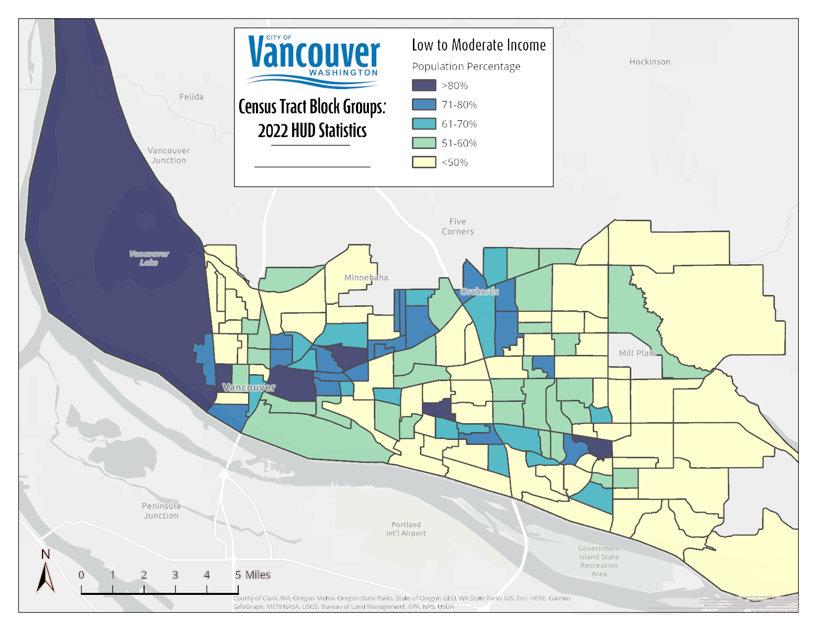
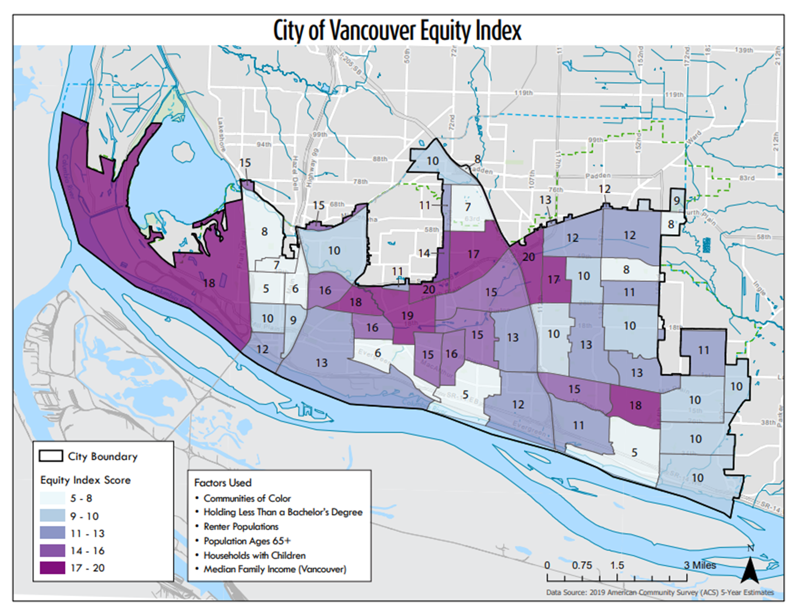
Neighborhood Improvements Need

Slide 15
Project Schedule Timeline
September 2023
Complete Community Engagement
October 2023
Funding Notice / Applicant Workshop
December 2023
Applications Due
February 2024
Application Review
March 2024
Scoring Committee Review
April 2024
Council Review of Recommendations
May 2024
Public Hearing for Consolidated Plan and Action Plan 2024-2028 Consolidated Plan and 2024 Action Plan submitted to HUD
July 2024
Activities supporting established goals launched

Slide 16
Needs, Barriers, and Challenges
What are the most needed services for those experiencing homelessness?
What are the most needed services for those you serve?
What barriers do you experience in the access of these services?
What barriers do you experience in the delivery of these services?
What are some of the challenges you face with the use of federal grants?

Slide 17
Thank You

Slide 18
Agenda Items
City of Vancouver Affordable Housing Fund and Homeless Services Updates (information)
Samantha Whitley, City of Vancouver
Jamie Spinelli, Board Member and City of Vancouver staff
Board Member Update (action)
Terms ending
Request: 3-person subcommittee for application review, interviews (if needed) and member selection.
District 2 Elected Official (filled) | District 1 Low-income Representative (filled)
District 3 Elected Official (filled) | District 3 Low-income Representative (recently vacated)
District 5 Community Representative (filled) | District 5 Low-income Representative (vacant)

Slide 19
Agenda Items
Open Public Forum (up to 3 minutes)
Other Business
WSCAP Legislative Advocacy Training, September 19, 3-5pm, Zoom
Save the date: Next CAAB Meeting
November 1, 2023 starting at 9am
All CAAB meetings are held in-person and virtually

