Slide 1
UCPB Agenda September 11, 2023
(info) I. Introductions
(action) II. Approval of April 10, 2023 minutes
(info) III. CAPER Preview
(info) IV. RFA Discussion
(info) V. April – June 2023 reports
(info) VI. Program updates
(info) VII. Other
            Public comment

Slide 2
Agenda Item II April 10 Meeting Minutes
URBAN COUNTY POLICY BOARD MEMBERS PRESENT: Councilor Glen Yung Clark County, Deputy Mayor Cherish DesRochers City of Battle Ground, Steve Wall City of Camas, Chuck Green City of Ridgefield, David Scott City of Washougal, Tracy Coleman City of Woodland, Marina Viray Town of Yacolt
GUESTS: Janet Kenefsky, John McDonagh (Greater Vancouver Chamber); Katie Ullrich (Proud Ground); Carmen Castro (Hispanic Metro Chamber)
STAFF: Michael Torres, Emily Langston, Janet Snook
I. Introductions
II. March 13, 2023, Meeting Minutes
Minutes were approved following a motion by Dave Scott that was seconded by Chuck Green.
III. CDBG and HOME Program Performance Evaluation overview
The July 1, 2021, to June 30, 2022, CAPER was accepted as satisfactory. CDBG entitlement will exceed credit limit by May 1, 2023, and County will need to report increase drawdowns to HUD. All funds have been allocated, but spending has been delayed. Expect to be on schedule this summer. The Fair Housing and Employment Opportunity report determined Clark County is low risk for noncompliance.
2023 Action Plan to be released for public comment at end of week and to go to County Council in May. Jurisdiction recertification for 2024-2026 to be done soon.
IV. Proud Ground presentation
Proud Ground provides equity-focused homeownership assistance using the land trust model. They partner with community organizations and conduct marketing campaigns, including holding five dedicated information sessions in Clark County. Since 2014, 22 homes have been acquired. Homeowners were 88 percent prior Clark County residents; 86% are families with children. Fourteen Clark County residents are mortgage ready. Homebuyers need to be able to afford $2,200/month to afford a home on the open market based on current interest rates. Homebuyers need to work through approved lenders for coordinating Proud Ground downpayment assistance.
V. Program updates
Covered under Performance Evaluation overview.
VI. Other • Public Comment: none
• Next meeting, May 8, 9:30-11am, if needed
Meeting adjourned.

Slide 3
III. 2022 CAPER Preview
Consolidated Annual Performance Evaluation Report (CAPER)
Overview of spending in CDBG, CDBG-CV, HOME, HOMEARP
  Brief Battle Ground HealthCare performance overview and public hearing for Commerce grant closeout
2022 Program Year ran July 1, 2022 to June 30, 2023
2022 CAPER will be presented to County Council September 26, 10am
  Presentation and public hearing
Draft CAPER to be released September 14 for public comment
  Comment period will run September 14-28

Slide 4
IV. RFA Discussion
Overview of RFA and application process
Previous discussion topics
  Equity
  Past performance

Slide 5
IV. RFA Discussion
Consolidated Plan
Current five-year Consolidated Plan runs 2020-2024
Annual RFA designed to solicit projects and programs that will work towards these goals
Final funding round for this ConPlan – priorities and goals may change with the 2025-2029 ConPlan and RFA may be significantly revised to solicit applications in line with the new goals

Slide 6
IV. RFA Discussion
Goals and Application Guidance
2020-2024 ConPlan Goals
  Public Facilities and Neighborhood Improvements
  Affordable Housing and Homelessness
  Asset and Economic Development
Separate applications (and application guidance) released for each goal area

Slide 7
IV. RFA Discussion
RFA timeline
RFA released and Neighborly application portal opens – October 2
Pre-application meetings – second week of October (specific dates and times to be announced)
Pre-application due – October 31 (may submit earlier; staff will do rolling review as received)
Application due – December 1

Slide 8
IV. RFA Discussion
Previous discussion about RFA and scoring improvements
Additional consideration/weight in equity
Weight in addressing specific community needs
Past performance
Make sure language in application questions clearly and completely matches how the questions will be scored (Board members noticed some questions were difficult to score because the answers didn’t quite align with the rubric)

Slide 9
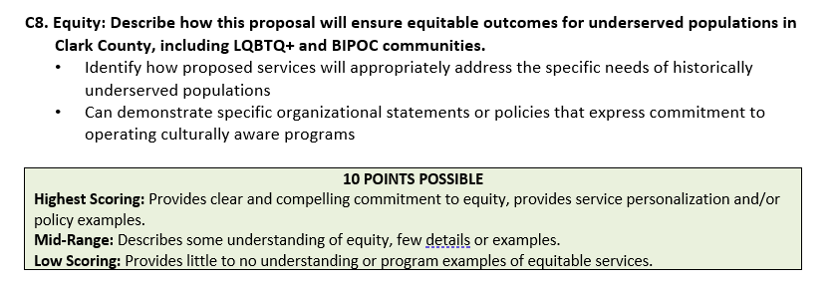
IV. RFA Discussion
Equity
All applications
Options: ask for more concrete details on the agencies’ equity efforts and a plan for incorporating equity into this project. Increase points possible?

Slide 10
IV. RFA Discussion
Equity
(From Washington County)
Advancing Racial Equity – People of color struggle disproportionately with unaffordable housing, displacement, and homelessness. Washington County is committed to addressing this inequity by prioritizing opportunities to serve historically underserved communities, removing barriers to fairness in representation, opportunity, and access and providing equal opportunity for very low-income families of all ethnic backgrounds to experience freedom of housing choice.
Tell us about historically underserved communities in your project area including demographics and other factual data in your response. How have you connected to this community(ies) in planning for this project? How do you plan to ensure that these communities are aware of this housing opportunity? What barriers do you anticipate these communities encountering in accessing housing? What is your plan for mitigating identified barriers to access? How will you serve this community(ies) through building operations?
Please attach any actionable MOUs with service organizations.

Slide 11
IV. RFA Discussion
Equity
For construction projects
(From Washington County)
Equity Plan - Washington County is dedicated to advancing equity by among other things increasing housing and economic opportunities for low-income residents and creating business opportunities for State of Oregon certified Minority, Women, Disabled Business Enterprises, and Emerging Small Business enterprises (M/W/DBE/ESB). Please discuss the roles and responsibilities of the development team and its members as those relate to the specific housing needs in the community, including who has access to the housing opportunities to be created by this project. Please advise how the development team will create community economic opportunities. Include in the response information related to M/W/DBE/ESB Contracting, Workforce Training and Hiring, Section 3 requirements, Professional Services and Commercial Space. Applicant should provide a detailed plan to achieve aspirational goals of 20% COBID certified subcontractor participation and 20% COBID certified professional services participation. Project sponsors will be required to provide documentation of subcontracting efforts and results. Washington County strongly encourages architects, contractors, sub-contractors, and other bond project team members to involve Washington County-based workforce and businesses. If the plan includes a significant partnership with a trade association/consultant, such plan should include in detail the expected division of work.

Slide 12
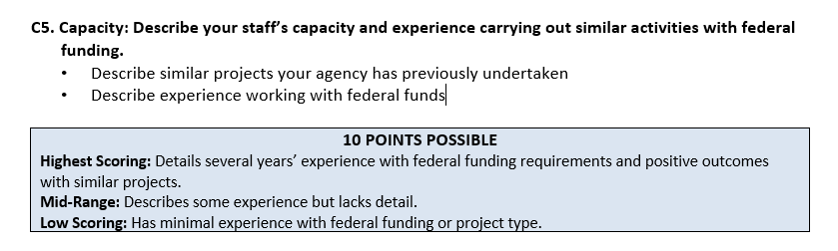
IV. RFA Discussion
Past performance
Public Facilities and Neighborhood Improvements
Suggestion: in addition to experience, request information about how the organization performed on these previous projects (i.e. outcomes vs. stated goals, adherence to timeline, etc.)

Slide 13
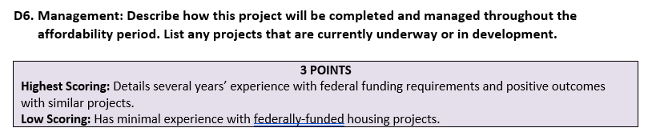
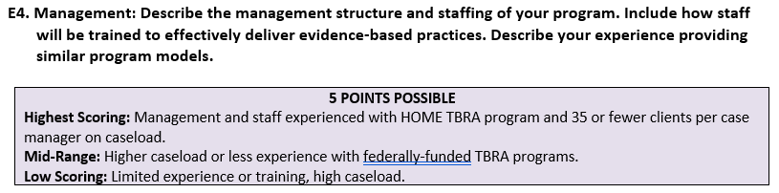
IV. RFA Discussion
Past performance
Affordable Housing and Homelessness
Construction projects:
TBRA programs:

Slide 14
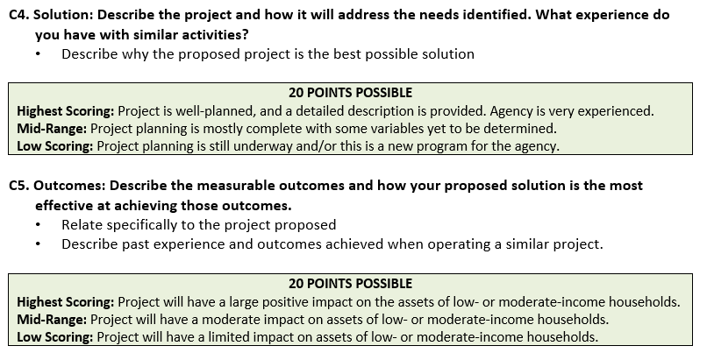
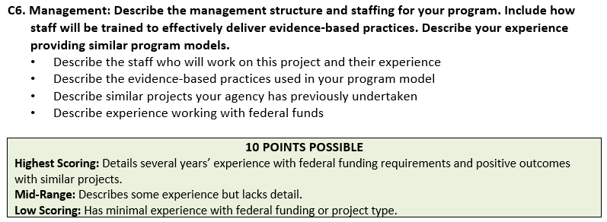
IV. RFA Discussion
Past performance
Asset and Economic Development

Slide 15
Agenda Item VI. Apr – Jun 2023 Quarterly Reports

Slide 16
Agenda Item VI. Apr – Jun 2023 Quarterly Reports

Slide 17
Agenda Item VI. Apr – Jun 2023 Quarterly Reports

Slide 18
VI. Program updates
Urban County Requalification
  Amendments have been sent out to the cities for signature
  Please contact Emily ASAP with any questions
  County will submit to HUD September 26

Slide 19
Wrap Up
VII. Other
  Public Comment
Next meeting: October 9, 9:30am, if needed

