Slide 1
VAB Agenda – January 11, 2024
Call to Order, Pledge, Invocation, Roll Call
Approval of December 14, 2023 minutes (action)
Committee Reports (info and action)
WDVA Update (info)
Burial Benefits and Costs (info)
November 2023 Contractor and Fund Reports (info)
Veterans Assistance Center updates (info)
Old Business (info)
New Business (info)
Open Forum (info)
Adjourn

Slide 2
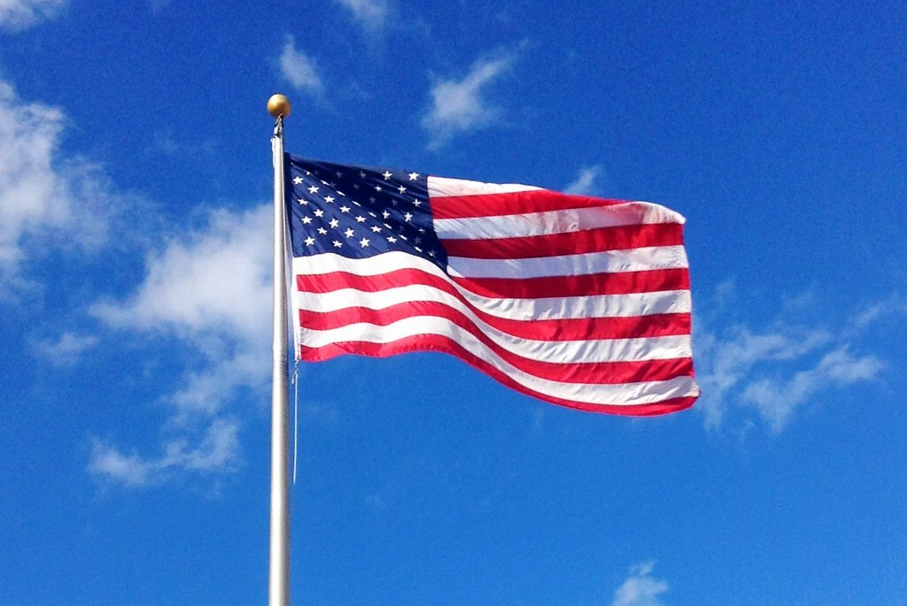
Agenda Item I. Call to Order/Pledge/Invocation/Roll Call

Slide 3
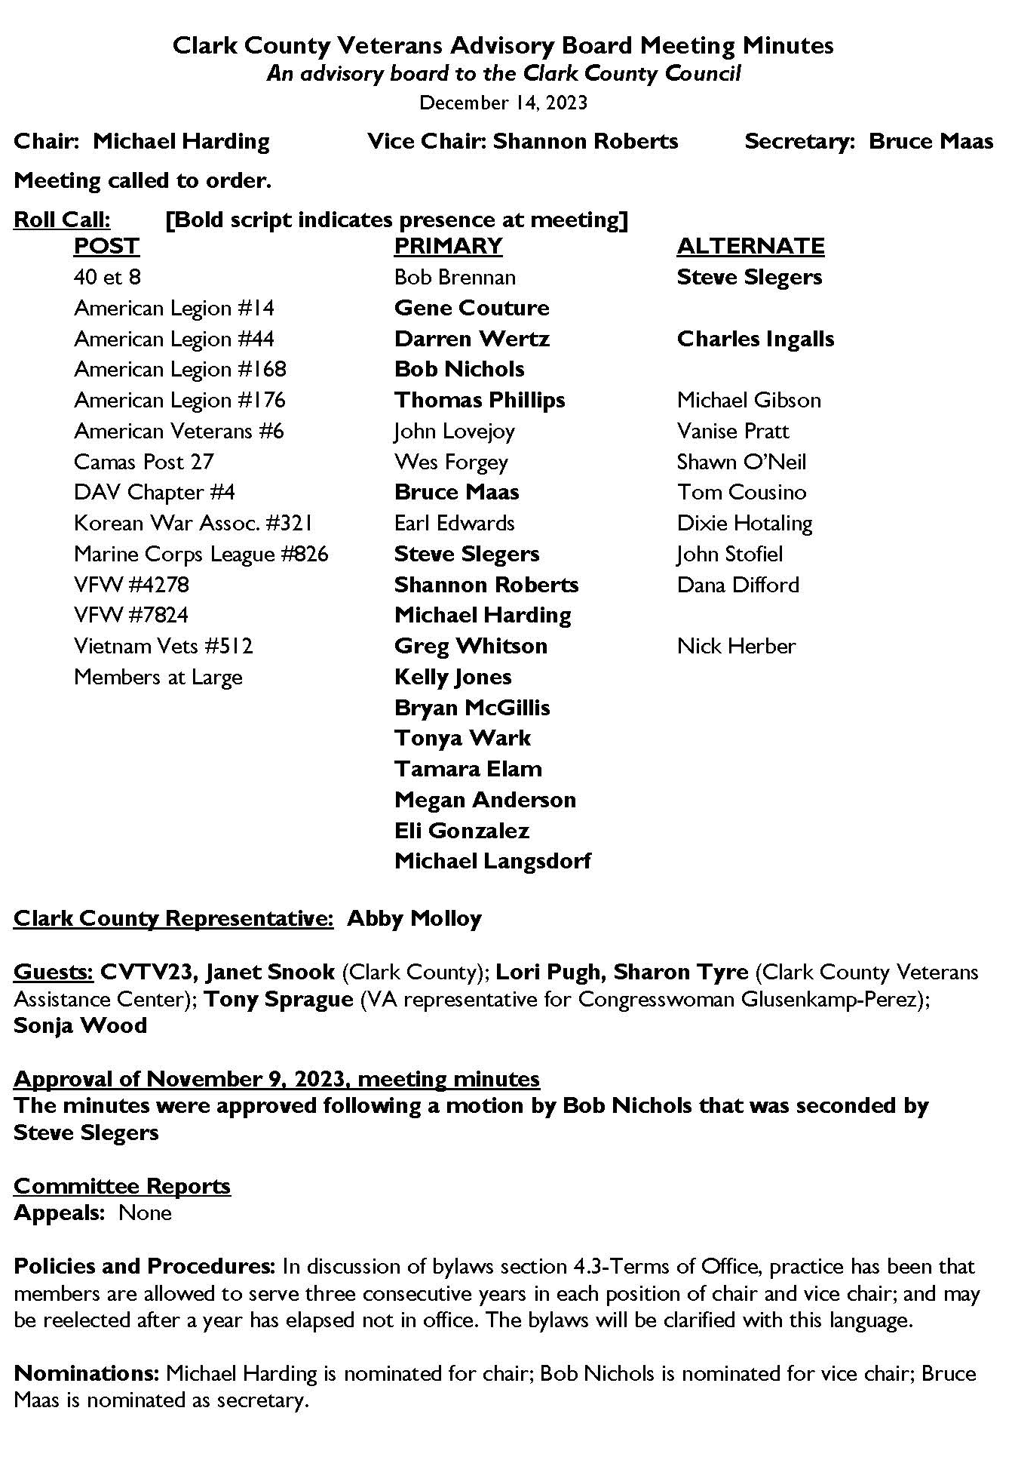
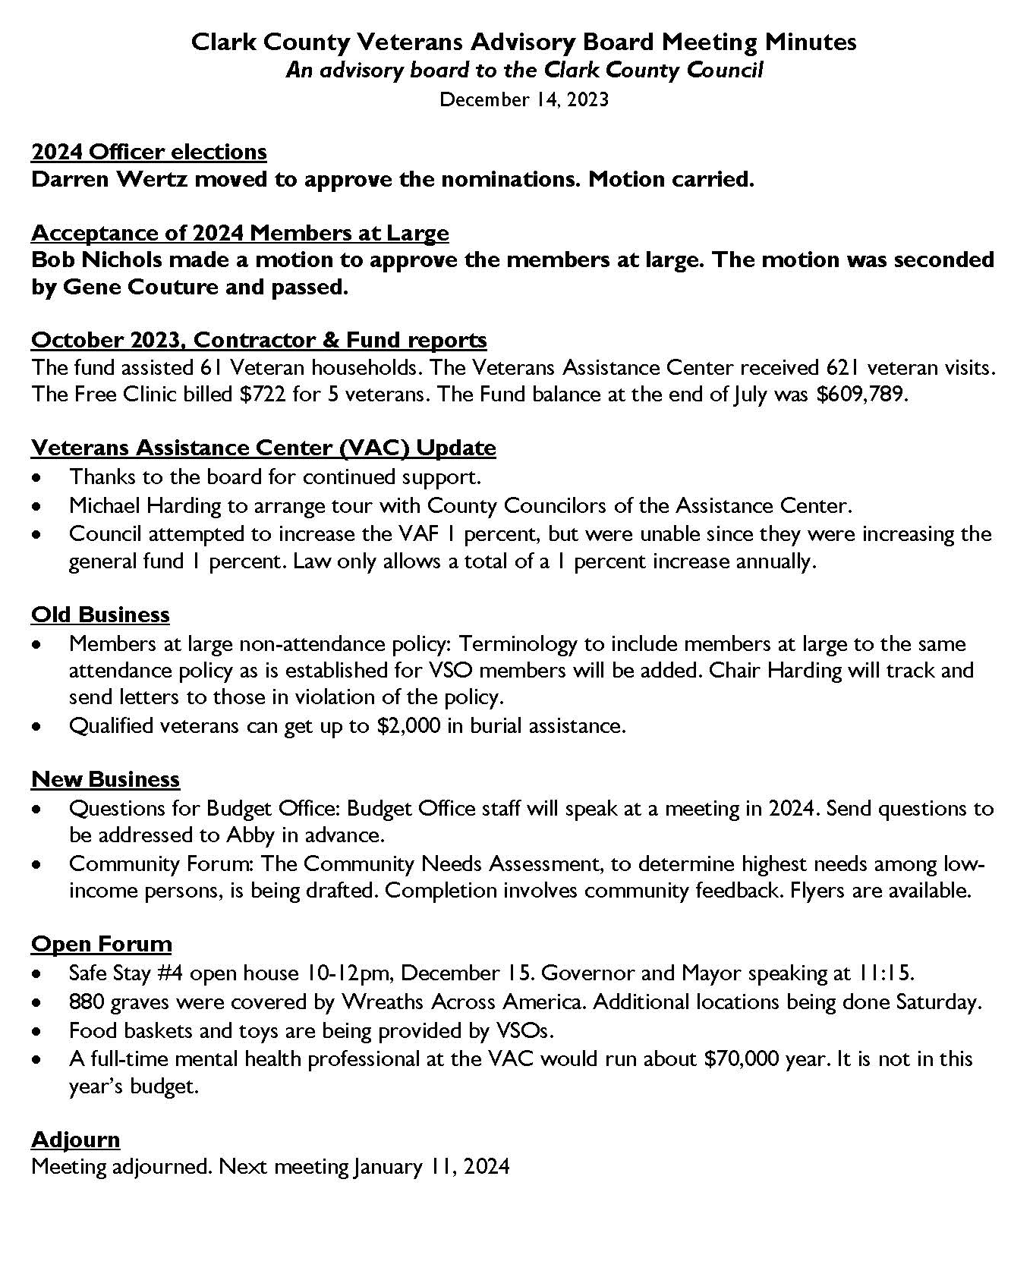
Agenda Item II. Approval of December 14th minutes

Slide 4
Agenda Item III. Committee Reports
Appeals – Gene Couture
Policies and Procedures – Kelly Jones
Vote on proposed bylaws amendments: Section 4.3 and Section 2.3
Nominations – Bruce Maas

Slide 5
Proposed bylaws amendments
Section 2.3 – Termination
Add fourth clause: “If a CCVAB Member-at-Large has more than two (2) consecutive unexcused absences from CCVAB scheduled business meetings, this may be cause for termination from the committee. The member shall be notified of their termination from the VAB.”
Section 4.3 – Terms of Office
Current language: “The elected officers of the CCVAB shall assume duties and responsibilities on 1 January of each year. No member may hold the office of Chair or Vice Chair for more than three (3) consecutive years.”
Proposed revision: “The elected officers of the CCVAB shall assume duties and responsibilities on 1 January of each year. Members are allowed to serve up to three consecutive years in each position of Chair and Vice Chair. Members are eligible for reelection to either position after one year has elapsed.”

Slide 6
Agenda Item IV. WDVA Update David Puente, WDVA Director

Slide 7
Washington State Department of Veterans Affairs
Programs and Services
David Puente, Director
DavidP@dva.wa.gov
Solomon Gilbert, Deputy Director
Solomon.Gilbert@dva.wa.gov

Slide 8
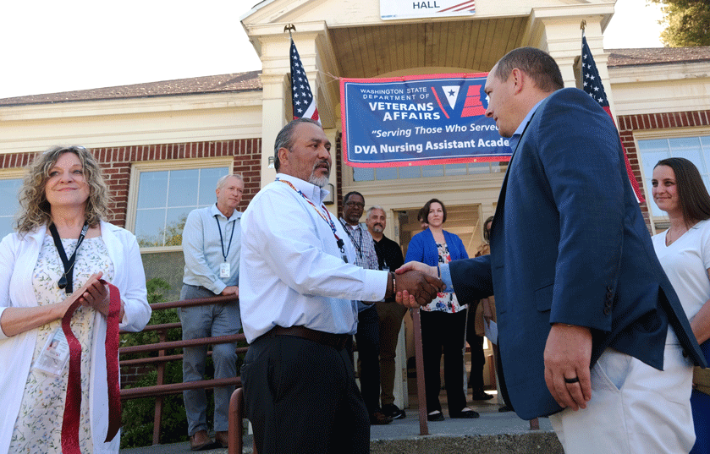
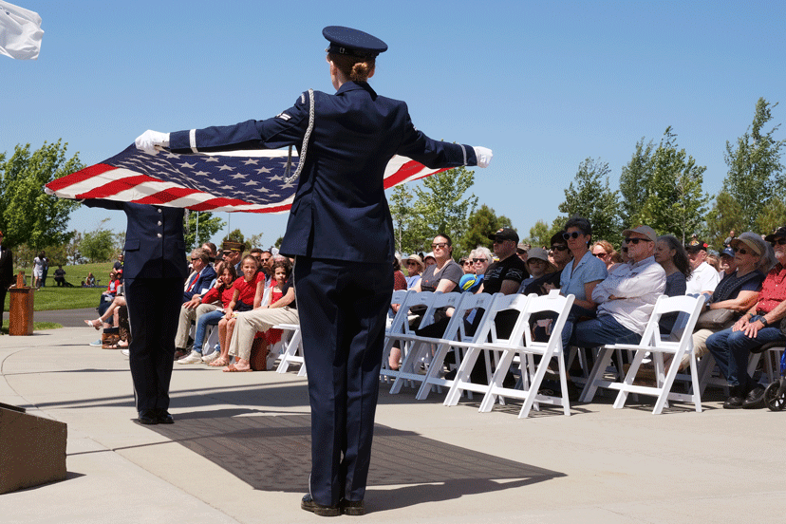
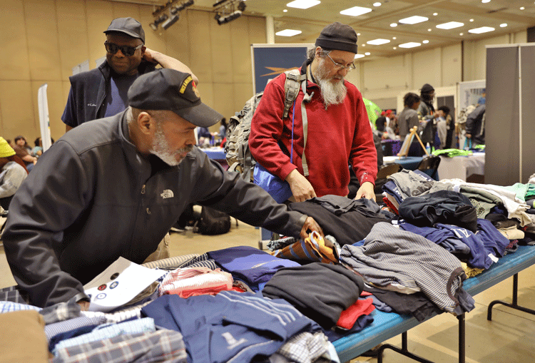
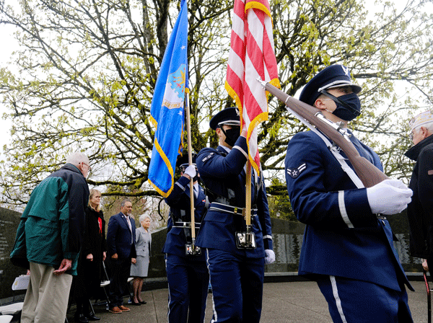
Major Programs
State Veterans Homes
Transitional Housing Program
State Veterans Cemetery
Veterans Services
Counseling and Wellness
Notes:
Please modify the agenda based on your location. Time spent on each program can be adjusted based on the audience.

Slide 9
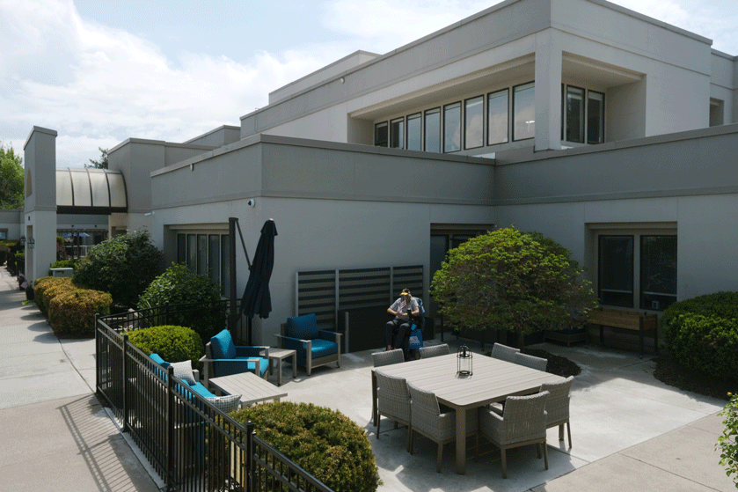
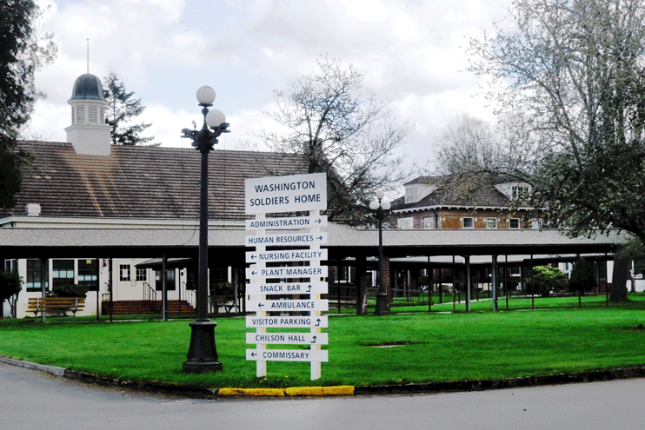
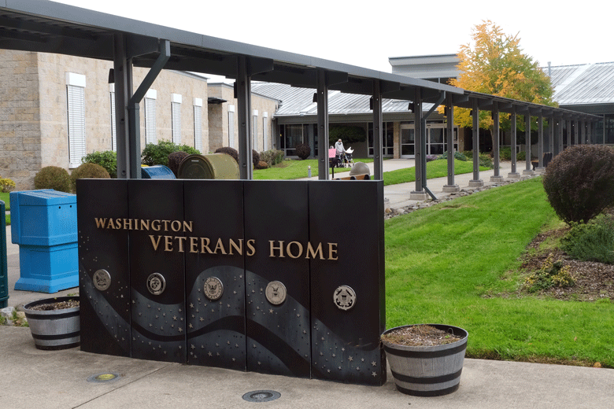
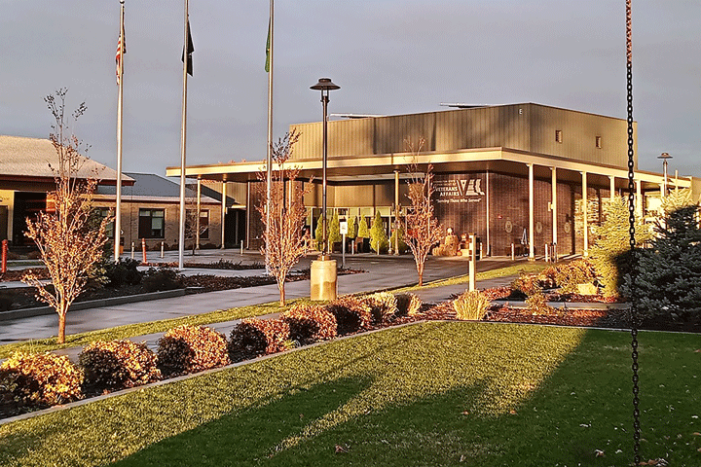
State Veterans Homes
Spokane Veterans Home
Spokane
Serving 100 Residents
WA Soldiers Home
Orting
Serving 97 Residents
WA Veterans Home
Port Orchard
Serving 240 Residents
Memory Care Provided
Walla Walla Veterans Home
Walla Walla
Serving 80 Residents
Memory Care Provided
Our State Veterans Homes are Medicaid and Medicare Certified and provide 24-hour nursing care, medical care and pharmacy services. Veterans rated 70%-100% Service Connected, or whose service connected disability is the reason nursing care is needed, may have their nursing home care paid by the Federal VA.
As part of residing in our homes, our residents benefit from:
Physical Therapy
Occupational Therapy
Recreational Activities
Social Services
Volunteer Programs
Hospice
Nutritious Meals
Community Involvement
Religious Programs
Transportation
Laundry
Beauty & Barber Shops
Fishing Pond (Orting)
To be eligible for admission, applicants must meet the following criteria:
Served at any time, in any branch of the United States Armed Forces including the National Guard;
Received an honorable discharge;
Reside in Washington State;
Be the spouse of a resident or widow of an eligible veteran;
Or be a Gold Star Parent who lost a child while serving in the armed forces.
Notes:
Four State Veterans Homes provide Nursing Home Level care to veterans, spouses of residents, or widows of an eligible veteran. Gold Star parents are also eligible.
Veterans Homes are located in Orting, Port Orchard, Spokane and Walla Walla. Our Homes in Port Orchard and Walla Walla also offer secure Memory Care units.
Veterans Homes accept payment from a variety of sources including Medicare, Medicaid, Private Insurance, and of course Private Pay. (If asked, the daily rate for care is $292 for a double room, $312 for a private room as of 9/1/2023, Rates are slightly higher in Orting due to the Medicaid rate $328 & 338. Rates are adjusted July 1 of each year.)
For Veterans rated 70% to 100% service connected disabled, or whose service connected disability is the reason they need nursing home care, their cost of care may be covered by the Federal VA. This means the veteran is able to keep all their other income including VA disability, retirement or social security.
We have staff members at each State Veterans Home who can answer questions about the admissions process and can also help veterans file for increases to their disability claims once they become residents.
Our Veterans Homes are committed to providing quality nursing home care and treating veterans and their family members with the dignity and respect they deserve.

Slide 10
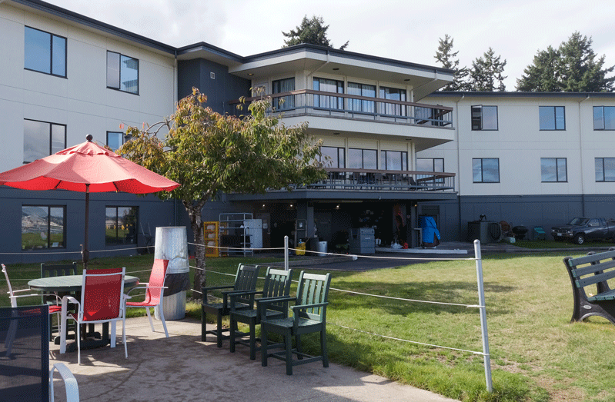
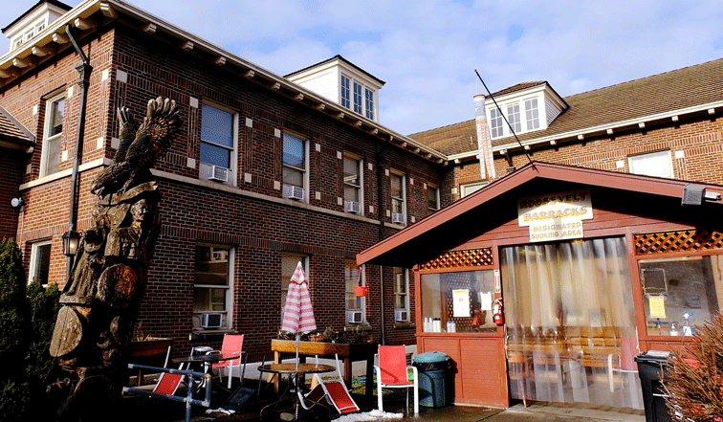
Transitional Housing Program (THP)
Transitional housing facilities in Port Orchard and Orting help veterans in need with stable housing, vocational rehabilitation, and employment.
Veterans are surrounded with supportive staff and wrap-around services that lead to successful program completion and their return to the community.
Building 10 in Port Orchard - 48 Beds
Roosevelt Barracks / Betsy Ross in Orting
52 Beds in Roosevelt Barracks
10 Beds in Betsy Ross which are dedicated for women veterans
20 Beds Contract Residential Shelter
Program Goals include:
Increased residential stability
Greater self-determination
Increased skill level and income potential
Contact THP, Monday - Friday 8:30-4:30, at 360-895-4371
Or THP staff at: Building 10: Port Orchard, WA
Phone: 360-895-4371
Fax: 360-895-4451
Roosevelt Barracks: Orting, WA
Phone: 253-263-0735
Fax: 360-893-5623
Email: thp@dva.wa.gov
Notes:
Transitional housing facilities in Port Orchard and Orting help those in need with stable housing, vocational rehabilitation, and employment.
Veterans are surrounded with staff and wrap-around services that lead to successful program completion and their return to the community.
Port Orchard: 48 Per Diem beds, all Per Diem Beds
Orting: 62 Per Diem beds (including 10 in Betsy Ross) & 20 Contract Residential Services beds
To be eligible, veterans must: Have served in any branch of the US Armed Forces and received an honorable or general under honorable conditions discharge.
Be homeless for one or more nights, Have a desire to lead a clean and sober lifestyle, Have a desire to make meaningful life changes leading to independent living, and Be willing to undergo criminal background check.
The WDVA Transitional Housing Program has a proven track record of helping veterans rediscover their self-worth, often helping them reconnect with family and friends, and helping them move on with productive and happy lives.
At our Orting Location, we also have a partnership with Quixote Communities who operates the Orting Veterans Village on our campus. The Orting Veterans Village is a permanent supportive tiny house village for 35 homeless veterans.

Slide 11
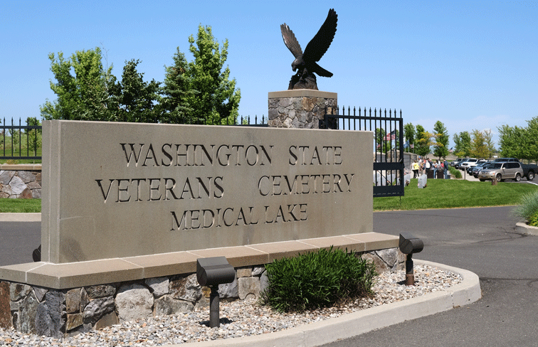
State Veterans Cemetery
Located in Medical Lake, WA the cemetery has a committal service shelter, and provides for casketed burial, columbarium niches, and burial plots to support cremations, as well as a scatter garden.
21702 West Espanola Rd
Medical Lake, WA
Eligibility mirrors that of the U.S. Department of Veterans Affairs Cemeteries.
Armed Forces License Plates help support the State Veterans Cemetery
$28 from the sale or renewal of each Armed Forces License Plate are directed to operating and maintaining the state veteran’s cemetery, and to providing programs, and services for veterans without homes, and other activities that benefit veterans
Notes:
Located in Medical Lake, WA the cemetery has a committal service shelter, and provides for casketed burial, columbarium niches, and burial plots to support cremations, as well as a scatter garden.
Burial in the Washington State Veterans Cemetery – Medical Lake is open to all members of the armed forces who have met a minimum active duty service requirement and were discharged under conditions other than dishonorable. A Veteran's spouse, widow or widower, minor dependent children, and under certain conditions, unmarried adult children with disabilities may also be eligible for burial. Eligible spouses and children may be buried even if they predecease the Veteran. Members of the reserve components of the armed forces who die while on active duty or who die while on training duty, or were eligible for retired pay, may also be eligible for burial.
You can help support the State Veterans Cemetery by purchasing an Armed Forces License plate for your vehicle. $28 from the sale or renewal of each Armed Forces License Plate is directed to operating and maintaining the state veteran’s cemetery, and to providing programs, and services for veterans without homes, and other activities that benefit veterans

Slide 12
Veterans Services
Claims Assistance through Veteran Service Officers
WDVA contracts with 6 Veteran Service Organizations
African American PTSD Association
American Legion
AMVETS
National Association of Black Veterans Inc
Veterans of Foreign Wars
Vietnam Veterans America.
23 County Veteran Service Officer (VSO) agreements with 30 (out of 39) counties being served
WDVA has MOAs with the 7 out of the 29 federally recognized Indian tribes to provide VSO training and accreditation to their Tribal VSOs
Homeless Veteran Reintegration Program
The HVRP offers a structured, individually designed case management plan to assist veterans become employable and economically secure.
Notes:
We have several ways in which we assist our veterans with claims, we have 23 counties with CVSOs accredited through WDVA, 7 additional counties share VSO services from other counties and we contract with 6 nonprofit veteran service organizations, we have 7 Indian tribes with TVSO’s accredited through WDVA. There are 6 additional counties that contract directly with WDVA for VSO services and there are additional counties considering entering into CVSO partnerships with WDVA.
Our Homeless Veteran Reintegration Program assists veterans without homes, who are employable and actively seeking employment. This is a partnership with our WorkSource Offices and their Veterans Representatives. Funding from this program can purchase items necessary for work such as tools, boots, clothing, and bus passes. Our case managers also partner with community housing providers to help veterans secure housing as they become employment ready.

Slide 13
Veterans Services Continued
Veterans Innovations Program (VIP)
Assists Post 9/11 veterans facing financial hardships.
Transitioning Warrior Program (JBLM)
Provides information about all available benefits to separating personnel from Joint Base Lewis McChord
Statewide Apprenticeship Coordinator
Assists veterans in connecting with apprenticeships. Veterans gain marketable skills, make a livable wage, and can use Veterans Education Benefits as part of their apprenticeship.
Veterans Estate Management Program (VEMP)
VEMP offers protective payee services for veterans and family members who are incapable of managing their own financial affairs.
WA State Military Transition and Readiness Council
A partnership that supports military service members and families to successfully transition into civilian careers.
Notes:
VEMP - Protective payee services for veterans and family members. The Washington State Department of Veterans Affairs Veterans Estate Management Program (VEMP) offers protective payee services for veterans and family members who are incapable of managing their own financial affairs. By assuming custody of the individual’s finances, the department ensures basic needs – such as housing, food, clothing and medical care – are provided.
Transitioning Warrior Program
In addition to all of the programs described, there are additional programs and partnerships at WDVA including partnerships that help connect veterans who are referred to us from other agencies, like DSHS, to their earned benefits.

Slide 14
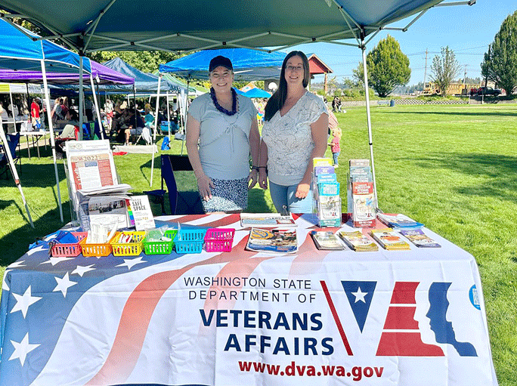
Veterans Services Continued
Veteran Owned Business Certification Program
Certifies Veteran and Service Member Owned Businesses so that public entities can identify them and do business with them.
LGBTQ+ Veterans Outreach Coordinator
Connects LGBTQ+ veterans to benefits and assists with the
upgrade of discharge status.
Military Spouse Outreach Initiative
Shares resources with military spouses, convenes workgroups
on important issues such as employment and childcare, and
advocates for military spouses.
Other WDVA Programs, Call Centers, and Service Hubs
Olympia Service Center: 1-800-562-2308
King County Office
BLDG 10 at Port Orchard
Spokane Regional Veterans Service Center
VA Regional Office in Seattle
Notes:
Our new LGBTQ+ Veterans Outreach Coordinator helps connect lesbian, gay, bisexual, transgender, and queer+ veterans to their earned benefits, services, programs, resources, and information. The program also assists with the upgrade of discharge status, including for veterans who were given an other-than-honorable discharge under the Don't Ask, Don't Tell policy.
And finally, we have Call Centers and Service Hubs throughout the state. You can always reach WDVA through our toll-free number at 1-800-562-2308.

Slide 15
Counseling and Wellness
WDVA Counseling Program
Contracted Licensed Mental Health Providers serve veterans and families experiencing Post-Traumatic Stress, Military Sexual Trauma, or other military related issues.
Veterans Training Support Center
No-cost training provided each month on a variety of topics, thanks to a grant from King County Veterans Services. Sign up at www.dva.wa.gov
Traumatic Brain Injury Program
Supports and represents every veteran in WA that has incurred a Brain Injury.
Notes:
WDVA’s Contracted Licensed Mental Health Providers serve veterans and families by providing no cost counseling services in Washington State communities. Currently we have 41 contracted community providers. Veterans and families can self-refer to these counselors and can find a list on the WDVA website.
The Veterans Training Support Center (VTSC) offers no-cost training thanks to a grant from King County Veterans Services. While the training is targeted toward King County, they are available virtually to veterans, families, and those serving veterans and families in Washington State.
Our Brain Injury & Recovery Program provides one on one support, resources and referrals. In addition, the program supports the groups and agencies that are out there doing great things for our vets including providing training and advice to any agency, group, summit, or conference.

Slide 16
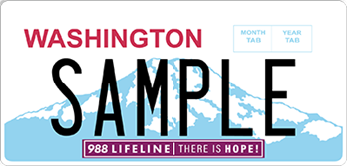
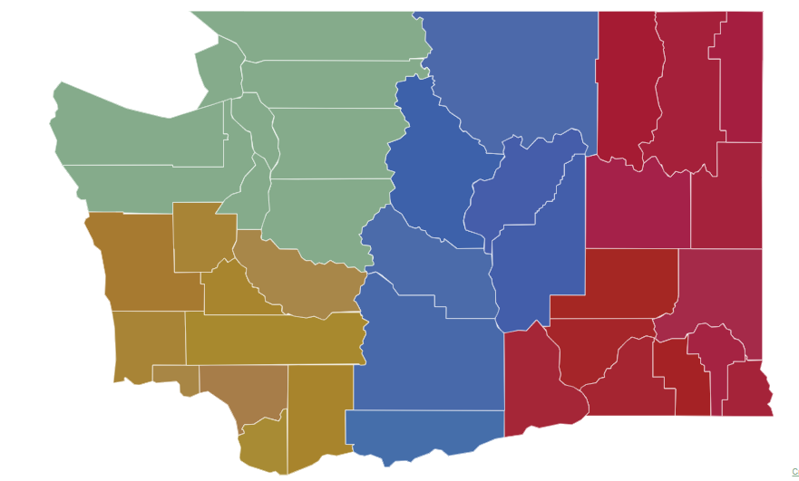
Suicide Prevention & Support Program
Includes the Governor’s Challenge to Prevent Suicide among Servicemembers, Veterans and Families (SMVF)
WDVA Counseling Program
Community-Based Services Grant
Veteran & Military Member Suicide Prevention Account
Military & Veteran Resource Database & Web Application
Educational Materials for Providers
Suicide-Safer Homes Taskforce
Prevent Veteran Suicide Emblem
Suicide Prevention Peer Team
Regionally located to provide:
Community workshops
Collaboration with regional agencies & organizations serving Veterans
Resource referral
For Non-Emergency Questions/Requests for Assistant Email: Connect@DVA.wa.gov
Also see https://dva.wa.gov/SP for more information!
New Suicide Prevention License Plate Emblem
Notes:
The Suicide Prevention and Support Program is a combination of a national initiative known as the Governor’s Challenge to End Veteran Suicide, the Staff Sergeant Fox VA Grant and legislation passed by the Washington State legislature. With the assistance of an advisory committee made up of federal, state and local partners, this program aims to help veterans & families before they experience a crisis.

Slide 17
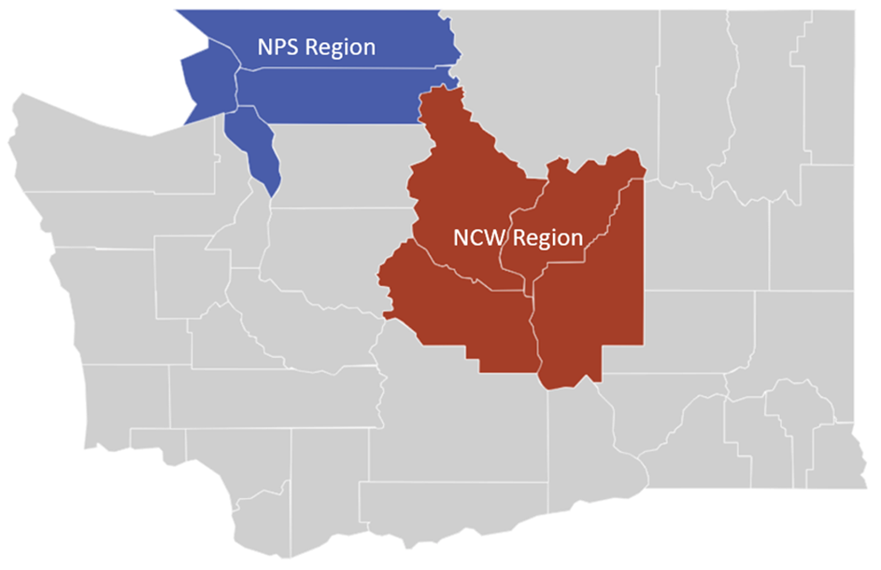
VA Staff Sergeant Fox Suicide Prevention Grant
Enables the WDVA to provide resources toward community-based suicide prevention efforts to meet the needs of eligible Veterans and their families through outreach, peer support, suicide prevention services, and connection to VA and community resources.
The program seeks to aid servicemembers, Veterans, and their families through:
Upstream suicide prevention intervention
Outreach and education on suicide prevention, peer support, and wrap-around services available throughout the state
Peer support case management
The Equipment and Services fund for alternative behavioral health services
Referrals and warm handoffs to resources
Notes:
WDVA continues to seek opportunities across the entire resource spectrum to uniquely position itself to provide necessary program and services.

Slide 18
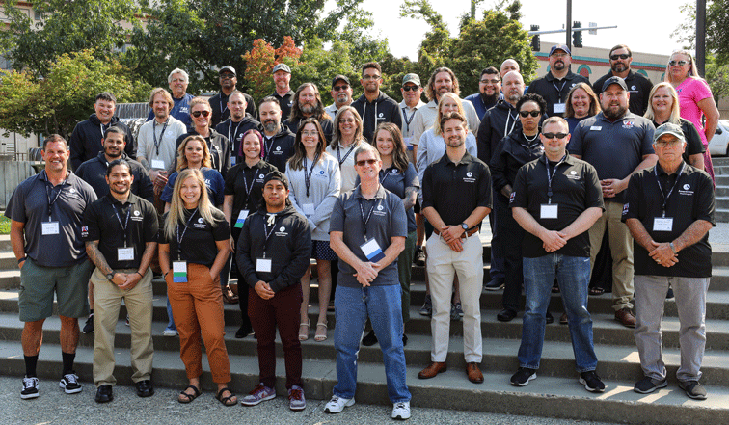
Counseling and Wellness, Cont.
Vet Corps
Through training and peer-to-peer support, Vet Corps Member’s
support student veterans, veterans in the community, and
military families by building on shared experiences and creating
supportive relationships.
Veterans Peer Corps
Provides training to community members interested in serving as Peer Mentors.
Veterans Conservation Corps
Provides opportunities for veterans to connect with nature in their own way while restoring and cultivating Washington’s natural resources.
Veterans Farm at Orting
Offers a place where veterans can lease fertile farmland, attend classes, volunteer and generally support a growing community.
Tobacco Cessation Program
Helps connect veterans and military families to resources that help decrease tobacco dependence, increase cessation efforts, and support for staying stopped.
Notes:
The Vet Corps program stations individuals, referred as Vet Corps Members (VCM’s), at colleges, universities, and community organizations throughout Washington state. The program is specifically designed to help veterans and their family members navigate their journey as they transition from military to civilian/collegiate/or community life. The program also ensures veterans are aware of the many resources available to them and helps connect them to their earned benefits.
The Veterans Peer Corps (VPC) Provides training to community members interested in serving as Peer Mentors. Many veterans have a need for support services, including peer-to-peer interaction and connections. The Veterans Peer Corps gives veterans places to gather, share experiences and stories, heal together, and ultimately create a sense of a Veteran Community within their own community.
The Veterans Conservation Corps (VCC) Provides opportunities for veterans to connect with nature in their own way while restoring and cultivating Washington’s natural resources. It also offers Internships for Veterans through partnerships with community organizations across the state.
The Veterans Farm at Orting is situated on the Soldiers Home campus as the base of Mount Rainer in the Orting Valley. Offering a place where veterans can lease fertile farmland, attend classes, volunteer and or generally support a growing community. Veterans interested in leasing land at the Veterans farm pay an annual fee of only $50 which entitles Veterans to use the land as they see fit, which includes irrigation, greenhouse, and cold storage.
The Veterans Commercial Tobacco Cessation Program. In partnership with Washington State Department of Health and funded by a grant from The Centers for Disease Control (CDC), the Veterans Commercial Tobacco Cessation Program (DVA) exists to connect Washington’s veterans and military families to resources that help decrease tobacco dependence, increase cessation efforts, and provide support for staying stopped.

Slide 19
Transition, Readiness, & Family Services
WA State Military Transition and Readiness Council (WSMTRC)
Partnership that supports service members and families to successfully transition into civilian careers.
Military Spouse Initiatives
Policy and program advocacy for military spouses (employment, credential portability, childcare, etc.). Convenes cross-sector workgroups. Shares resources and provides individual consultation.
Apprenticeship Program
Assists Veterans in connecting with registered apprenticeships and other career-connected learning. Convenes cross-sector apprenticeship workgroup.
Veteran-Owned Business (VOB) Program
Recruits and enrolls Veteran and service members in VOB Certification and Linked Deposit programs. Convenes cross-sector entrepreneur business development workgroup.
Notes:
The Washington State Military Transition and Readiness Council (WSMTRC) is a cross-jurisdictional and cross-sector partnership that supports military service members and families successfully transition into civilian careers.
The Military Spouse Outreach Initiative connects military spouses with resources to help them transition to a new duty station. The military spouse coordinator works with spouses to provide information on things like how to transfer professional licenses so they can get a job more quickly and Washington’s rules for residency in colleges and universities. The coordinator also convenes workgroups on issues of importance to military spouses such as childcare and housing, to name a few.
Apprenticeship for Veterans - Apprenticeship is a combination of on-the-job training (OJT) and related classroom instruction under the supervision of a journey-level craft person or trade professional in which workers learn the practical and theoretical aspects of a highly skilled occupation.
Businesses certified as Veteran or Service Member Owned are listed on a website so public agencies who are asked to do more purchasing from veteran owned businesses, can find them. The Governor has asked state agencies to do 5% of their purchasing with VOBs so it’s very important that we get the word out about the program and get more businesses certified! Businesses must be owned by an honorably discharged veteran, although a 50/50 split is ok if a veteran and their spouse who own the business together, the business must also be incorporated or based in WA state.

Slide 20
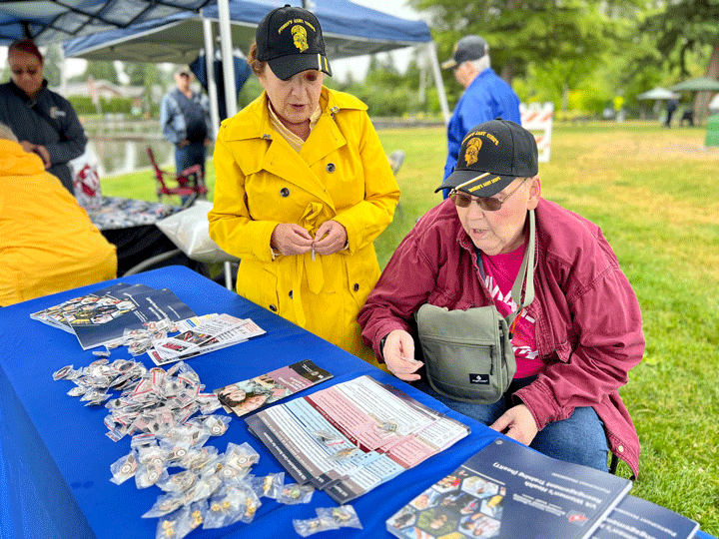
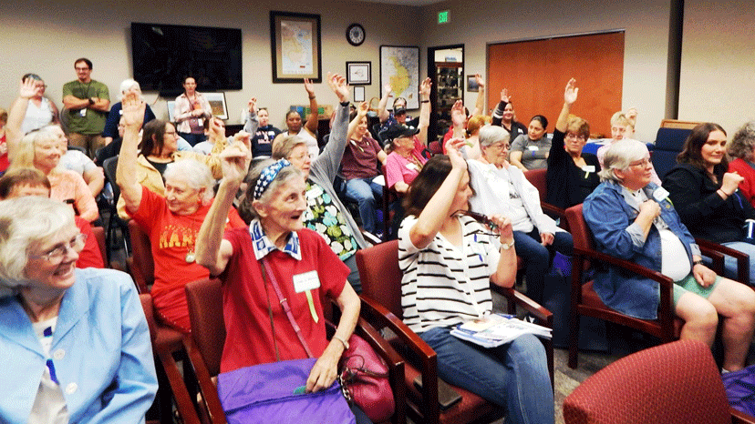
Women Veterans Program
70,000 Women Veterans in Washington State
Women Veterans Advisory Committee since 2008
Women Veterans Coordinator (Seeking FTE in 2023)
Bimonthly educational Webinars or Brown Bags
Annual Women Veterans Celebration around June 12th
Incarcerated Women Veterans Program at state
institutions
Welcome Home sponsorship for women in the
Transitional Housing Program
Use of a donation to support Women Veterans Regional Events
Dedicated budget to support activities, travel, etc.
Close relationships with federal VA partners for outreach and support

Slide 21
Other State Benefits
Reduced Fishing/Hunting License (DV 30%+)
State Park Passes (DV 30%+)
Federal Park Passes (all veterans)
Reduced Public Transportation Fees (DV 40%+)
Reduced Tuition at Public Colleges and Universities
Free License Plates for 100% disabled veterans and Gold Star spouses and parents.
Reduced Property Taxes (DV 80%+), contact the county assessor for more information
Recording of Discharges
DD 214 Database
Governors Welcome Home Letters
County Veterans Assistance Funds

Slide 22
Notes:
Please add or remove slides from the strategic plan as appropriate for your audience.

Slide 25
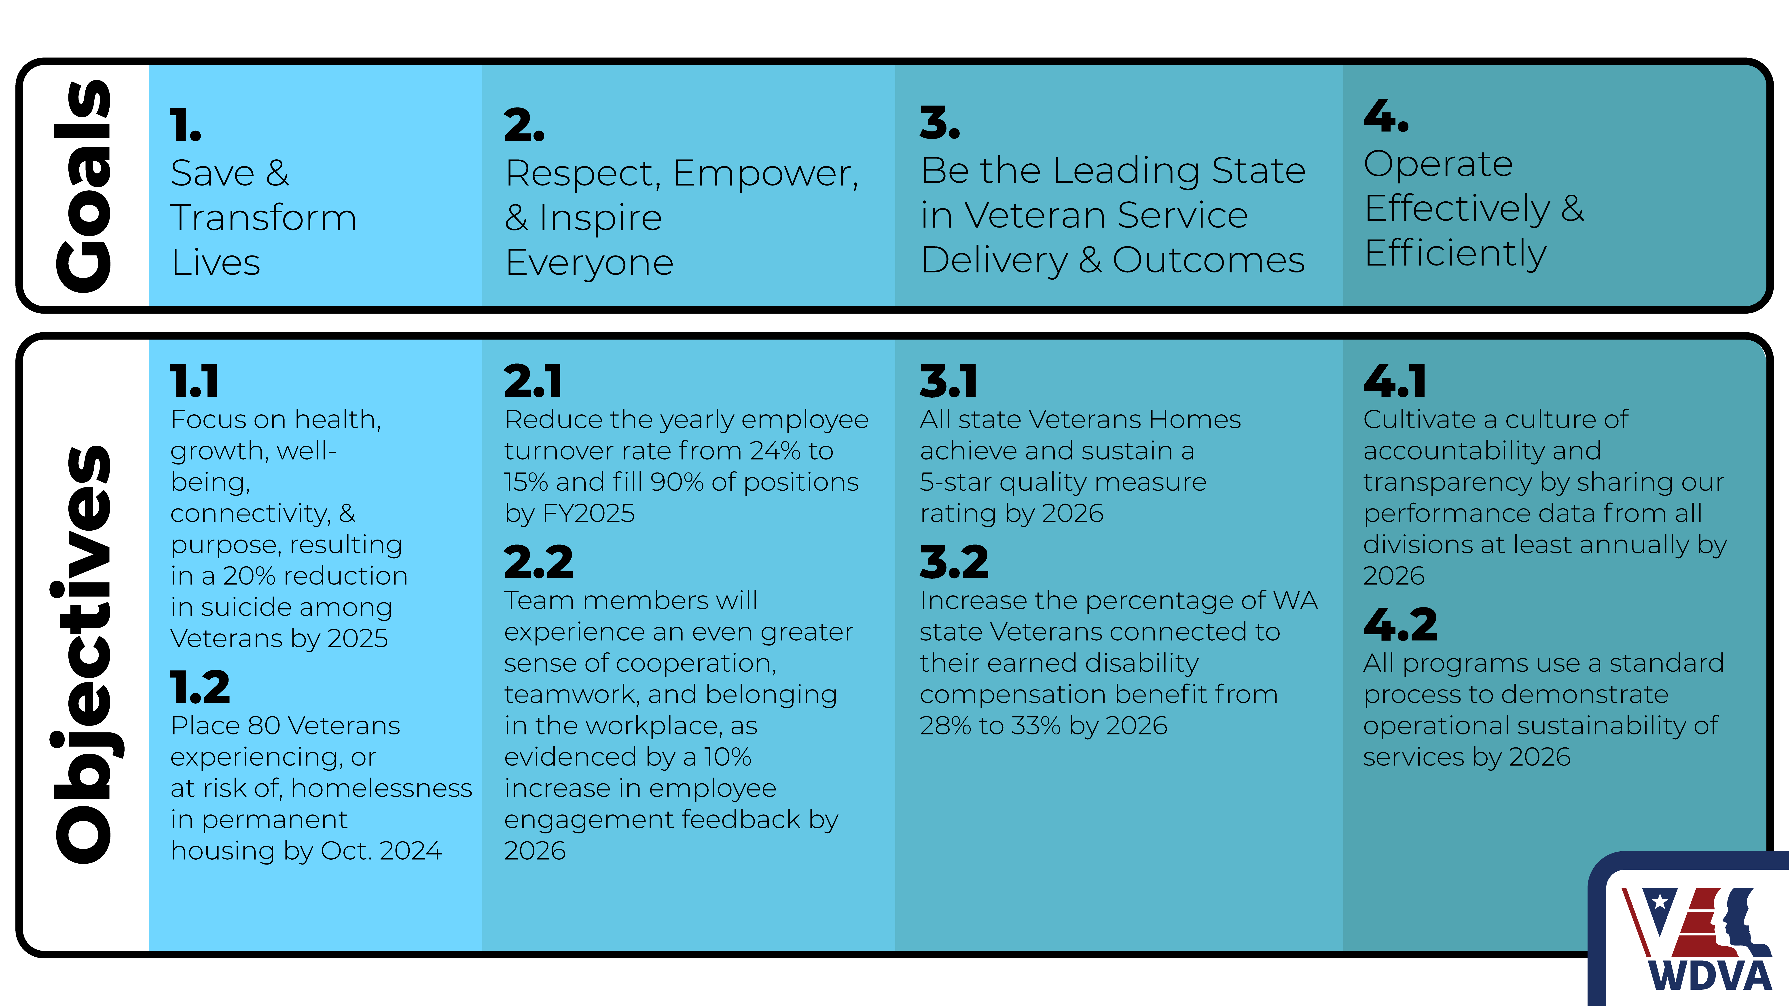

Slide 27
Connect to Your WDVA!
1-800-562-2308
www.dva.wa.gov
Veterans Homes Information
1-877-VETS-R-US
1-877-838-7787
Veteran Services
Steven J. Gill – 360-789-5886
Counseling and Wellness
Keith Meyer – 360-725-2220
Cemetery
Rudy Lopez – 509-299-6280
Follow us on Social Media!
Facebook (WSDVA):
www.facebook.com/wsdva
Twitter (WDVA):
https://twitter.com/WDVA
LinkedIn:
www.linkedin.com/company/Washington-state-department-of-veterans-affairs-recruiting
Instagram (WSDVA):
https://www.Instagram.com/wsdva
YouTube: Washington Department of
Veterans Affairs or WDVA
https://www.youtube.com/user/
WAVeteransAffairs/video

Slide 28
Agenda Item V.
Burial Benefits and Costs Christopher Castro, Evergreen Memorial Gardens

Slide 29
All About Veterans Death Benefits
Christopher J. Castro​
All About Veterans Death Benefits
Christopher J. Castro

Slide 30
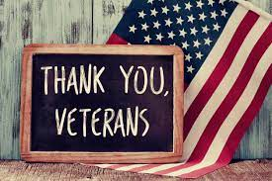
Thank YOU!

Slide 31
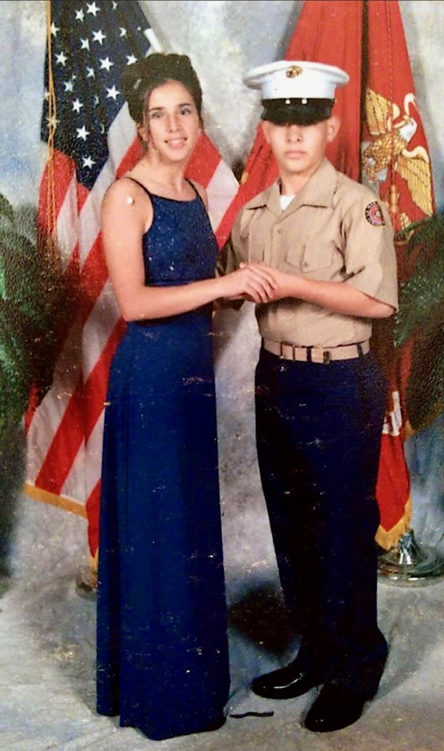
Who am I…?
Father
Former chef
Advance Funeral Planner
Passion for serving others and food of course.

Slide 32
About Veterans Death Benefits
What You Need to Know
The benefits your entitled to as a veteran.
How your loved ones apply to receive veterans’ benefits.
What can you do to prepare.

Slide 34
Burial
Who Qualifies?
What’s Included
Any member of the Armed Forces who dies while on active duty or any veteran honorably discharged.
An assigned gravesite.
Opening and Closing of the grave.
A grave liner for casketed remains.
A government headstone or marker.
Perpetual care at no cost to the family.
Who Can Join You?
Under certain conditions surviving spouse and minor children of eligible person.

Slide 35
Burial in a VA National Cemetery
What to know
A space may not be reserved in advance.
VA national cemeteries only allow arrangements to be made at time of death, so no guarantee that spouses or other family will be side by side or even nearby.
Burials in VA national cemeteries are usually not conducted on weekends.
Should the spouse of the veteran pass the grave will be double depth.
Dependent children can also be placed in the VA cemetery up to the age of 18. Should they remain a dependent due to a disability, there is no age limit.
A graveside service is not permitted in a VA cemetery, most have an area known as a committal area where services are completed.
Services run every 30 minutes in most VA national cemeteries.

Slide 36
Burial At Sea
What is Sea Burial?
Who Can Be Present?
A means of final disposition of remains that is performed on United States Navy vessels.
Committal ceremony is performed while the ship is deployed.
Active-duty members, retirees, veterans that were honorably discharged, U.S. civilian marine personnel of the Military Sealift Command and dependent family members.

Slide 37
United States Flag
Flag must be requested by family.
A flag is provided at no cost to drape the casket or accompany the urn of a deceased veteran.
An application for United States Flag for Burial Purposes (VA Form 27-2008) must be submitted along with a copy of the veteran's discharge paperwork.
Flags may be obtained from VA regional offices and most U.S. Post Offices.

Slide 38
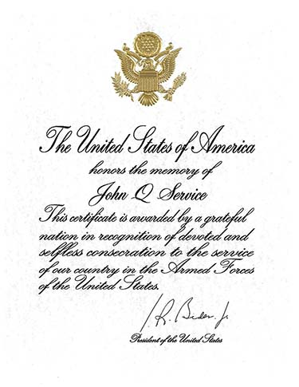
Presidential Memorial Certificate
Flag must be requested by family.
A flag is provided at no cost to drape the casket or accompany the urn of a deceased veteran.
An application for United States Flag for Burial Purposes (VA Form 27-2008) must be submitted along with a copy of the veteran's discharge paperwork.
Flags may be obtained from VA regional offices and most U.S. Post Offices.
Certificate is signed by the current sitting president at the time of passing.

Slide 39
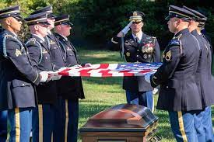
Full Military Honors
What to know?
Every eligible veteran by law is entitled to receive a military funeral honors ceremony.
Honors include the folding and presentation of the United States flag and the playing of “Taps”, upon the family's request.
The Department of Defense program calls for the funeral director to request military funeral honors on behalf of the veteran’s family.
The VA will only provide a rifle team for a veteran that is retired with 20 or more years of service.

Slide 40
Headstone/Marker
Any deceased veteran discharged under conditions other than dishonorable is eligible for a standard Government headstone, marker or medallion.
The VA, upon request and at no charge to the applicant will furnish a Government headstone or marker for the grave of any deceased eligible veteran in any cemetery around the world.
A bronze medallion in several sizes available for privately purchased headstone or marker.
Upright headstones are available in granite or marble, and flat markers are available in granite, marble and bronze.
Niche markers for cremated remains also available.
VA Form 40-1130 must be submitted for headstones or markers.
VA Form 40-1330M must be submitted if requesting the medallion.
If the family has ordered a VA marker, then they become ineligible to obtain the VA medallion. Only provided when a veteran has used a private company for the marker or headstone such as in a non-VA national cemetery.

Slide 41
Private Marker with Medallion
VA Marker

Slide 42
Your loved ones can receive veterans’ benefits by contacting their local veterans’ office.
Families will be asked to provide the information when requesting benefits:
Proof of military service (DD214).
Certified copy of original marriage certificate.
Verification of amount of amount of life insurance your beneficiaries will receive as a result of your death.
Social security number of spouse or dependents, if applicable.
Certified copy of a death certificate.
Copies of paid hospital and doctor bills incurred by last illness, if applicable.
Copies of paid funeral, burial and cemetery receipts.

Slide 43
Thank YOU!
Christopher J. Castro
Family Services Counselor
Evergreen Memorial Gardens
E: chris@evergreenmemorialgardens.com
P: (360) 609-9575

Slide 44
Agenda Item VI. November 2023 Contractor & Fund Reports
CCVAC
63 Veterans served in November, services totaling $19,235.16
53 men, 10 women, and 0 other Veterans served
7 denials, 0 subject to appeal
601 visits to the center for essentials and food, 776 meals served
765.5 volunteer hours, totaling $18,900 in value
Free Clinic
2 veterans served in November. Services totaled $308 in value. Billed $718.92
Fund
November revenue: $218,711.20
November expenditures: $65,295.03
Fund balance: $763,204.80
Notes:
Batting average for claims approval

Slide 45
Agenda Item VII. CCVAC updates

Slide 46
Agenda Items VIII. – XI.
Old Business
Questions for Budget Office
Community Forum Event
New Business
2024 Committee Appointments
2024 Work Plan Discussion
Discussion of excused absence limit
Open Forum
Adjourn
Next meeting: February 8, 2024

