Slide 1
VAB Agenda – February 8, 2024
Call to Order, Pledge, Invocation, Roll Call
Approval of January 11, 2024 minutes (action)
Committee Reports (info and action)
Member Roles and Responsibilities (info)
December 2023 Contractor and Fund Reports (info)
Veterans Assistance Center updates (info)
Old Business (info)
New Business (info)
Open Forum (info)
Adjourn

Slide 2
Agenda Item I. Call to Order/Pledge/Invocation/Roll Call

Slide 3
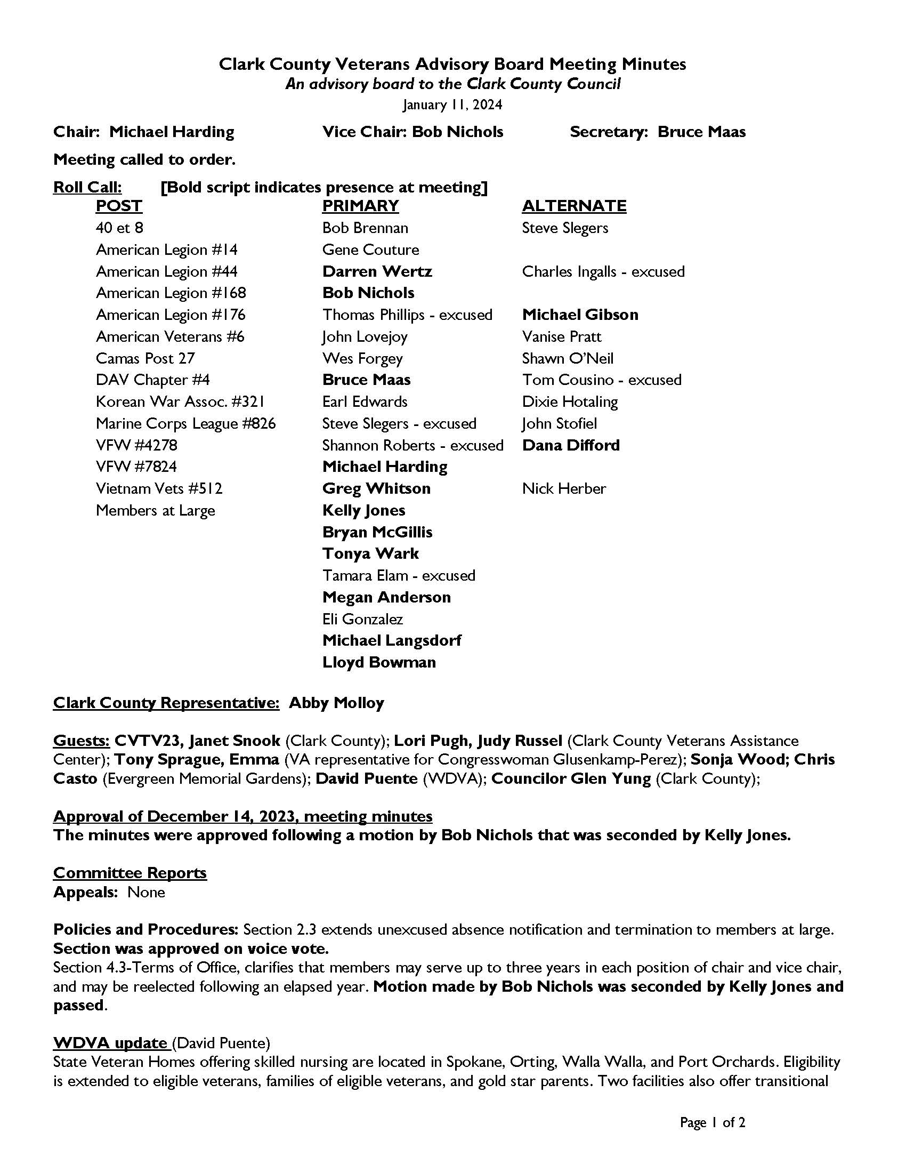
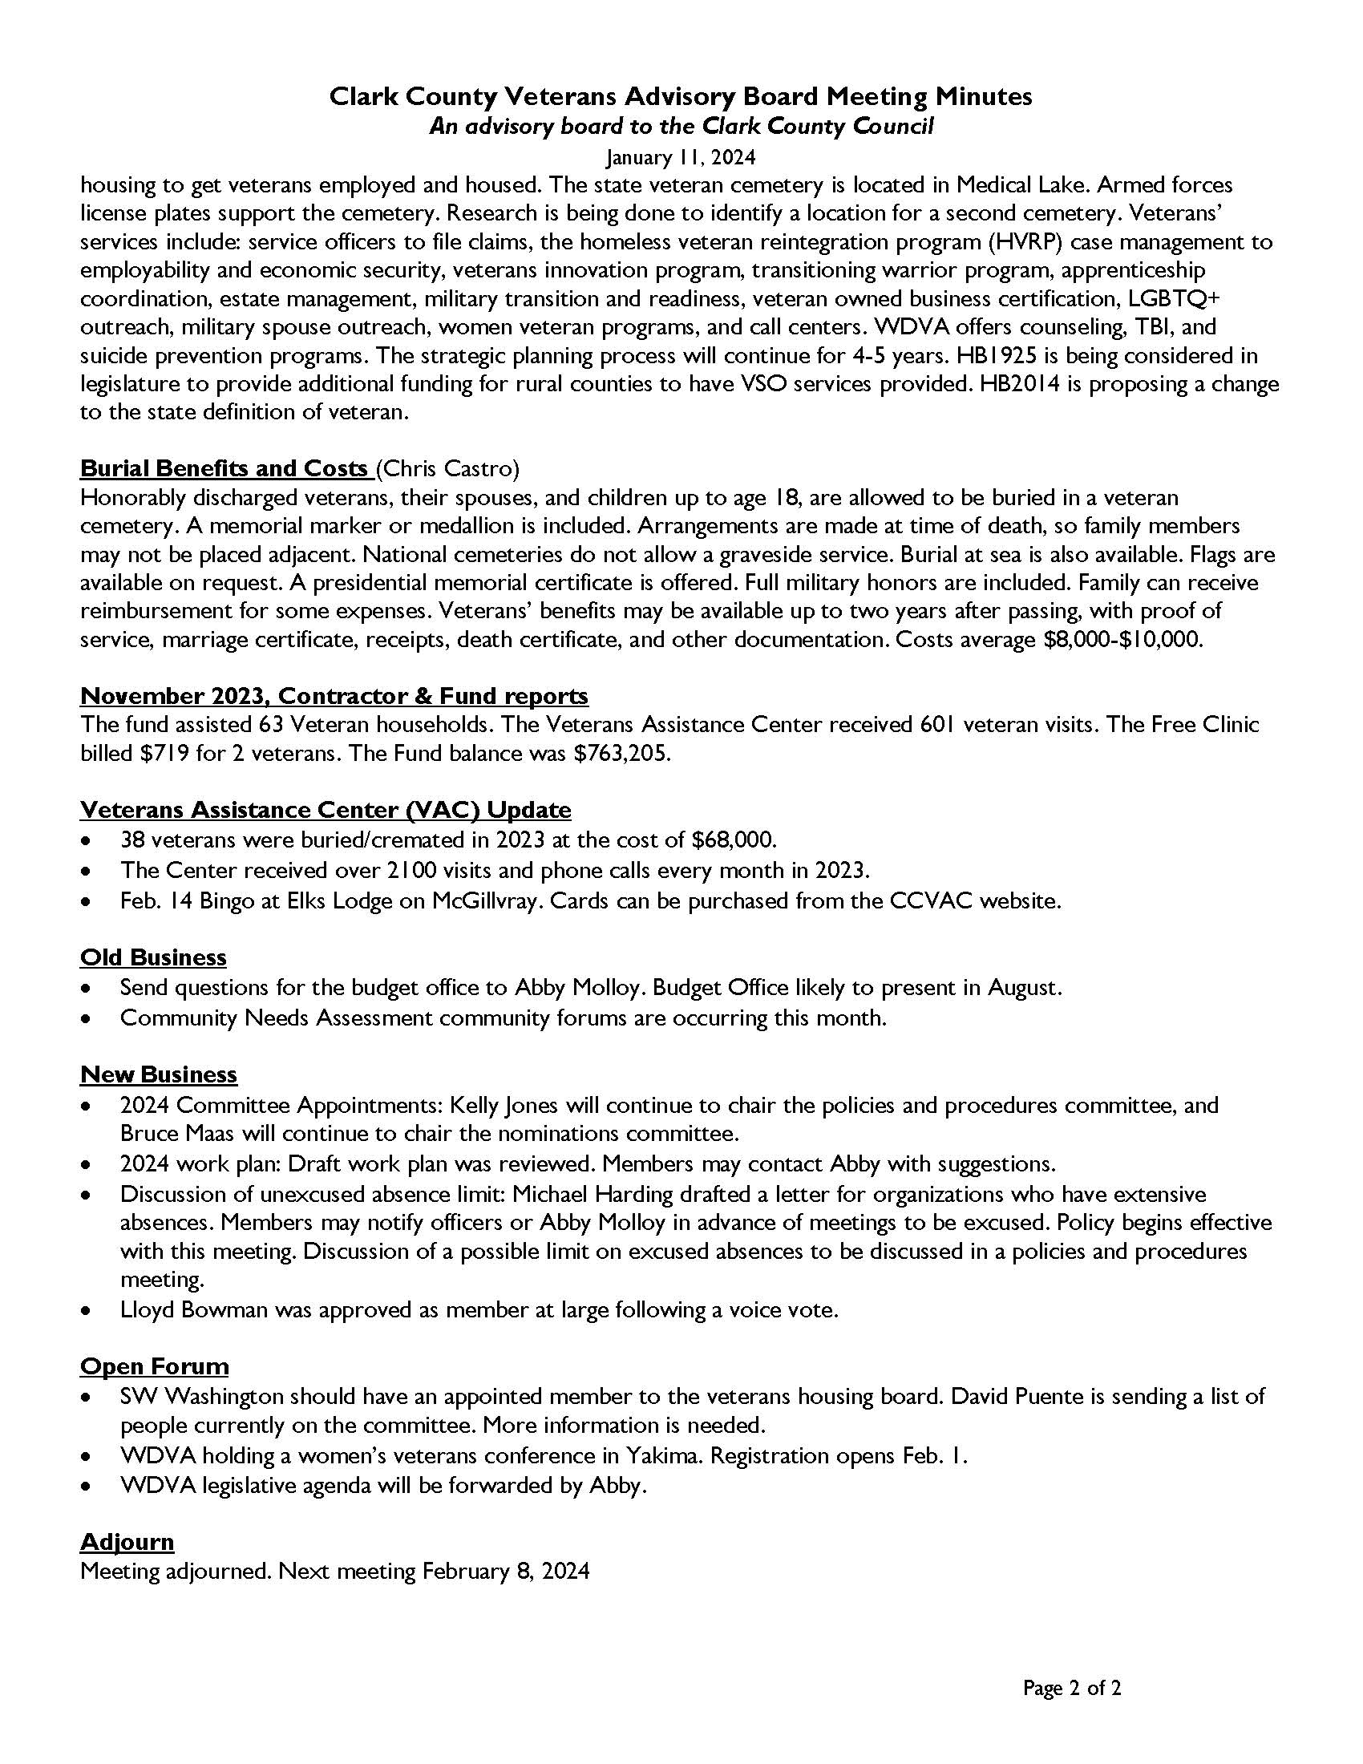
Agenda Item II. Approval of January 11th minutes

Slide 4
Agenda Item III. Committee Reports
Appeals – Gene Couture
Policies and Procedures – Kelly Jones
Nominations – Bruce Maas

Slide 5
Agenda Item IV. Roles and Responsibilities
The Advisory Role
Members of advisory boards provide an important link between the public and agencies, and the Clark County Council. The information that members provide about community needs and opinions can have a profound effect on policies and lead to better service. Advisory board members play a very special role in creating recommendations for Veteran services in Clark County.
Notes:
Now it’s time for our annual review of the VAB Member Roles and Responsibilities. Everything on these slides is pulled directly from the VAB handbook. This provides a pretty broad overview so I recommend reviewing the entire handbook in more detail if you need a refresher. I have hard copies in the room here today and sent out digital copies over email.
First we are going to start with an overview of the purpose of the CCVAB member advisory role and I will read this excerpt out loud.

Slide 6
Expectations
Members of the Veterans Advisory Board are expected to:
Interpret and communicate community opinions, attitudes, and needs to Clark County Community Services and the Clark County Council.
Study programs and services and analyze issues and needs.
Offer proposals and recommend changes in programs, policies, and standards.
Provide the public with information on county policies, programs, and budgets.
Remain knowledgeable about board policies and changes.
Stay up-to-date on issues, legislative activity, and statutes affecting the board
Notes:
Appointed members of the VAB, including organizational members and members at large are expected to…

Slide 7
Expectations
Veterans Advisory Board members support and counsel staff and make important recommendations about policy. They do not administer policy, programs, or services. When presenting recommendations, it is essential that board members keep the following in mind:
Ideas should be expressed in clear and concise language.
Proposed solutions should be viable and cost-effective.
Recommendations should identify reasons for the changes suggested.
Advice should reflect the views of a consensus or a majority of board members.
Notes:
Additionally…

Slide 8
Effective Board Members…
Attend all board meetings.
Are well prepared for meetings.
Recognize that serving the public interest is the top priority.
Recognize that the board must operate in an open and public manner.
Are knowledgeable about the issues affecting the board.
Examine all available evidence before making a judgment.
Communicate well and participate in group discussions.
Are aware that authority to act is granted to the board as a whole, not to individual members.
Exhibit a willingness to work with the group in making decisions.
Recognize that compromise may be necessary to reach consensus.
Do not let personal feelings toward other board members or staff interfere with their judgment.
Notes:
The handbook also outlines some guidance to being an effective board member.
It is imperative that board members recognize they are in a critical position to shape and influence board decisions and actions. It is important that each member keeps informed and up to date on issues, legislative activity and statutes affecting the board.
In a nutshell, effective board members are expected to…

Slide 9
Restrictions and Requirements
Some highlights:
Board members must be familiar with and operate within their board’s governing statutes and bylaws, as well as state and federal laws.
No board member may make unilateral decisions or take action without the consent of the board as a whole.
Individual board members must use discretion to avoid the appearance of speaking for the board.
Members are restricted from accepting or soliciting anything of economic value as a gift, gratuity or favor if it is given only because the member holds a responsible position with the county.
If you are unable to complete your term, it is important to inform Community Services staff. A letter of resignation should be sent indicating the date your resignation is effective and whether you are able to serve until a replacement is named.
Notes:
There are certain restrictions and requirements that may affect you during your tenure as a board member. The handbook has a longer list, but I have just included some highlights here:

Slide 10
Open Public Meetings Act
The Open Public Meetings Act (OPMA) applies to the Veterans Advisory Board.
The OPMA requires that all meetings of the governing body of a public agency, as well as some other meetings on policies affecting the public, be open to the public. In addition, the public must be notified of such meetings in a timely manner.
If a quorum of the board members meets (or even emails) about board business without prior public notification, they are violating the OPMA. Board members also need to be aware of the perception of them meeting as well. This could cause issues, even if it’s not a violation of the law.
The minutes of all regular meetings must be recorded and made available for public inspection.
Notes:
It is also important to note that the OPMA applies to the VAB…

Slide 11
Ethics and the Appearance of Fairness
Examples of conflicts of interest:
• Directing contracts to a business in which you have a financial interest.
• Using confidential information for private investments.
• Accepting gifts or favors in exchange for certain regulatory rulings.
• Accepting gifts or favors in exchange for making certain purchases.
• Obtaining personal favors from employees.
• Accepting favors for disclosure of confidential information.
• Engaging in outside employment which assists non-governmental entities in their quests for business.
For additional information on provisions of the state ethics law, visit the Washington State Executive Ethics Board website at www.ethics.wa.gov/.
Notes:
As a board member, you are expected to uphold a high ethical standard. It is extremely important that board members avoid conflicts of interest or even the appearance of conflicts of interest. Using a public position for private gain is improper and illegal. Similarly, actions benefiting close relatives are prohibited. There are penalties for violations of state ethics statutes. Up on the slide I have listed some examples of conflicts of interest…
This was a high level overview of the main VAB member roles, responsibilities, and expectations. Again, I recommend looking at the handbook more closely if you would like more information. Are there any questions at this time?

Slide 12
Agenda Item V. December 2023 Contractor & Fund Reports
CCVAC
64 Veterans served in December, services totaling $36,017.48
48 men, 16 women, and 0 other Veterans served
8 denials, 0 subject to appeal
596 visits to the center for essentials and food, 696 meals served
900.5 volunteer hours, totaling $22,233 in value
Free Clinic
6 veterans served in December. Services totaled $2,954 in value. Billed $3,761.96.
WDVA
Third quarter: 898 claims, 90% “batting average”, $498,254 VA payments
Fund
December revenue: $23,860.88; expenditures: $162,103.75; fund balance: $624,961.93
11/09/2023
Notes:
Batting average for claims approval

Slide 13
Agenda Item VI. CCVAC updates

Slide 14
Agenda Item VI. CCVAC updates

Slide 15
Agenda Items VII. – X.
Old Business
New Business
Open Forum
Adjourn
Next meeting: March 14, 2024

