Slide 1
VAB Agenda – March 13, 2025
Call to Order, Pledge, Invocation, Roll Call (action)
Executive Session (discussion)
Vote on Ron Brandon reinstatement (action)
Approval of February 13, 2025 minutes (action)
Committee Reports (info)
Member Roles and Responsibilities Presentation (info)
January 2025 Contractor and Fund Reports & 2024 Year-End Report (info)
Veterans Assistance Center Updates (info)
Veterans Assistance Center Budget Modification Request (Action)
Old Business (info)
New Business (info)
Open Forum (info)
Adjourn

Slide 2
Agenda Item II. Call to Order/Pledge/Invocation/Roll Call

Slide 3
Executive Session

Slide 4
Vote on Ron Brandon reinstatement

Slide 5
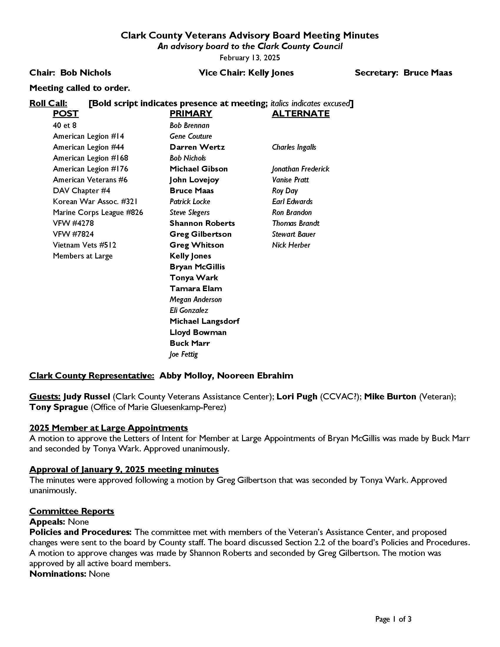
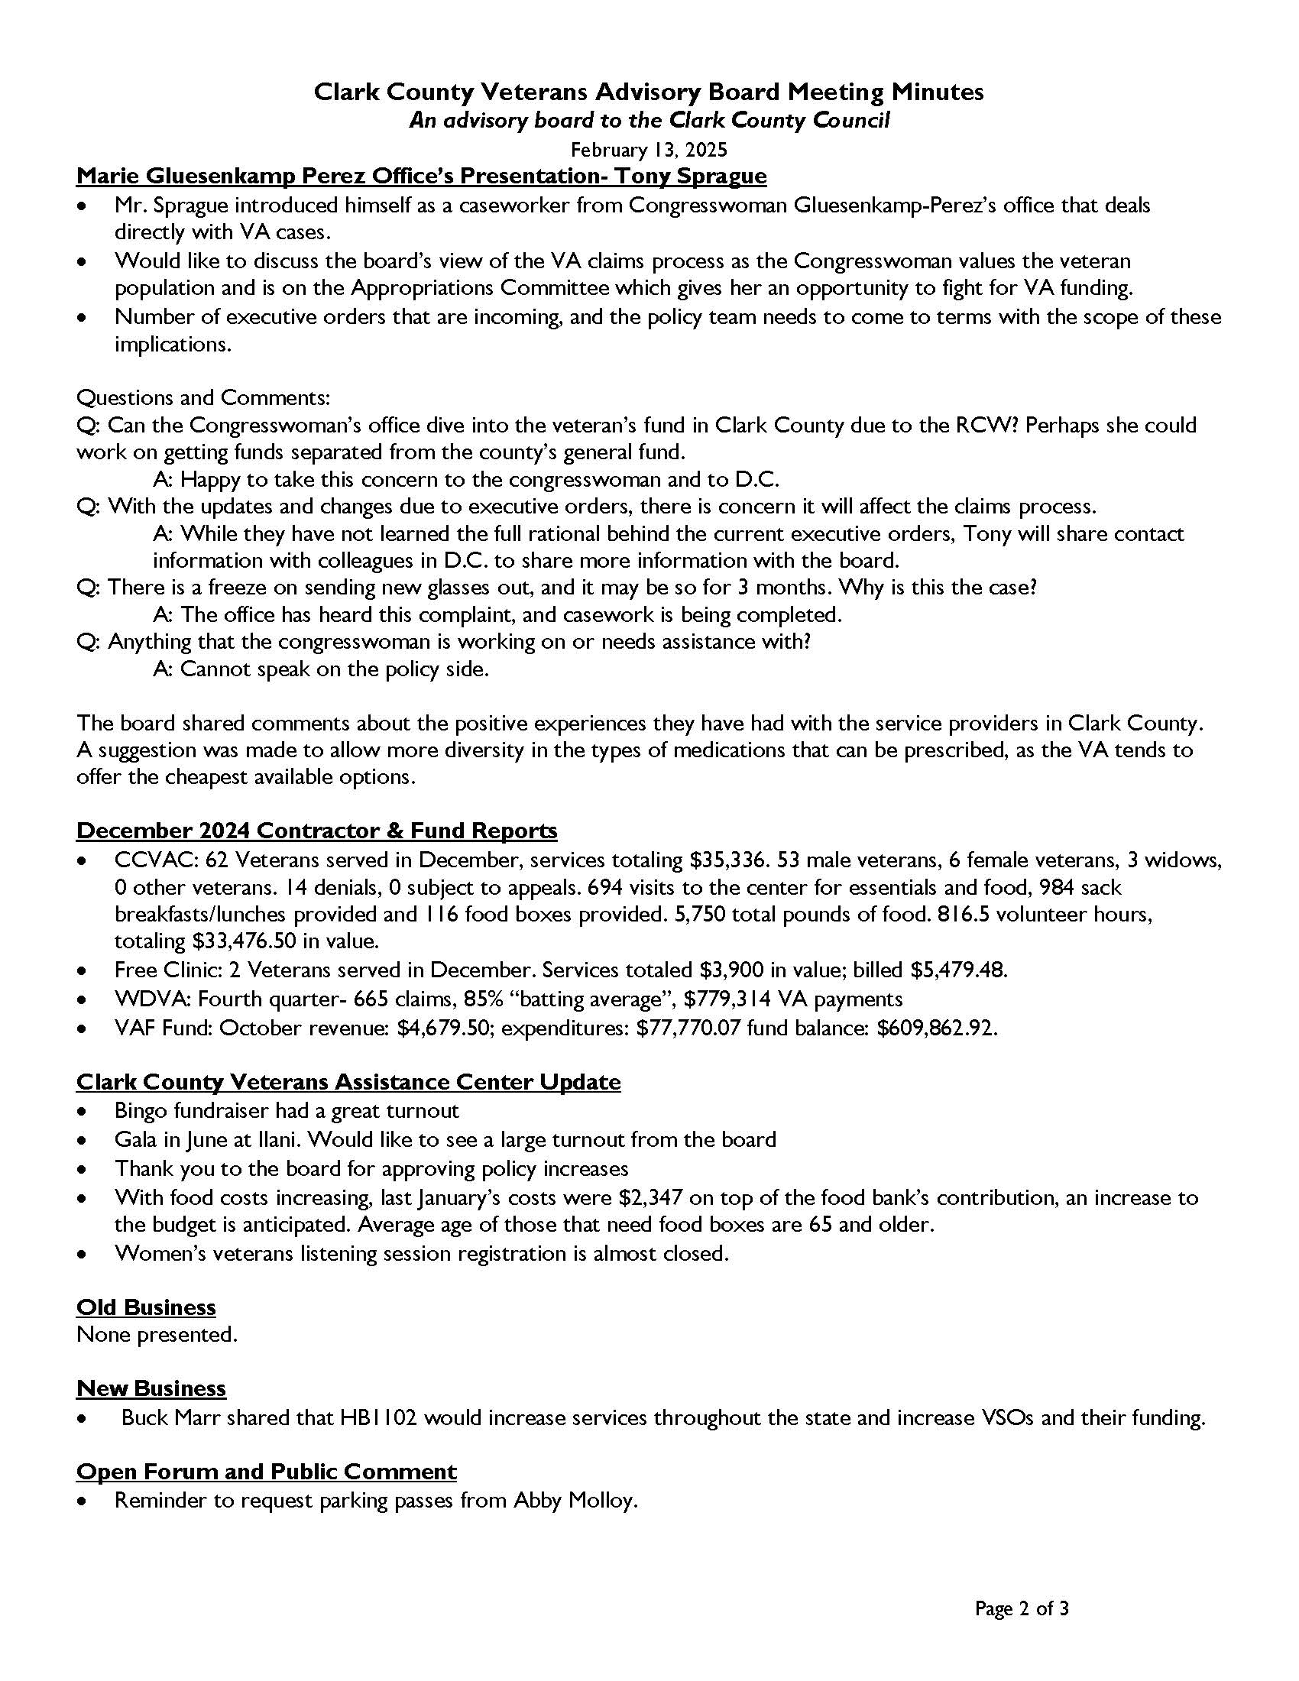
Agenda Item IV. Approval of February 13th minutes

Slide 6
Agenda Item V. Committee Reports
Appeals – Gene Couture
Policies and Procedures – Kelly Jones
Nominations – Bruce Maas

Slide 7
Member Roles and Responsibilities & OPMA Training
Abby Molloy
Notes:
This information is all pulled from the VAB handbook and state advisory board handbook

Slide 8
Roles and Responsibilities
Veterans Advisory Board Role
A VAB is required for every county in Washington State and was created by RCW 73.08.070. VAB members serve as advisers on policy matters to Clark County Community Services, which is responsible for administering policy. The VAB may study policy and make recommendations for changes or implementation. The VAB does not have authority to enforce policy or create rules, but their analysis and recommendations can play an important role in furthering the effective implementation of Veteran assistance. When presenting recommendations, it is essential that board members keep the following in mind:
Ideas should be expressed in clear and concise language.
Proposed solutions should be viable and cost-effective.
Recommendations should identify reasons for the changes suggested.
Advice should reflect the views of a consensus or a majority of board members.
Notes:
Now it’s time for our annual review of the VAB Member Roles and Responsibilities. Everything on these slides is pulled directly from the VAB handbook. This provides a pretty broad overview so I recommend reviewing the entire handbook in more detail if you need a refresher. I have hard copies in the room here today and sent out digital copies over email.
First we are going to start with an overview of the purpose of the CCVAB member advisory role and I will read this excerpt out loud.

Slide 9
Expectations
Members of the Veterans Advisory Board are expected to:
Interpret and communicate community opinions, attitudes, and needs to Clark County Community Services and the Clark County Council.
Study programs and services and analyze issues and needs.
Offer proposals and recommend changes in programs, policies, and standards.
Provide the public with information on county policies, programs, and budgets.
Remain knowledgeable about board policies and changes.
Stay up-to-date on issues, legislative activity, and statutes affecting the board
Notes:
Appointed members of the VAB, including organizational members and members at large are expected to…

Slide 10
Effective Board Members…
Attend all board meetings.
Are well prepared for meetings.
Recognize that serving the public interest is the top priority.
Recognize that the board must operate in an open and public manner.
Are knowledgeable about the issues affecting the board.
Examine all available evidence before making a judgment.
Communicate well and participate in group discussions.
Are aware that authority to act is granted to the board as a whole, not to individual members.
Exhibit a willingness to work with the group in making decisions.
Recognize that compromise may be necessary to reach consensus.
Do not let personal feelings toward other board members or staff interfere with their judgment.
Notes:
The handbook also outlines some guidance to being an effective board member.
It is imperative that board members recognize they are in a critical position to shape and influence board decisions and actions. It is important that each member keeps informed and up to date on issues, legislative activity and statutes affecting the board.
In a nutshell, effective board members are expected to…

Slide 11
Laws Affecting Board Activities
Restrictions and Requirements:
Board members must be familiar with and operate within their board’s governing statutes and bylaws, as well as state and federal laws.
To ensure accountability, all applicable policies and procedures adopted by the board should be in written form.
No board member may make unilateral decisions or take action without the consent of the board as a whole.
Individual board members must use discretion to avoid the appearance of speaking for the board.
Board members must keep in mind that their mission is to serve the public, and that it is inappropriate to use board membership to create a personal platform.
Notes:
There are certain restrictions and requirements that may affect you during your tenure as a board member. The handbook has a longer list, but I have just included some highlights here:

Slide 12
Laws Affecting Board Activities, cont.
Members are restricted by RCW 42.52.130, 140, 150 and 42.18.230 from accepting or soliciting anything of economic value as a gift, gratuity or favor if it is given only because the member holds a responsible position with the county.
Questions about board issues should be directed to the board chair or county staff, who will see that all board members receive needed information by the next regular meeting.
Details of board investigations, personnel files or business discussed at closed executive sessions should not be disclosed unless they are part of the public record.
If you are unable to complete your term, it is important to inform Community Services staff. A letter of resignation should be sent indicating the date your resignation is effective and whether you are able to serve until a replacement is named.

Slide 13
Ethics and the Appearance of Fairness
Examples of conflicts of interest:
• Directing contracts to a business in which you have a financial interest.
• Using confidential information for private investments.
• Accepting gifts or favors in exchange for certain regulatory rulings.
• Accepting gifts or favors in exchange for making certain purchases.
• Obtaining personal favors from employees.
• Accepting favors for disclosure of confidential information.
• Engaging in outside employment which assists non-governmental entities in their quests for business.
For additional information on provisions of the state ethics law, visit the Washington State Executive Ethics Board website at www.ethics.wa.gov/.
Notes:
As a board member, you are expected to uphold a high ethical standard. It is extremely important that board members avoid conflicts of interest or even the appearance of conflicts of interest. Using a public position for private gain is improper and illegal. Similarly, actions benefiting close relatives are prohibited. There are penalties for violations of state ethics statutes. Up on the slide I have listed some examples of conflicts of interest…
This was a high level overview of the main VAB member roles, responsibilities, and expectations. Again, I recommend looking at the handbook more closely if you would like more information. Are there any questions at this time?

Slide 14
Board Transactions
Board members are expected to adhere to bylaws and all relevant statutes.
A quorum of a minimum of one elected officer and five Primary and/or Alternate members of the CCVAB, including members at large, must be present to conduct official business.
County agencies and boards are required to have copies of public records pertaining to board business available for public inspection. Records relating to the conduct of official business are subject to disclosure even if they are on a personal computer. Records regarding advisory board business must be retained for six years. (RCW 42.56)
Notes:
The Veterans Advisory Board has a set of bylaws to direct and clarify its actions, procedures and organization. Board members are expected to adhere to bylaws and all relevant statutes.
County agencies and boards are required to have available for public inspection and copying their public records, such as procedural rules and statements of general policy, and other records, written or electronic, pertaining to the board’s business. Exemptions to disclosure are limited and identified in statute.
Records relating to the conduct of official business are subject to disclosure even if they are on a personal computer. Records regarding advisory board business must be retained for six years.
For additional information on disclosure requirements and exemptions from disclosure, refer to Chapter 42.56 RCW or consult with the County Attorney.

Slide 15
Communications
“The county has received some questions from members of our boards and commissions regarding communications. First, the county sincerely appreciates your participation on our boards and commissions, and we value your passion and expertise. We hope this information is helpful and addresses the questions.
The county employs highly skilled communications staff. While there is no county policy that prohibits a board or commission from communicating with the public, media outlets, etc., it is highly recommended, and best practice, to engage with our communications staff (this is actually an expectation for county staff as well). They are here to support your communication efforts; helping to ensure accurate information is being shared, the communication is within the scope and responsibility of the board and commission, and the communication is done in a method that reaches the intended audience. Please work with your staff contact if you wish to communicate externally from your board or commission, and they will coordinate with the county’s communications staff.”
– Kathleen Otto

Slide 16
Parliamentary Procedures
VAB follows Robert’s Rules of Order
Detailed rules can be found at http://www.rulesonline.com/rror-05.htm
Here is a short YouTube video that about the Basics of Making Motions
https://www.youtube.com/watch?v=96Damodm-ec
Notes:
https://www.youtube.com/watch?v=96Damodm-ec

Slide 17
Open Public Meetings Act
The Open Public Meetings Act (OPMA) applies to the Veterans Advisory Board.
The OPMA requires that all meetings of the governing body of a public agency, as well as some other meetings on policies affecting the public, be open to the public. In addition, the public must be notified of such meetings in a timely manner.
If a quorum of the board members meets (or even emails) about board business without prior public notification, they are violating the OPMA. Board members also need to be aware of the perception of them meeting as well. This could cause issues, even if it’s not a violation of the law.
The minutes of all regular meetings must be recorded and made available for public inspection.
Notes:
It is also important to note that the OPMA applies to the VAB…

Slide 18
OPMA, cont.
If attendees are being disruptive, the governing board can remove the individuals or adjourn the meeting.
No actions may be taken at a meeting that is not properly advertised nor can an action be voted on by secret ballot.
Meeting dates and locations may be moved in the case of an emergency. Remote meetings can also be held during an emergency.
If the OPMA is knowingly violated, each board member can be subject to personal liability by civil penalty of $500 as assessed by a judge for the first offense. Additional offenses increase the penalty charged.
Any person may commence an action for the purpose of stopping violations of the OPMA.
Public comment time is required at all meetings.

Slide 19
Learning Opportunity: Open Government Training
Washington State Office of the Attorney General
Self-guided online training
https://www.atg.wa.gov/open-government-training

Slide 20
Code of Conduct
Standard board practice – VAB does not currently have one
Recommended by legal counsel
Reflects the organization’s core values, ethical principles and expectations of the board members’ responsibility
Defines board response to conduct violation
Will work with Policies and Procedures committee to create draft for board approval

Slide 21
Agenda Item VII. 2024 Year-End Fund Report
2024 revenue = $946,546.16
2024 expenditures = $992,466.99
Net decrease = $45,920.83
Fund balance = $523,508.16
11/09/2023

Slide 22
Agenda Item VII. January 2025 Contractor Reports
CCVAC
45 Veterans served in January, services totaling $17,919.91
38 male Veterans, 6 female Veterans, 1 widow, and 0 others served
18 denials, 0 subject to appeal
630 visits to the center for essentials and food. 1,035 sack breakfasts and lunches and 54 food boxes provided. 4,503 total pounds of food provided.
716.5 volunteer hours, totaling $29,376.50 in value
Free Clinic
1 veteran served in January. Services totaled $655 in value. Billed $727.54.
Fund
January revenue: $5,119.34; expenditures: $39,662.93; fund balance: $488,552.39
Notes:
December fund balance will be updated

Slide 23
Agenda Item VIII. CCVAC updates

Slide 24
Agenda Item IX. CCVAC Budget Modification Request
 | Existing 2025 budget | 2025 budget modification request
Services to Veterans | $400,000 | $400,000
Operating Expenses | $90,000 | $117,804 (rent increase July – Dec 2025)
Stand Down | $30,000 | $23,796 (move storage costs to operations)
Personnel Costs | $207,000 | $207,000
Administration | $156,000 | $156,000
TOTAL | $883,000 | $904,600

Slide 25
Agenda Items X. – XII.
Old Business
New Business
Open Forum
Adjourn
Next meeting: April 10, 2025
Notes:
WDVA - Legislative Updates
https://gcc02.safelinks.protection.outlook.com/?url=https%3A%2F%2Fwww.dva.wa.gov%2Fabout-wdva%2Flaws-legislation%2Flegislative-updates&data=05%7C02%7CAbby.Molloy%40clark.wa.gov%7C310458d50fe840e1feb808dd2d646f28%7C389c6904b0734843a92d4a72a350cf02%7C1%7C0%7C638716631581841100%7CUnknown%7CTWFpbGZsb3d8eyJFbXB0eU1hcGkiOnRydWUsIlYiOiIwLjAuMDAwMCIsIlAiOiJXaW4zMiIsIkFOIjoiTWFpbCIsIldUIjoyfQ%3D%3D%7C0%7C%7C%7C&sdata=FvR%2BwSxEVEUQPgwsCUyokLnz%2F4l1xb%2F%2Ffv0lgb9Wq8M%3D&reserved=0
Governor's Veterans Affairs Advisory Committee. Will be holding a town hall meeting. On February 5, 2024. From 10:00 AM - 12:30 PM. Location will be in Kelso or Longview. Meeting site pending.
Bob Knight's retired US Army Officer. And past President of Clark College. We be having a public memorial service is on Monday Jan 13 at
11:00 AM, AC MARRIOTT on the Waterfront. Entire first floor is dedicated to the service.

