Slide 1
Clark County Developmental Disabilities
Introduction to Planning for our 5-year Comprehensive Plan 2026 – 2030
It is our policy to produce a written plan for services every 5 years. Our current 2021 – 2025 Plan can be found on our website. The Plan drives our services. It is our roadmap to reach our goals and outcomes.
Our Planning process relies on community feedback to help form and shape our priorities for the next five years. In other words, we need you to comment, ask questions, guide, and make sure we’re accountable.
Let’s take a quick look at the process. First, who are we?

Slide 2
We are a Part of Clark County Community Services
Community Services has adopted the following mission and vision:
Mission
Clark County Community Services, through partnerships, supports all people in our community to increase their well-being and economic security.
Vision
We work to create a thriving community where people are valued and have the resources they need to flourish.
The Programs administrated by the Department include:
Response to Homeless Crisis
Behavioral Health
Developmental Disabilities
Veterans Assistance Fund
Youth Programs

Slide 3
Community Services
Equity Statement
Clark County Community Services recognizes past and present injustice, and we work to heal it. We believe that everyone deserves to live a healthy and safe life. We have a moral obligation to support all members of our community who are underserved and underrepresented.
To achieve more equitable services, we must be inclusive and work in partnerships within our community. We use our commitment to equity to inform everything we do to address disparities. We actively listen to and center the voices of those who have been historically underrepresented in order to challenge structural and institutional racism and discrimination. We honor and respect the experiences and perspectives of the people we serve. We look inward to challenge our own beliefs and barriers. We engage and support diverse communities so that they thrive.
We celebrate our community becoming more diverse and hold that our journey and success are intertwined with each other.

Slide 4
Developmental Disabilities - Our Mission and Vision
Mission:
Clark County will assist all people with Developmental Disabilities to achieve full, active and productive lives.
Vision:
People with Intellectual and Developmental Disabilities (IDD) are fully participating community members. This will occur in a community where each person is recognized for their gifts and contributions, where all are seen, and differences related to race, ethnicity, gender, orientation, age, ability, history, religion and/or nationality are honored and celebrated as a strength of the community.
Notes:
Developmental Disabilities is a Program within Community Services
We are responsible for program and supports of/for people with Intellectual and Developmental Disabilities (IDD) within the County.
We use federal, state and county funding to accomplish our work.
We currently have 6 staff to work with and in the community.
We take advice and guidance from the Developmental Disabilities Advisory Board (DDAB) – a volunteer board whose members are appointed by the County Council.
We plan for services in a number of different ways. But the Community is our first priority. So, we ask, what is it you need?

Slide 5
Developmental Disabilities (DD)
Washington State, through Counties, remains #1 in the country in Employment for people with developmental disabilities. We partner with:
Nonprofits
Community based organizations
Local governments
To serve people with Intellectual and Developmental Disabilities (IDD) and their families by providing:
Early supports for infants and toddlers
Supported Employment
Community Inclusion
Community Information and Education

Slide 6
Clark County Developmental Disabilities Advisory Board (DDAB)
Notes:
The DDAB is a ten-member volunteer Advisory Board appointed by the County Council.
It advises and provides guidance to the Clark County Councilors and program staff on effectiveness and efficiency of service to individuals with Intellectual and Developmental Disabilities (IDD) and their families.
The DDAB’s meetings are free and open to the public to attend.
There is opportunity for community input at each meeting.
We have a full Advisory Board right now, though positions come open from time to time. Contact us any time for more information regarding the Advisory Board.

Slide 7
Developmental Disabilities Staff
Program Manager (Trish Buescher)
2 Program Coordinators (Kristin Wade, Angela Gomez)
2 Office Assistants (Trudi Cumberbatch, Cheri Osterman)
1 Office Aide (Alex Koval)
Work together to oversee Early Supports for Infants and Toddlers, Supported Employment, Community Inclusion and Information and Education
Provides staff support and information to the Developmental Disabilities Advisory Board

Slide 8
Organizations We Contract With…
Ashby Family LEAD & Engagement Services
Employers Overload
Goldman and Associates
Innovative Services NW
Keys to Advancement
Service Alternatives
Tangible Systems
Trillium Employment Services
iEmbrace
ESD #112
Peace NW
Washington Initiative for Supported Employment

Slide 9
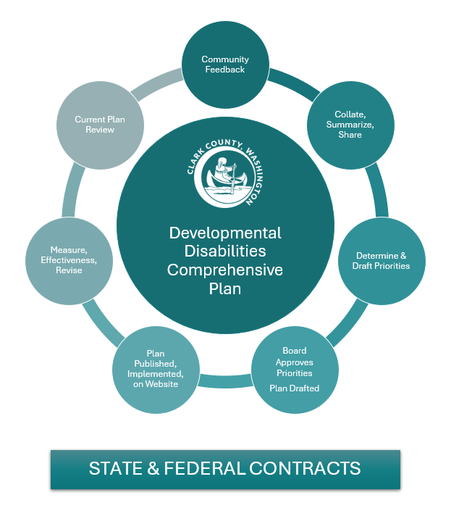
Plan Development Process
Notes:
We Solicit Community Feedback – We use surveys, meetings, presentations.
We review our State and Federal Contract requirements to assure alignment.
We review our current Plan and how we’re doing and did.
We collate, summarize and share our data and feedback with the Developmental Disabilities Advisory Board (DDAB). We ask for their input, feedback and consensus approval.
Along with the feedback and comments we received, and DDAB, we determine and draft our priorities.
We ask the DDAB to comment and then approve our priorities for the next 5 years.
We then draft the Plan.
We ask the County to approve the draft, then the Plan is ready for the final draft and implementation.
We include the new Plan on our website.
We consistently measure the effectiveness of the plan and revise as necessary.
In year 4 of the Plan, we start over.

Slide 10
We Solicit Community Feedback
Here is both what we are contracted for and items the community has asked us to prioritize:
Equity (Contract)
Employment (Contract)
Community Information and Advocacy (Contract)
Transitioning High School Students (Contract)
Recreation and Leisure (Contract through Community Inclusion)
Access to greater opportunity – whole life
Improved access to a livable wage (Contract)
Healthcare
Housing
Mental Health – Including long term impacts of COVID-19
Transportation
Aging – Planning for retirement
Better understanding and connection to services
Bundled services

Slide 11
Ways to Provide Feedback:
We would love to come to your community meeting or even to provide information and get feedback.
Fill out our survey – Coming soon!
Comment by email, phone or a media that works for you.
Thank-you!!!
DD.Program@Clark.wa.gov
(564) 397-7826
www.clark.wa.gov/community-services/developmental-disabilities
Notes:
QR Code and we will link to the survey once finalized.

