Slide 1
VAB Agenda – May 8, 2025
Call to Order, Pledge, Invocation, Roll Call (action)
Approval of April 10, 2025 minutes (action)
Committee Reports (info)
Marshall Leadership Awards Presentation (info)
March 2025 Contractor and Fund Reports (info)
Veterans Assistance Center Updates (info)
Old Business (info)
New Business (info)
Open Forum (info)
Adjourn

Slide 2
Agenda Item I. Call to Order/Pledge/Invocation/Roll Call

Slide 3
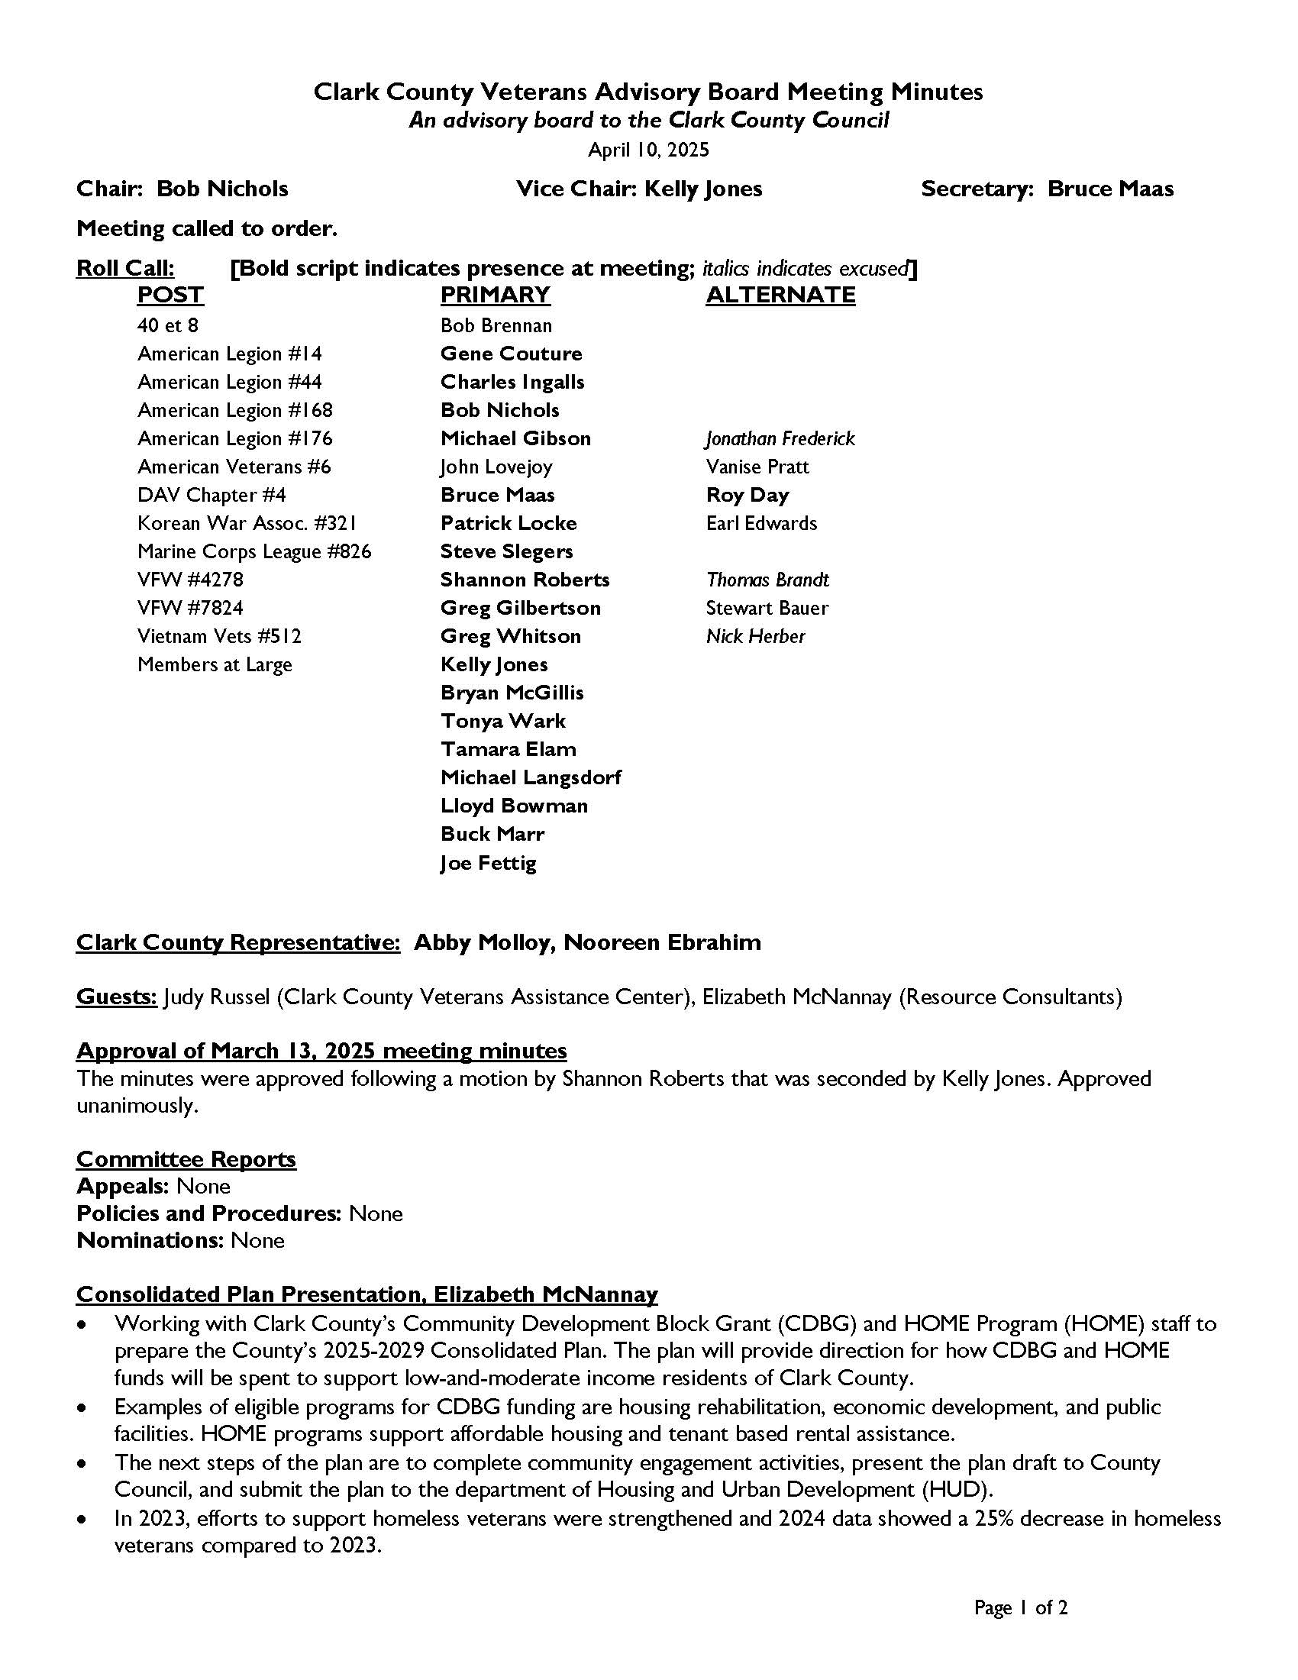
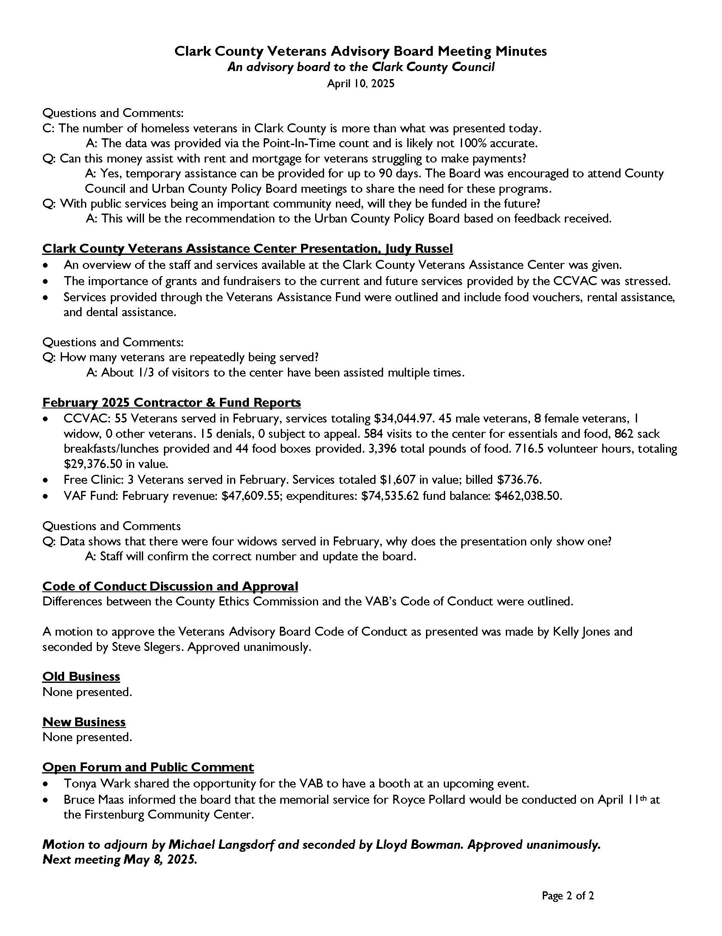
Agenda Item II. Approval of April 10th minutes

Slide 4
Agenda Item III. Committee Reports
Appeals – Gene Couture
Policies and Procedures – Kelly Jones
Nominations – Bruce Maas

Slide 5
Marshall Leadership Awards Presentation
Tiffany Lounsbury
Eduardo Torres
Temple Lentz
Notes:
This information is all pulled from the VAB handbook and state advisory board handbook

Slide 14
Agenda Item V. March 2025 Contractor Reports
CCVAC
37 Veterans served in March, services totaling $34,195.55
33 male Veterans, 0 female Veterans, 0 widows, and 0 others served
9 denials, 0 subject to appeal
622 visits to the center for essentials and food. 993 sack breakfasts and lunches and 61 food boxes provided. 4,544 total pounds of food provided
544 volunteer hours, totaling $21,912.32 in value
Free Clinic
3 veterans served in March. Services totaled $1,770 in value. Billed $703.41.
WDVA
First quarter: 735 claims, 93% “batting average”, $1,440,802 VA payments.
Fund
March revenue: $56,710.36; expenditures: $79,551.75
Fund balance: $439,197.11 ($22,841.39 decrease from last month)
Notes:
December fund balance will be updated

Slide 15
Agenda Item VI. CCVAC updates

Slide 16
Agenda Items X. – XII.
Old Business
New Business
Open Forum
Adjourn
Next meeting: June 12, 2025
Notes:
WDVA - Legislative Updates
https://gcc02.safelinks.protection.outlook.com/?url=https%3A%2F%2Fwww.dva.wa.gov%2Fabout-wdva%2Flaws-legislation%2Flegislative-updates&data=05%7C02%7CAbby.Molloy%40clark.wa.gov%7C310458d50fe840e1feb808dd2d646f28%7C389c6904b0734843a92d4a72a350cf02%7C1%7C0%7C638716631581841100%7CUnknown%7CTWFpbGZsb3d8eyJFbXB0eU1hcGkiOnRydWUsIlYiOiIwLjAuMDAwMCIsIlAiOiJXaW4zMiIsIkFOIjoiTWFpbCIsIldUIjoyfQ%3D%3D%7C0%7C%7C%7C&sdata=FvR%2BwSxEVEUQPgwsCUyokLnz%2F4l1xb%2F%2Ffv0lgb9Wq8M%3D&reserved=0
Governor's Veterans Affairs Advisory Committee. Will be holding a town hall meeting. On February 5, 2024. From 10:00 AM - 12:30 PM. Location will be in Kelso or Longview. Meeting site pending.
Bob Knight's retired US Army Officer. And past President of Clark College. We be having a public memorial service is on Monday Jan 13 at
11:00 AM, AC MARRIOTT on the Waterfront. Entire first floor is dedicated to the service.

