Slide 1
WELCOME! Community Action Advisory Board Meeting
This meeting is being recorded.
Please identify yourself when talking so we can capture accurate minutes.
“Chat” function is not available due to public disclosure rules.
Closed Captioning now available
Turn on Webex Assistant and follow the prompts to turn on closed captioning
Lock participant videos in Webex
Lock up to 6 participants to see them regardless of who is speaking
Each person can customize their own set of pinned participants
Hover over the thumbnail location you want to lock a participant to
Click on More and select Lock a participant to this location
Select the participant from the list you want to lock in that position

Slide 2
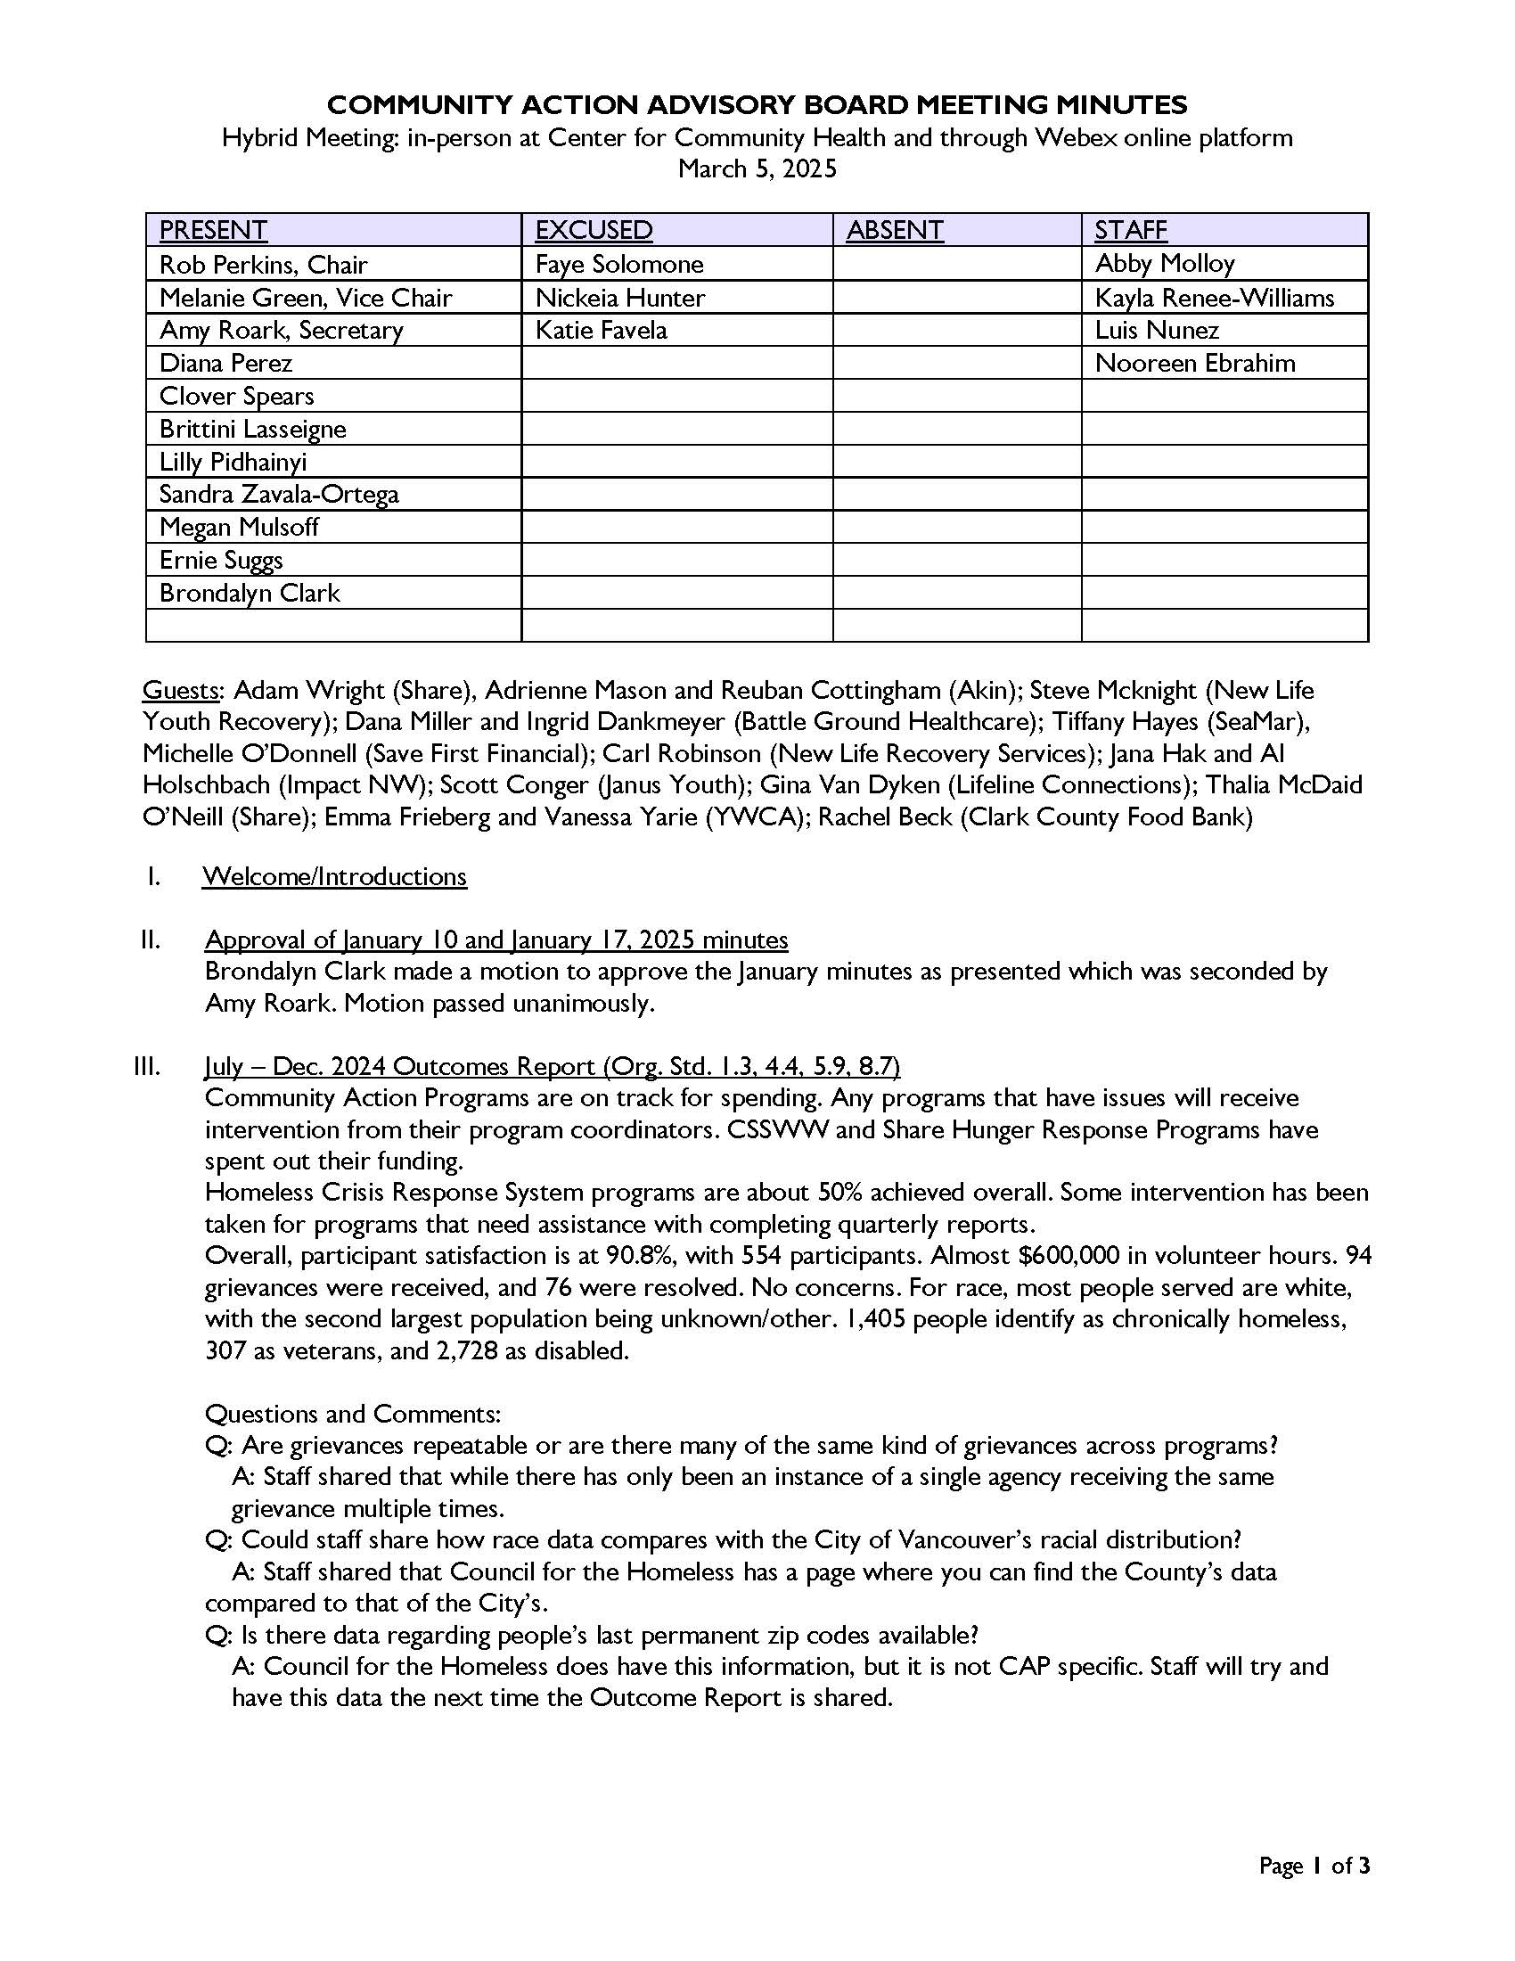
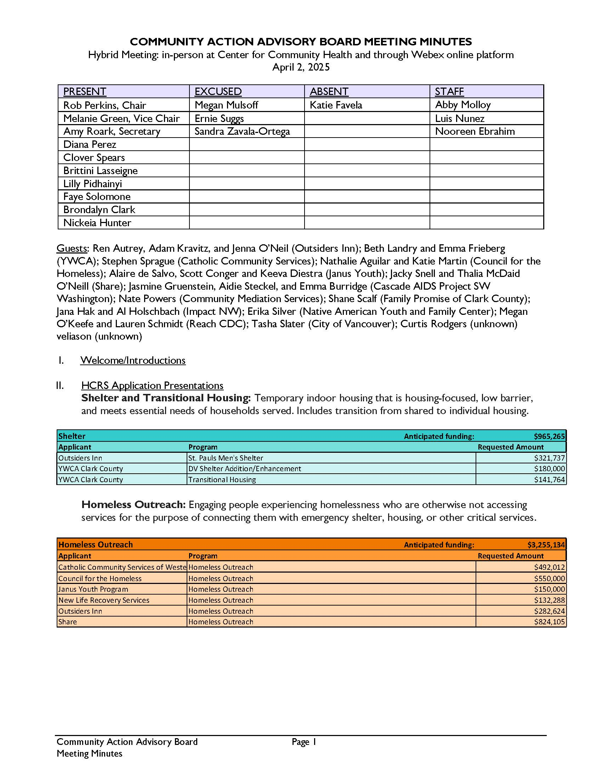
Approval of Mar and Apr 2025 Minutes

Slide 3
CAP and HCRS Funding Recommendations

Slide 4
CAP Funding Recommendations (action)
Physical Health |  | Available funding: |  | $113,500.00
Applicant | Program | Total Score | Requested Amount | Award
Share | Share’s Meal and Nutrition Programs | 95.5 | $113,500.00 | $113,500.00
Children's Home Society DBA Akin | Vancouver and Washougal Family Resource Centers Food Assistance Programs | 89.75 | $40,000.00
Battle Ground Healthcare | Battle Ground HealthCare Dental Services | 85.25 | $80,000.00
Free Clinic of SW WA | Free Clinic Dental Assistance | 81.5 | $50,000.00
New Life Friends Church | Food Assistance | 71.5 | $46,000.00
 |  |  | Total Funded: | $113,500.00
Income and Asset Building |  | Available funding: |  | $99,500.00
Applicant | Program | Total Score | Requested Amount | Award
Save First Financial | Save First Financial Wellness | 70.67 | $99,500.00 | $99,500.00
 |  |  | Total Funded: | $99,500.00
Transportation |  | Available funding: |  | $71,000.00
Applicant | Program | Total Score | Requested Amount | Award
New Life Recovery Services | Support Assistance Transportation (SAT) Program | 83.25 | $71,000.00 | $71,000.00
 |  |  | Total Funded: | $71,000.00

Slide 5
HCRS Funding Recommendations (action)
Rapid Re-housing |  |  | Available funding: | $ 588,415.00
Applicant | Program | Total Score | Requested Amount | Award
Impact Northwest | Impact Northwest's Rapid Re-Housing | 93.75 | $ 488,415.00 | $ 488,415.00
Janus Youth Programs | Nest | 88.5 | $ 207,858.00 | $ 100,000.00
YWCA Clark County | Rapid Re-Housing for Survivors of Domestic Violence | 87.75 | $ 200,000.00
Share | Share's Rapid Re-housing Program | 87.5 | $ 400,000.00 | $ -
Lifeline Connections | Lifeline Connections' Rapid Re-housing Program | 66.75 | $ 150,000.00 | $ -
 |  |  | Total Funded: | $ 588,415.00
Permanent Supportive Housing |  |  | Available funding: | $ 931,863.00
Applicant | Program | Total Score | Requested Amount | Award
Impact Northwest | PSH HUD | 92.33 | $ 20,215.00 | $ 20,215.00
Impact Northwest | PSH | 92 | $ 266,648.00 | $ 266,648.00
Share | PSH HUD | 89.33 | $ 195,000.00 | $ 195,000.00
Share | PSH | 88.67 | $ 500,000.00 | $ 450,000.00
 |  |  | Total Funded: | $ 931,863.00
SOAR |  |  | Available funding: | $52,000
Applicant | Program | Total Score | Requested Amount | Award
Sea Mar- CNSW | SOAR (SSI/SSDI Outreach, Access, and Recovery) | 72.8 | $52,000 | $ 52,000.00
 |  |  | Total Funded: | $ 52,000.00

Slide 6
HCRS Funding Recommendations (action)
Temporary Housing Supports |  |  | Available funding: | $ 571,764.00
Applicant | Program | Total Score | Requested Amount | Award
YWCA Clark County | Transitional Housing | 89.8 | $ 141,764.00 | $ 141,764.00
YWCA Clark County | DV Shelter Addition/Enhancement | 88 | $ 180,000.00 | $ 180,000.00
Outsiders Inn | St. Pauls Men's Shelter | 76.4 | $ 321,737.00 | $ 250,000.00
 |  |  | Total Funded: | $ 571,764.00
Homeless Outreach |  |  | Available funding: | $ 874,105.00
Applicant | Program | Total Score | Requested Amount | Award
Share | Homeless Outreach | 95 | $ 824,105.00 | $ 824,105.00
Janus Youth Program | Homeless Outreach | 90.67 | $ 150,000.00 | $ 50,000.00
Outsiders Inn | Homeless Outreach | 85.33 | $ 282,624.00 | $ -
Council for the Homeless | Homeless Outreach | 83 | $ 550,000.00 | $ -
Catholic Community Services of Western WA | Homeless Outreach | 78 | $ 492,012.00 | $ -
 |  |  | Total Funded: | $ 874,105.00

Slide 7
HCRS Funding Recommendations (action)
EPRAP |  |  | Available funding: | $ 3,307,000.00
Applicant | Program | Total Score | Requested Amount | Award
Native American Youth & Family Center | EPRAP | 85.5 | $ 653,818.00 | $ 653,818.00
Share | EPRAP | 85 | $ 850,000.00 | $ 850,000.00
Impact NW | EPRAP | 81.5 | $ 786,082.00 | $ 786,082.00
Janus Youth Program | EPRAP | 79.75 | $ 732,297.00 | $ 732,297.00
YWCA Clark County | EPRAP | 78.5 | $ 565,000.00 | $ 284,803.00
Cascade AIDS Project SW WA | EPRAP | 78.25 | $ 215,000.00 | $ -
Family Promise of Clark County | EPRAP | 70.5 | $ 100,000.00 | $ -
Reach CDC | EPRAP | 62.25 | $ 313,992.40 | $ -
Community Mediation Services | EPRAP | 59 | $ 300,000.00 | $ -
Council for the Homeless | Targeted Prevention | 58 | $ 315,000.00 | $ -
 |  |  | Total Funded: | $ 3,307,000.00

Slide 8
CAP and HCRS RFA Next Steps
CAAB recommendations must be approved by County Council
Staff report will be drafted and sent to Council
Staff will inform the board when the Council meeting for the approval of the recommendations is determined
Staff will draft contracts to begin July 1
Staff will create quarterly reports to monitor program activity
Staff will create a monitoring plan to verify programs are meeting contract requirements

Slide 9
RFA Reflection
What were the biggest challenges during this scoring process?
What did you think went well during this scoring process?
What would you recommend doing differently next time?

Slide 10
Finance Reports (information)
July – December 2024 All Funding Finance Report
Rhonda Hills, Alissa Page
PDFs of the reports will be sent in the follow-up email
Separate expense and revenue reports

Slide 11
Finance Reports: Funding Expended by Fund Source
Distribution of funding expended by fund source July – December 2024.

Slide 12
Finance Reports: Funding Expended by Service Type
Distribution of funding expended by type of service provided July – December 2024.

Slide 13
Finance Reports: Funding Expended by Service Type
Distribution of funding by type of service provided. Compares regular and COVID funds expended July – December 2024.

Slide 14
Finance Reports: Revenue Fund Sources
Comparison of fund sources received between state, local and federal awards. Allocation timelines vary.

Slide 15
Finance Reports: Revenue Fund Categories
Comparison of funds received between allocation types. Allocation timelines vary.

Slide 16
Finance Reports: Clark County Annual Audit
Clark County undergoes an annual audit for all funding.
Results are posted online at http://portal.sao.wa.gov/reportsearch
Most recent audit report was issued 9/05/2024 for the period January 1, 2023 through December 31, 2023
No findings were identified, including for funds overseen by Community Services

Slide 17
Task Force Updates
Legislative Advocacy Task Force
Brittini Lasseigne
Community Needs Assessment Task Force
Abby Molloy
Notes:
CNA: English, Spanish and Russian versions on website. Still waiting on other translations
Policy:

Slide 18
City of Vancouver Affordable Housing and Homelessness Update
Samantha Whitley

Slide 19
Housing Team Updates
Rental Habitability
AHF Awards
Federal Awards
Samantha Whitley, Housing Programs Manager Economic Prosperity & Housing

Slide 20
Rental Registration
Online Rental Registration
Annual Fee
Tenant Relocation Assistance
Outreach & Education
Registration to start 2026
Inspections to start 2027
Council to review May or June

Slide 21
2025 AHF
Recommendations
6 applications received
$28.5M requested
5 applications recommended

Slide 22
AHF Rental Unit Production and Preservation
Developer | Project Name | Recommended Award | AHF Units | Total Units
Community Roots | Mill Plain Tiny Homes | $1,050,000 | 14 | 20
Palindrome | Artifact – Heights Site C | $4,100,000 | ~55 | 109
Mid-Columbia Manor | Smith Tower Preservation | $2,000,000 | 50 | 170
VHA | Heights Site P Senior Housing | $1,000,000 | ~14 | 51
VHA | Heights Site P Family Housing | $3,000,000 | ~40 | 80
 |  | $11,150,000 | 177 units | 330 units

Slide 23
Recommended HUD Funding
Rental Assistance $468,500
Janus Youth Programs
Share
Capacity Building $255,000
Community Foundation
Supportive Services $710,000
Council for the Homeless
Housing Connector
Thrive 2 Survive

Slide 24
Recommended HUD Funding
Business Assistance $309,000
Fourth Plain Forward
Hispanic Metropolitan Chamber
Microenterprise Services of Oregon
Public Service $215,800
Community Mediation Services
Council for the Homeless
Friends of the Children

Slide 25
May is Community Action Month!
Link to toolkit: https://communityactionpartnership.com/cam-2025/
Link to webinar: https://www.youtube.com/watch?v=p5cSRg6H_N4
Notes:
Every year, NCAP releases a community action month toolkit to support outreach and promotion efforts for the month of May. The toolkit was sent out and is linked here. This year, they also released a webinar about community action month and how to navigate and use the toolkit. It is also linked here and will be included in the follow up email if you would like to watch it. These are more for agencies to promote their work and the accomplishments of community action, but may be interesting and useful for you as well. There are some talking points about the importance and impact of this funding, which is under serious threat by the federal government. These talking points could be useful if you are planning on doing any advocacy around preserving this funding.

Slide 26
Open Public Forum and Other Business
Open Public Forum (up to 3 minutes)
Other Business
Adjourn
SAVE THE DATE
Next Equity Training: Wednesday, June 4, 9-11 am
Next Regular Meeting: Wednesday, July 2, 9-11 am

