Slide 1

Property Tax Exemption
PROGRAM FOR SENIORS AND PERSONS WITH DISABILITIES
Clark County Assessor’s Office
Assessment Services Team
Updtd 2025.

Slide 2
AGENDA
      Program Overview
      Qualifications and Eligibility
      Income Thresholds
      Income, explained
      Deductions, explained
      Required Documents
      2025 Update - ADUs
      How to Apply
      Conclusion/Contact
      Questions

Slide 3


OVERVIEW
Washington State Program
      Administered by each county Assessor’s office within WA state, with guidance from the Department of Revenue
      Rules of the program are set by State Legislature
      Purpose
      Reduce property taxes for senior citizens and people with disabilities, allowing them to remain in their home despite increasing property taxes.
      How it works
      Freezes the assessed value of the home and land
      Exempts taxpayers from paying voter-approved levies and part 2 of the state school tax
      Reduces the taxable value of the property based on income
      No obligation for repayment, no lien on the property
      Applications are renewed every 6 years maximum
Notes:
1.7.2013
3
‹#›

Slide 4

QUALIFICATIONS
To be eligible you must meet the following requirements on December 31st of the year before the tax is due.
      Own the home by December 31 of the assessment year.
      Reside in the home as your primary residence for 6 months of the assessment year and each year going forward
      Must qualify based on either age (61+)
      OR disability status - SSA, Doctor, or V.A.
      Income threshold: $62,000
Notes:
1.7.2013
4
‹#›

Slide 5
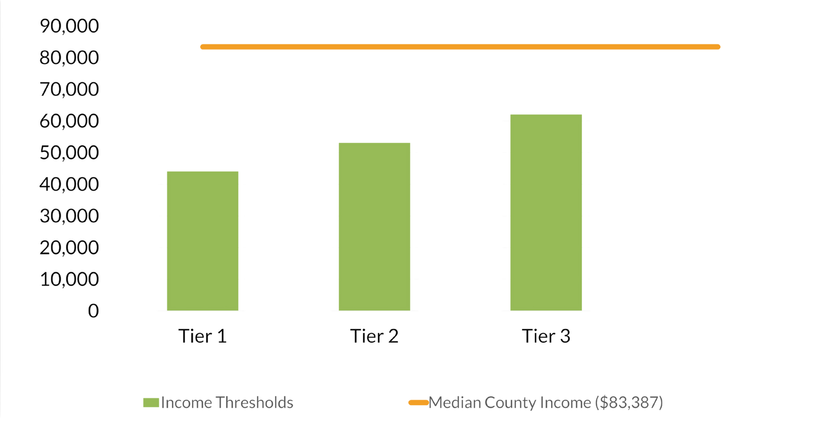
INCOME THRESHOLD
TIER 1: 0 - 44,000
Exempt from paying regular property tax on a portion of your assessed taxable value. Exempt from voter approved levies. Home and land value are frozen in qualifying year.
TIER 2: 44,001 - 53,000
Exempt from paying regular property tax on a portion of your assessed taxable value. Exempt from voter approved levies. Home and land value are frozen in qualifying year.
TIER 3: 53,001 - 62,000
Exempt from paying excess/voter-approved levies. Home and land value are frozen in the qualifying year.
Notes:
1.7.2013
5
‹#›

Slide 6
WHAT COUNTS AS INCOME?
Income includes:
    Wages (from W-2s)
    Pensions (1099s)
    Annuities (1099s)
    Social Security Benefits (1099s)
    Social Security Disability (1099s)
    IRAs (1099s)
    Interest (1099s)
    Dividends
    V.A. Retirement
Income excludes:
      V.A. Disability payments
      DSHS Payments
      Federal Stimulus Payments
      IRA Rollovers
      Reverse mortgages
      Must see documentation to support the income exclusion
Notes:
1.7.2013
6
‹#›

Slide 7
WHAT COUNTS AS A DEDUCTION?
Allowable Deductions
    Out-of-pocket prescription drug expenses
    Medicare premiums (All “Parts”)
    In Home Care expenses
    Nursing or Adult family home expenses
    Medical/ Mobility equipment expenses
    Long Term Care Insurance Premiums paid
    Health Insurance cost sharing out of pocket expenses
    Naturopathic treatments from Washington licensed naturopath
    Disposable medical supplies
    Prosthetic device expenses
    And more...
Notes:
1.7.2013
7
‹#›

Slide 8


REQUIRED DOCUMENTS
With application, please provide:
      Drivers License or State ID Card
      Disability Award Letter
      Complete Tax Return including all schedules (if filed)
      Pension/Annuity 1099s
      Social Security 1099s
      If you don’t file taxes – provide all W2’s and all 1099’s showing income
      Any expenses for allowed deductions
      If applicable:
      Death Certificate for any owners
      Divorce Decree
      Copy of entire trust (with declaration of trust)

Slide 9

2025 UPDATES - ADUs
    Starting in 2025, accessory dwelling units (ADUs) may be eligible to be included in the exemption program!
    These changes result in a greater reduction of property taxes for the applicant because the value of the ADU is included in the reduced valuation for the program(s).
    HB2375 defines an ADU as “a separate, autonomous residential dwelling unit that provides complete independent living facilities for one or more persons and includes permanent provisions for living, sleeping, eating, cooking, and sanitation.” It adds this meaning of ADU to the definition of a “residence.”
    Examples of ADUs may include:
      Hardship mobile homes
      Above-garage apartments/renovated garages
      Backyard cottages/tiny homes

Slide 10

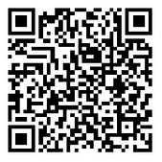
HOW TO APPLY
      Online: Clark.wa.gov/Assessor
      Email: taxreduction@clark.wa.gov
      Mail: Send to -
      Senior Exemption
      Clark County Assessor’s Office
      PO Box 5000
      Vancouver WA 98666
      Assessor’s Office:
      2nd floor of the Public Service Center
      Monday – Thursday 9:00am to 4:00pm
      Appointments available select days - call for more information
      564-397-2391
      Drop Box:
      Located at the Clark County Public Service Center
      1300 Franklin St, First Floor
      Monday – Friday between the hours of 9:00am to 5:00pm
Notes:
1.7.2013
Add QR code
9
‹#›

Slide 11
Thank you!
QUESTIONS?
Clark County Assessor’s Office
Assessment Services Team
Updtd 2025

