Slide 1
VAB Agenda – August 14, 2025
Call to Order, Pledge, Invocation, Roll Call (action)
Approval of June 12, 2025 minutes (action)
Special Election – Vice Chair & Special Appointment – P&P chair (action)
Committee Reports (info)
Fort Vancouver Quilts of Valor Presentation (info)
May and June 2025 Contractor and Fund Reports (info)
Veterans Assistance Center Updates (info)
Old Business (info)
New Business (info)
Open Forum (info)
Adjourn
Notes:
Open QOVF.com

Slide 2
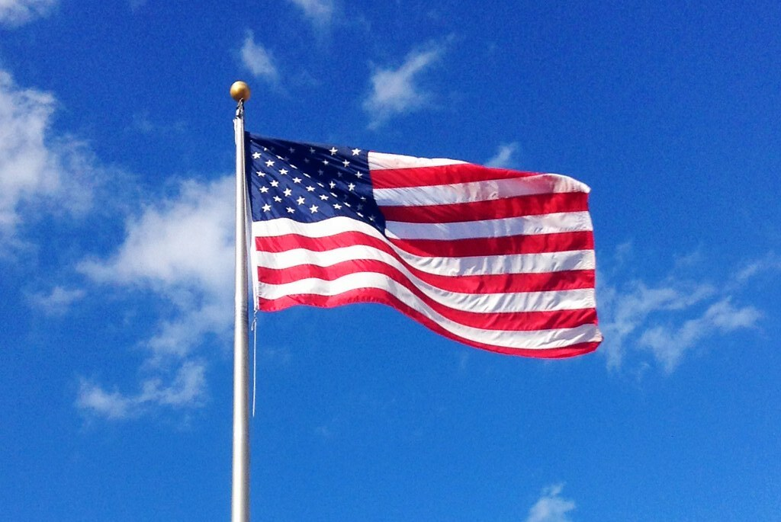
Agenda Item I. Call to Order/Pledge/Invocation/Roll Call

Slide 3
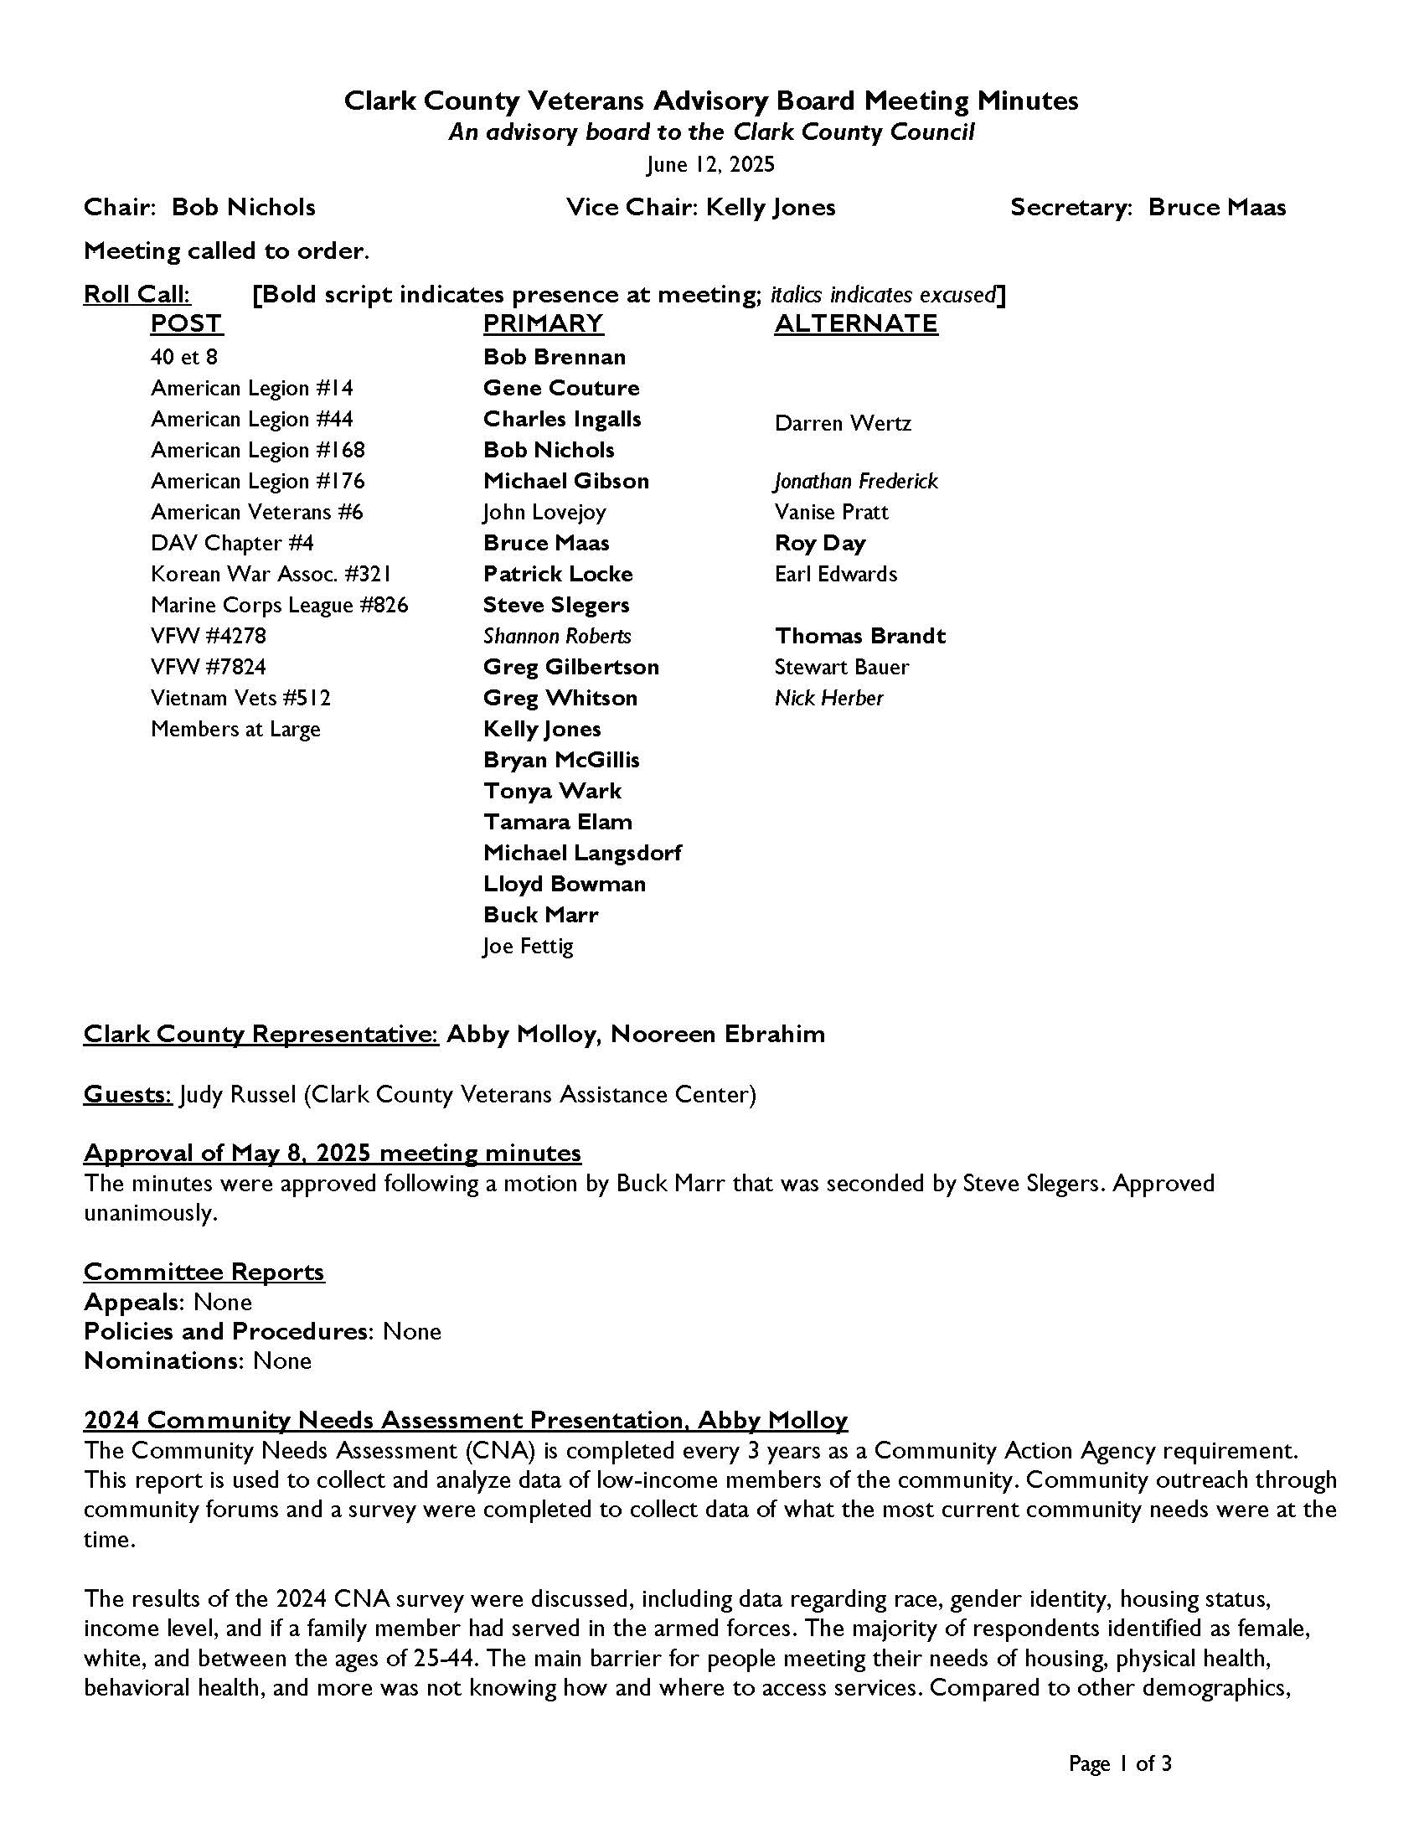
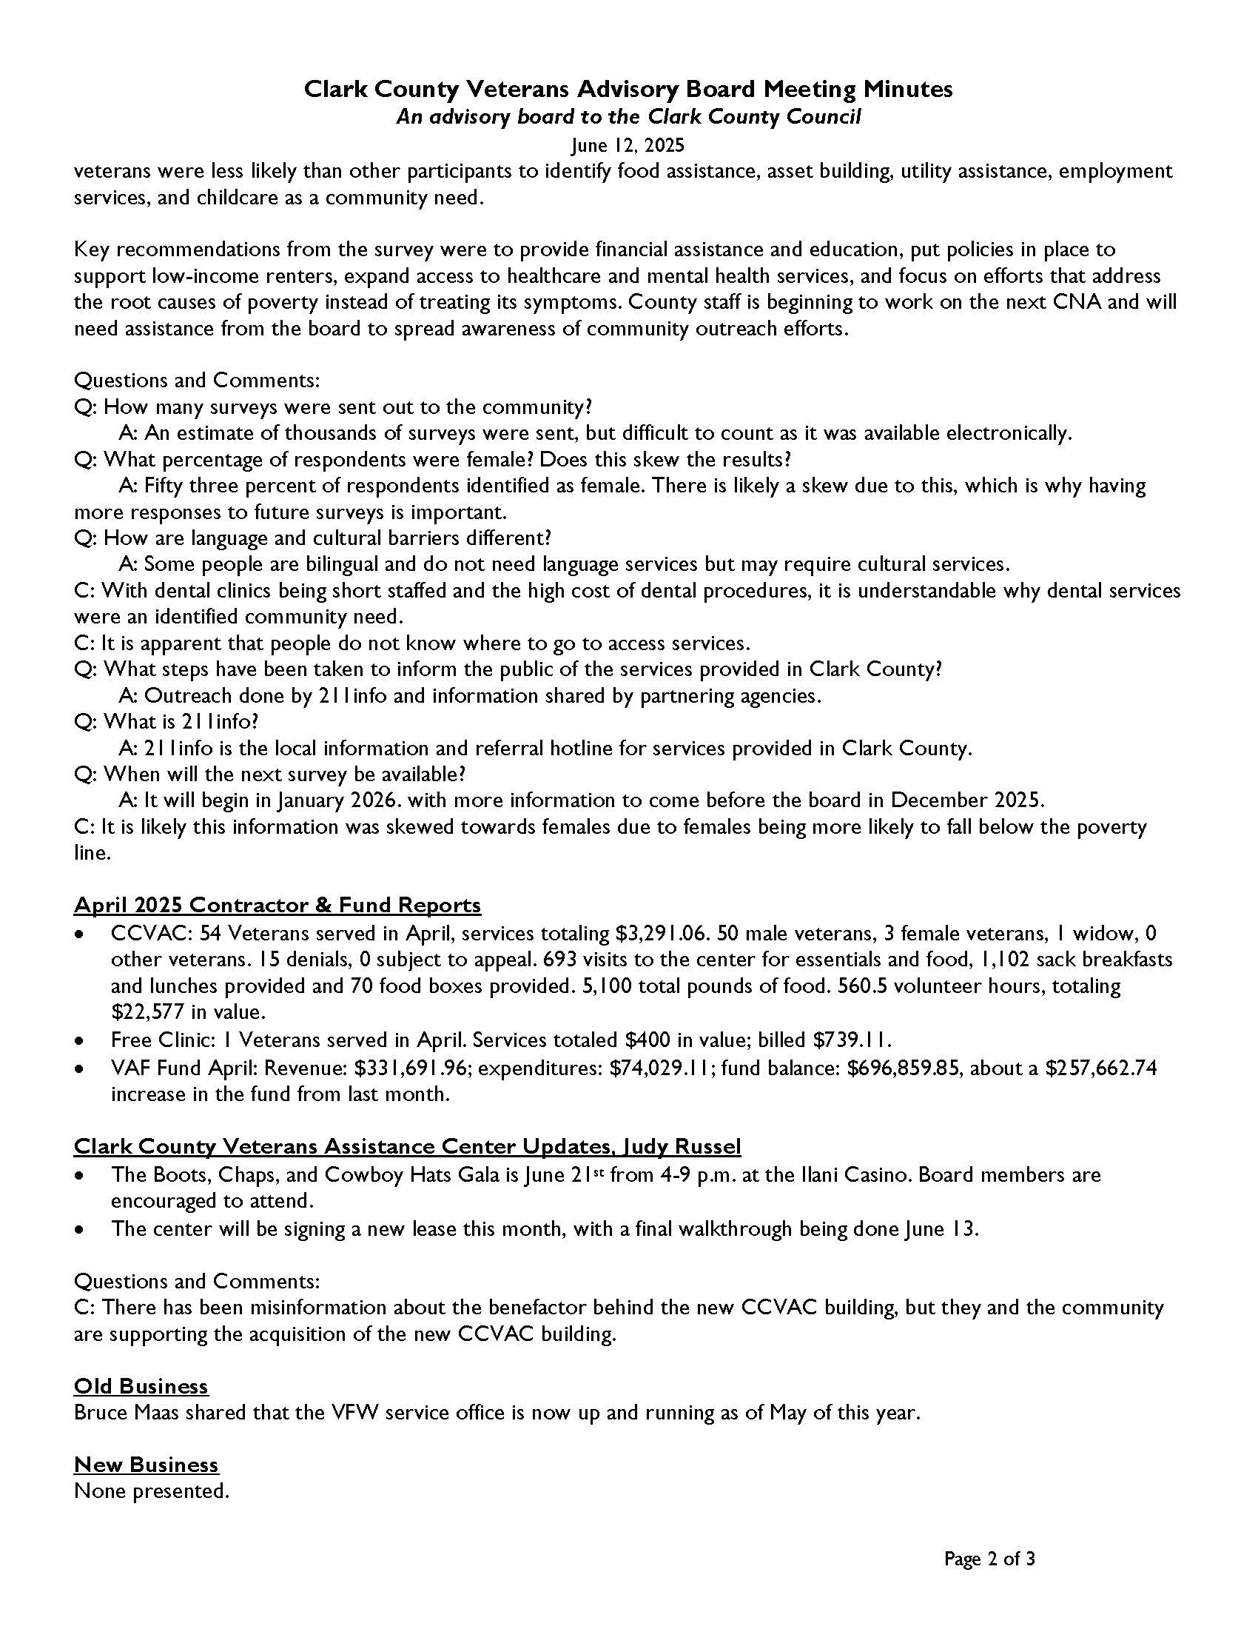
Agenda Item II. Approval of June 12th minutes

Slide 4
Agenda Item III. Special Election and Appointment
1. Special Election – Vice Chair
2. Special Appointment – Policies and Procedures Chair

Slide 5
Agenda Item IV. Committee Reports
Appeals – Gene Couture
Policies and Procedures – TBD
Nominations – Bruce Maas

Slide 6

Notes:
Open QOVF.com

Slide 7
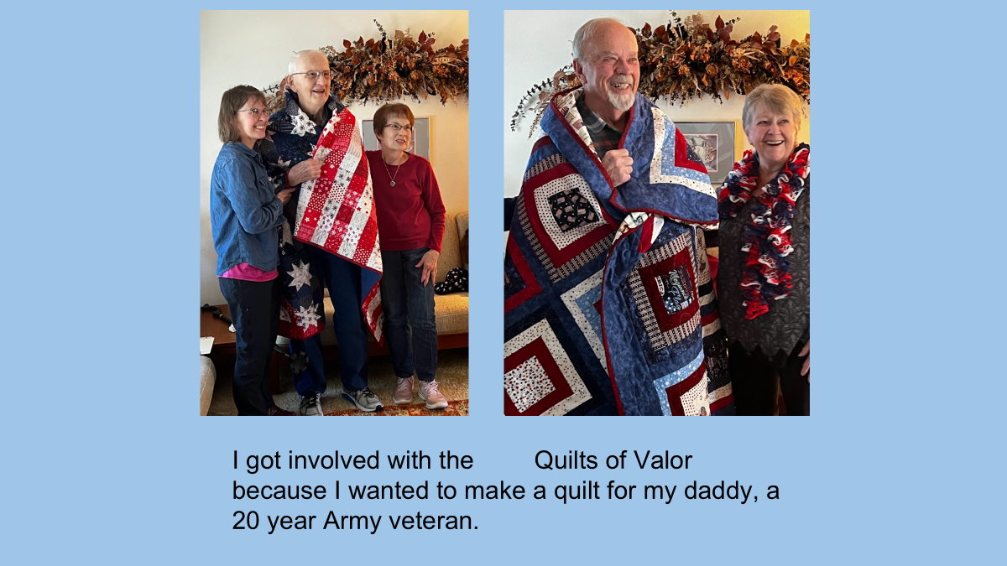

Slide 8
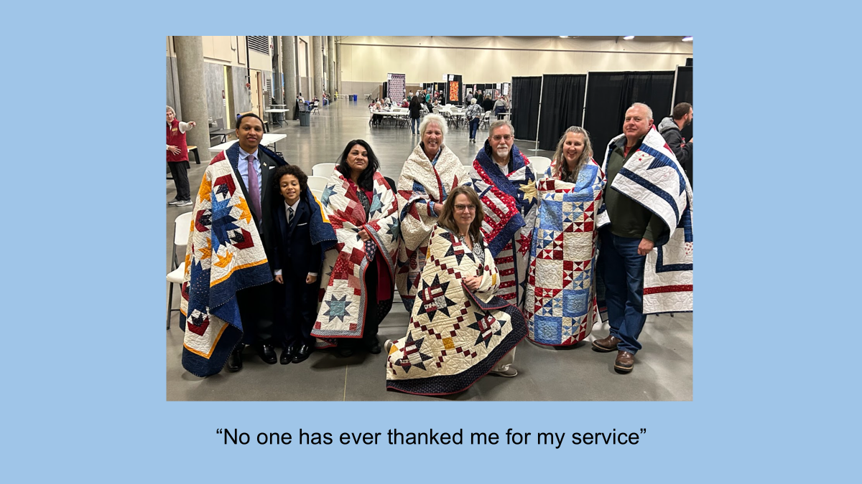

Slide 9
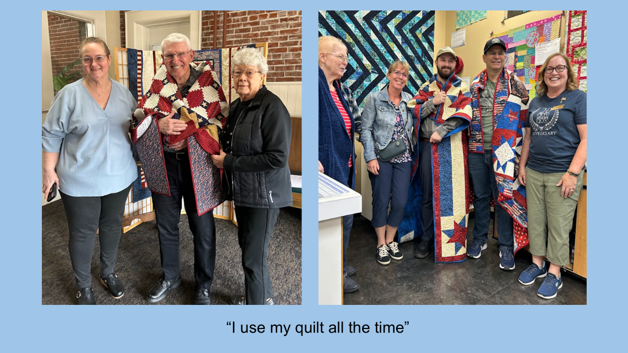

Slide 10
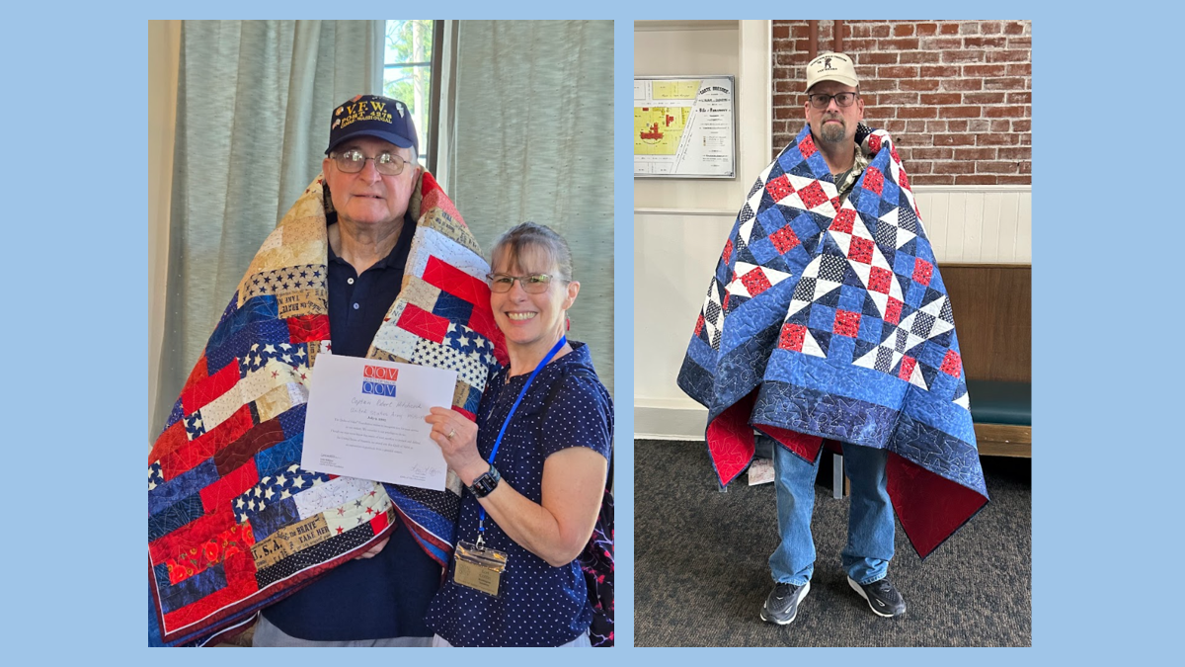

Slide 11
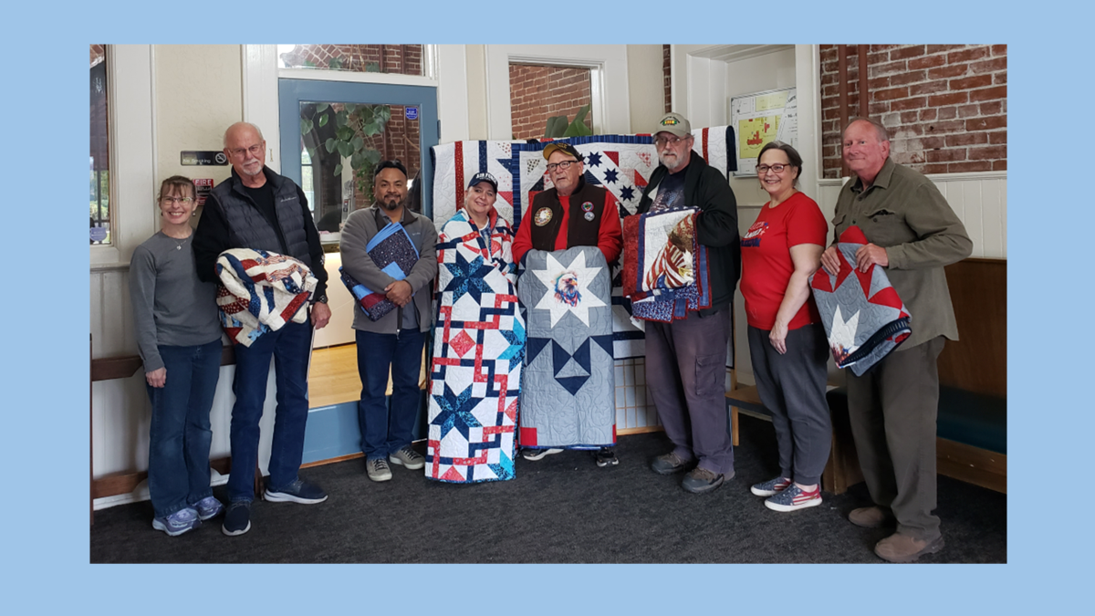

Slide 12
Agenda Item VI. May 2025 Contractor Reports
CCVAC
  53 Veterans served in May, services totaling $44,936.60
  49 male Veterans, 4 female Veterans, 0 widows, and 0 others served
  10 denials, 0 subject to appeal
  654 visits to the center for essentials and food. 1,036 sack breakfasts and lunches and 54 food boxes provided. 4,043 total pounds of food provided.
  523 volunteer hours, totaling $21,066 in value
Free Clinic
  2 veterans served in May. Services totaled $3,036 in value. Billed $3,204.38.
Fund
  May revenue: $82,340.48; expenditures: $125,566.94
  Fund balance: $653,633.39 ($43,226.46 decrease from last month)
Notes:
December fund balance will be updated

Slide 13
Agenda Item VI. June 2025 Contractor Reports
CCVAC
  51 Veterans served in June, services totaling $48,071.07
  43 male Veterans, 8 female Veterans, 0 widows, and 0 others served
  5 denials, 0 subject to appeal
  537 visits to the center for essentials and food. 848 sack breakfasts and lunches and 52 food boxes provided. 4,173 total pounds of food provided
  709.5 volunteer hours, totaling $28,579 in value
Free Clinic
  1 veteran served in June. Services totaled $454 in value. Billed $732.51
WDVA
  Second quarter: 622 claims, 93% “batting average”, $1,354,208 VA payments.
Fund
  June revenue: $10,670.64; expenditures: $85,121.60
  Fund balance: $579,182.43 ($74,450.96 decrease from last month)
Notes:
December fund balance will be updated

Slide 14

Agenda Item VII. CCVAC updates

Slide 15
Agenda Items VIII. – XI.
Old Business
New Business
Open Forum
Adjourn
Next meeting: September 11, 2025

