Slide 1








URBAN COUNTY POLICY BOARD
Welcome!
September 8, 2025 Agenda
This meeting is being recorded
Please announce your name when speaking
Chat function is for technical assistance only
Call-in users can unmute using *6
(info) | I. | Introductions
(info) | II. | Public Comment
(action) | III. | Approval of Minutes: June 9, 2025
(action) | IV. | LLC TBRA Funding Request
(info) | V. | CAPER Outcome Overview
(info) | VI. | Quarterly Report Review
(info) | VII. | 2026 RFA Overview
(info) | VIII. | Program Updates
(info) | IX. | Other
Clark County Intergovernmental Agreement Members:
Notes:
Docs to open:
START RECORDING

Slide 2
Item II. Public Comment (info)
Up to 3 minutes per person
Comments must be specific to the work of the Urban County Policy Board
Community Development Block Grant (CDBG) funding
HOME Investment Partnerships funding
CDBG/HOME Request for application process
Five-Year Consolidated Plan and Annual Action Plans
Local projects and programs funded with county CDBG and HOME funds
Reports (local and federal)

Slide 3
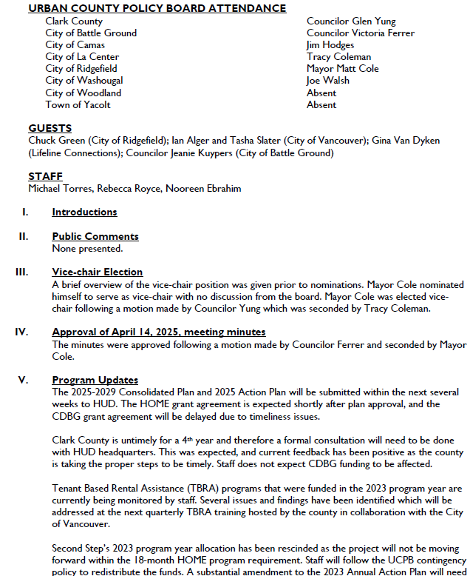
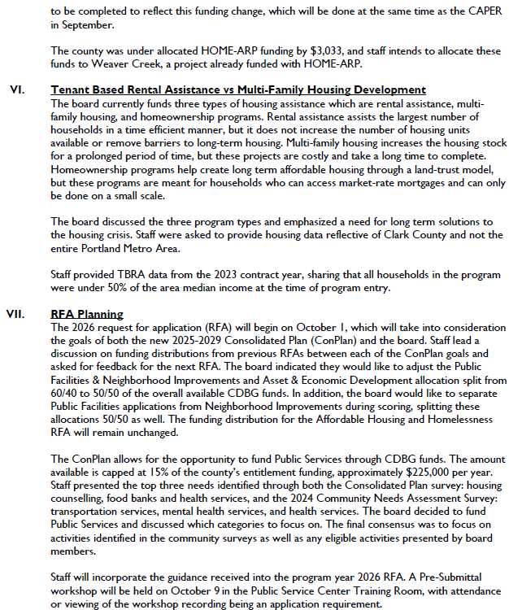
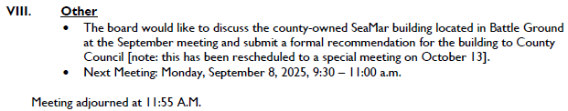
Item III. June 9 Meeting Minutes (action)

Slide 4
Item IV. LLC TBRA Additional Funds Request
LLC is making a formal request to the UCPB for additional funding for their program year 2024 contract
Provides assistance from January through December 2025
Original award: $87,816
UCPB Funding and Application Guidelines require the UCPB to review and approve any requests for additional funds above 10% of the original award
Request for an additional $90,000.
Funds available through program income collected during the year
No CDBG funds available to support the case management side of the program
LLC staff available to provide overview and answer questions
Notes:
The original award was the agency’s full request.
Guidelines: Contingency Fund Guidelines section 4
Did not apply for 2025 funds

Slide 5
Item V. CAPER Overview (info)
Consolidated Annual Performance Evaluation Report (CAPER)
Accomplishments and spending for PY2024 (July 1, 2024 to June 30, 2025)
Final year of the previous Consolidated Plan
County Council presentation and public hearing 9/23 10am
Draft CAPER released for public comment 8/22
The Columbian, News Release, County social media, email to stakeholders
Comments accepted through 9/22 and at public hearing
Due to HUD by 9/27

Slide 6
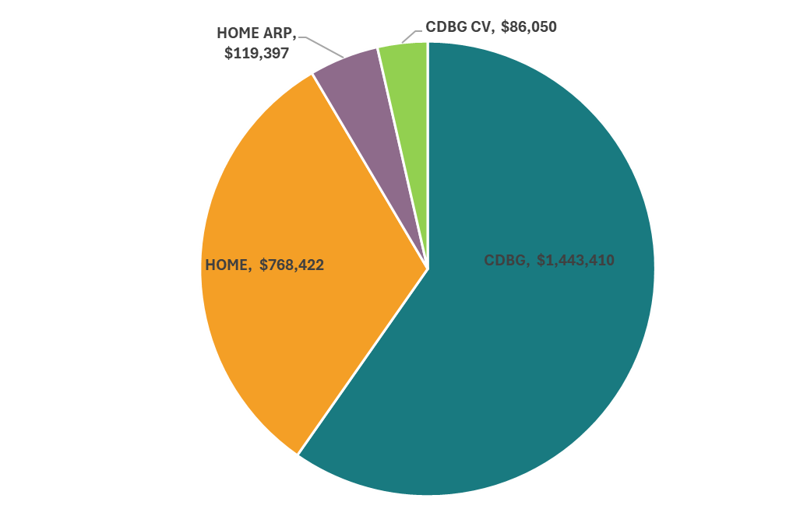
2024 Total CDBG and HOME Spending
Funding Source | Amount
Community Development Block Grant | $1,443,410
HOME Investment Partnerships Program | $768,422
CDBG-CV – COVID Relief | $86,050
HOME-ARP – American Rescue Plan Act | $119,397
Total | $2,471,279
Notes:
Overall spending was down nearly 20% from PY2023 spending.
Several CDBG funded activities have moved through the environmental review phase and will be starting construction in early spring.
HOME-ARP balance is going to the Weaver Creek project, set to start construction later this year.
CDBG-CV are just about spent out.

Slide 7
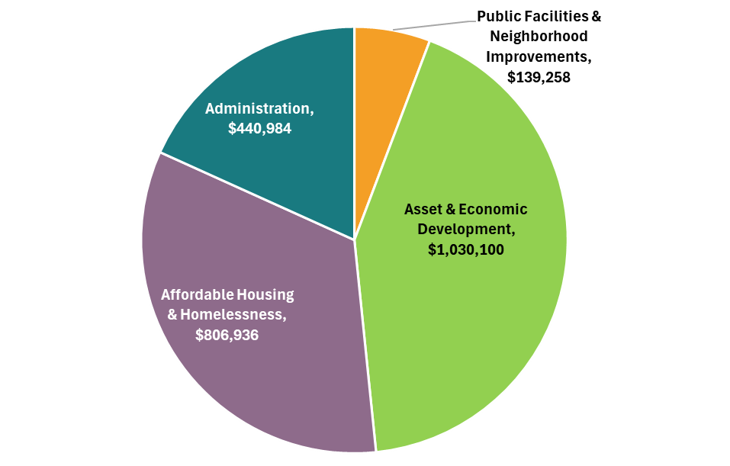
2024 Total Spending by Activity Type
Activity Type | Amount
Affordable Housing & Homelessness | $806,936
Public Facilities & Neighborhood Improvements | $139,258
Economic Development & Homeownership | $1,030,100
Administration | $440,984
Total | $2,417,278
Notes:
Significant reduction in the amount of PFNI projects in PY2024, from nearly $1m spent in PY23.

Slide 8
2024 Reported Activities
Public Facilities & Neighborhood Improvements | Asset & Economic Development | Affordable Housing & Homelessness
Washougal Hamllik Park Improvements | Fourth Plain Forward Business Assistance | Janus Youth TBRA
Council for the Homeless Housing Solutions Center Acquisition | Greater Vancouver Chamber of Commerce Business Assistance | Lifeline Connections TBRA
 | Hispanic Metropolitan Chamber Business Assistance | The Salvation Army TBRA
 | Housing Preservation Program | Share TBRA
 | Proud Ground Homebuyer Assistance | YWCA TBRA

Slide 9
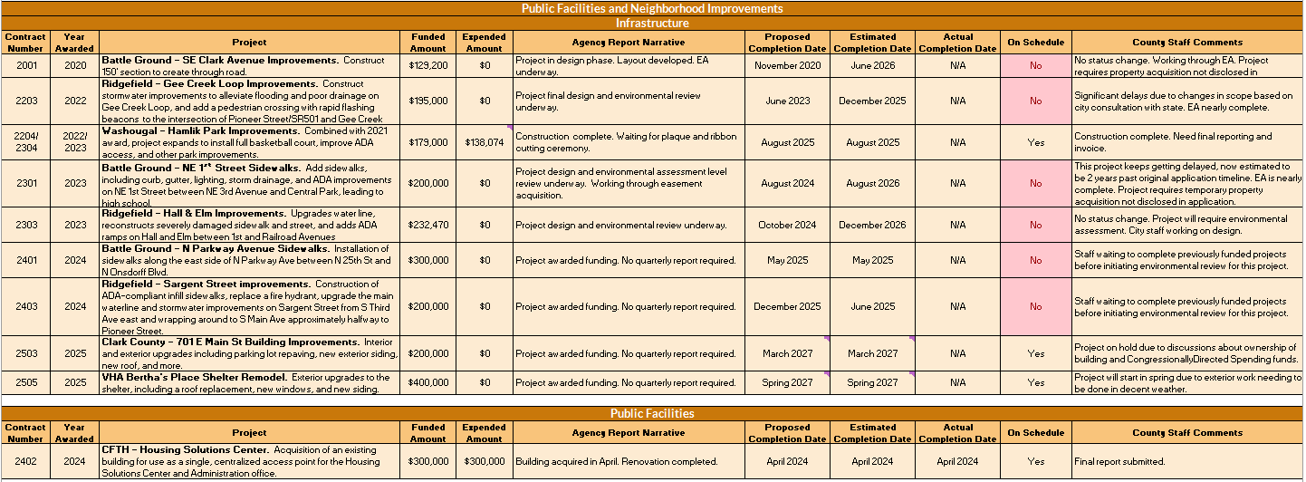
Item VI. April-June 2025 Qrtly Report Review (info)
Notes:
Quarterly report was included in the meeting reminder.
No status change for BG SE Clark and Ridgefield Hall & Elm. EA’s nearly complete for BG NE 1st St, Weaver Creek and Ridgefield Gee Creek. Washougal Hamllik Park construction complete, waiting on final reports and invoice.

Slide 10
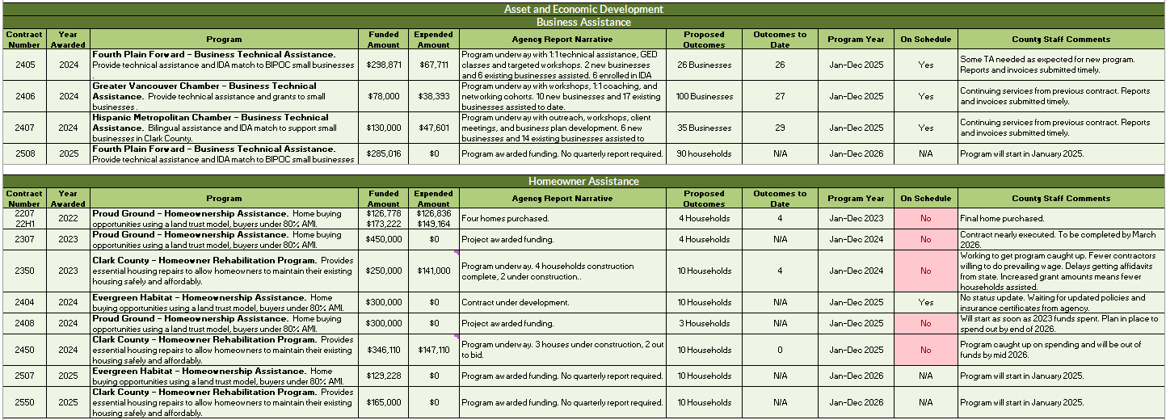
Item VI. April-June 2025 Qrtly Report Review (cont)
Notes:
Business Assistance programs are moving along smoothly. Proud Ground finished their 2022 contracts and moving to 2023 contract. Homeowner rehab is spending quickly and will need to slow down services due to lack of funds. Evergreen Habitat for Humanity is struggling to get their policies completed for their 2024 contract. Have been warned that if they don’t complete them by end of September, funding will be rescinded for not moving forward. Guidance is that projects need to move forward within 9 months and it has been almost 18 months.

Slide 11
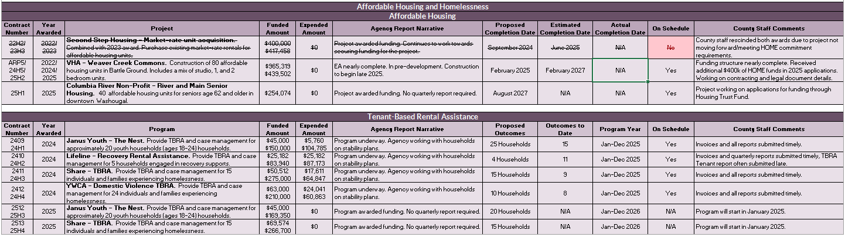
Item VI. April-June 2025 Qrtly Report Review (cont)
Notes:
TBRA programs are on track to meet or exceed outcomes.
Weaver Creek is finalizing funding structure, the EA is nearly complete and staff is working on contract documents and property legal documents (deeds, prom notes and covenants).

Slide 12
Item VII. 2026 Request for Applications Overview (info)
Applications and Funding Guides being updated
Staff review and update based on previous year’s applications and process
New requirement to attend or watch pre-submittal workshop video
Acquisition/relocation/right-of-way questions getting revamped
Expanding information in Funding Guides to be clearer on application and contract expectations
New Public Service application and Funding Guide under development
Combination of Community Services Block Grant and AED applications
Priority areas: transportation, health services (including mental health and dental), food assistance, housing counseling (rental or owner), childcare
Applications open October 1
Notes:
New requirement to attend or watch pre-submittal workshop video. We get many questions that are already answered during the workshop and are included in our FAQs. Hoping to curb some of the staff time needed to respond to these inquiries.
Acquisition/relocation/right-of-way questions tied to Uniform Relocation Act requirements. Have projects that indicated no acquisition or relocation required, but now coming up during design which is delaying projects due to the URA requirements. Temporary construction easements fall into this category.

Slide 13
Item VII. 2026 Request for Applications Overview (action)
Request to increase homeowner rehab to $400k
Currently receives $250,000 + program income for services and implementation costs
Implementation costs will not increase
Average assistance is over $35,000 per household
Change from loans to grants results in less program income generated

Slide 14
Item VIII. Program Updates (info)
2025-2029 Consolidated Plan and 2025 Annual Action Plan submitted on August 13
HUD has 45 days to review, due by September 26
HOME grant agreement expected shortly after plan approval
CDBG grant agreement will be delayed due to timeliness issue
Timeliness Update
Submitted a response to HUD HQ on June 30
No response to date
Notes:
Staff providing updates on specific very late and late projects on next slides.

Slide 15
Item VIII. Program Updates (cont)
Status | PY | Project | Amount | Notes
Very Late | 2020 | Battle Ground SE Clark Ave | $129,000 | Originally attached to Weaver Creek. Now waiting for URA not disclosed in application.
Very Late | 2022 | Ridgefield Gee Creek | $195,000 | EA nearly complete. Delayed to spring/summer 2026 to reduce impacts to wetland.
Very Late | 2022/ 2023 | Washougal Hamllik Park | $179,000 | Construction complete. Waiting on final reports/invoice.
Very Late | 2023 | Battle Ground NE 1st Street | $200,000 | EA complete. Now waiting for URA for temp const easement not disclosed in application.
Very Late | 2023 | Ridgefield Hall & Elm | $232,470 | Will need EA. Starting review process.
Very Late | 2023 | Proud Ground Homebuyer | $450,000 | Contract nearly executed.
Notes:
Activities that have been removed from list: PG 2022 project, Homeowner Rehab 2022 and 2023 activities

Slide 16
Item VIII. Program Updates (cont)
Status | PY | Project | Amount | Notes
Late | 2024 | Battle Ground N Parkway Avenue Sidewalks | $300,000 | Waiting for previous two projects to be further in process.
Late | 2024 | Ridgefield Sargent Street Improvements | $200,000 | Waiting for previous two projects to be further in process.
Late | 2024 | Evergreen Habitat Homeownership Assistance | $300,000 | Issues with policies. Communication slow.
Late | 2024 | Proud Ground Homeownership Assistance | $300,000 | Will start once 2023 funds spent.

Slide 17
Item VIII. Program Updates (continued)
House and Senate FY2026 budgets release
House: CDBG $3.3B (level funding), HOME $0
Senate: CDBG $3.1B (slight decrease), HOME $1.25B (level funding)
Staff believe there will be funding for both programs
ROAD to Housing Act
Passed out of Senate Banking Committee unanimously
Pros and Cons with the bill
Working with NACCED to submit a response with recommendations
Notes:
ROAD = Renewing Opportunity in the American Dream to Housing Act of 2025
Pros:
Section 502 reauthorizes HOME program (not done since the 1990s) with some improvements
Permanently Authorizes the CDBG-DR program
Creates pilot program to convert vacant and abandoned buildings into affordable housing, but only if HOME funding is above $1.35B
Moves some environmental reviews from CENST to Exempt (slightly reduces the burden of the review, but negligible improvement)
Cons:
No change to ERR 20% capacity requirement that bumps projects up to an EA
Section 206 (Build Now Act) ties CDBG allocations to housing production despite the program’s long-standing purpose of supporting a broad range of community development needs, including infrastructure, public services, and economic development. If reach goal, get a bump in CDBG funding. If don’t, lose CDBG funding.
Can share letter once it’s sent.
FOR OCTOBER: Clark County has an approved request through Senator Patty Murray’s office for the Battle Ground building owned by the county with CDBG funds.
Both chambers include funding for Congressionally Directed Spending, previously known as earmarks
House = $2.3B
Senate = $1.351B

Slide 18
Wrap Up
VIII. Other
Good of the Order
Save the Date - next UCPB meeting: October 13, 2025, 9:30 – 11:00am
Special meeting to discuss the county-owned Battle Ground building purchased through CDBG

