Slide 1
VAB Agenda – October 9, 2025
Call to Order, Pledge, Invocation, Roll Call (action)
Approval of September 11, 2025 minutes (action)
Committee Reports (info)
August 2025 Contractor and Fund Reports (info)
Veterans Assistance Center Updates (info)
Old Business (info)
New Business (info)
Open Forum (info)
Adjourn
Notes:
Open QOVF.com

Slide 2
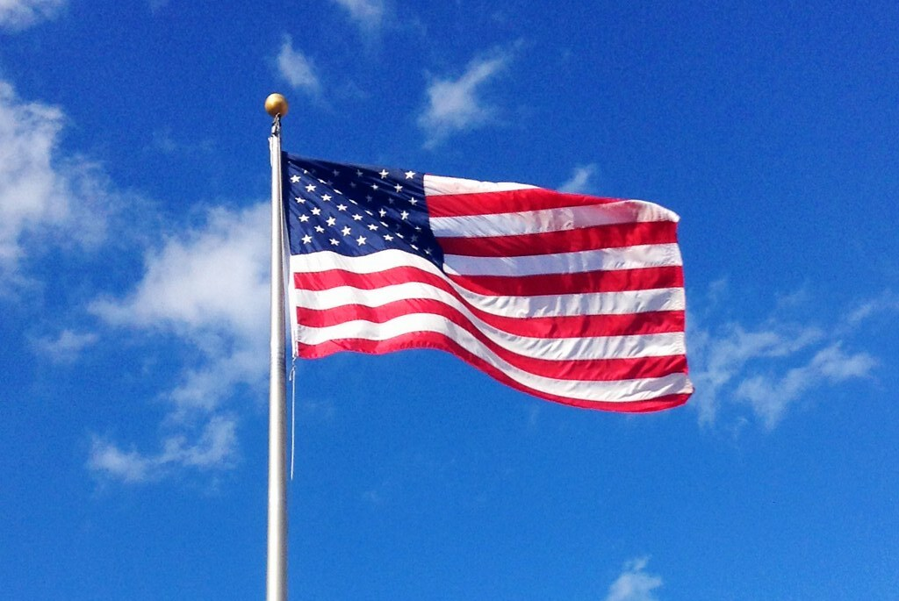
Agenda Item I. Call to Order/Pledge/Invocation/Roll Call

Slide 3
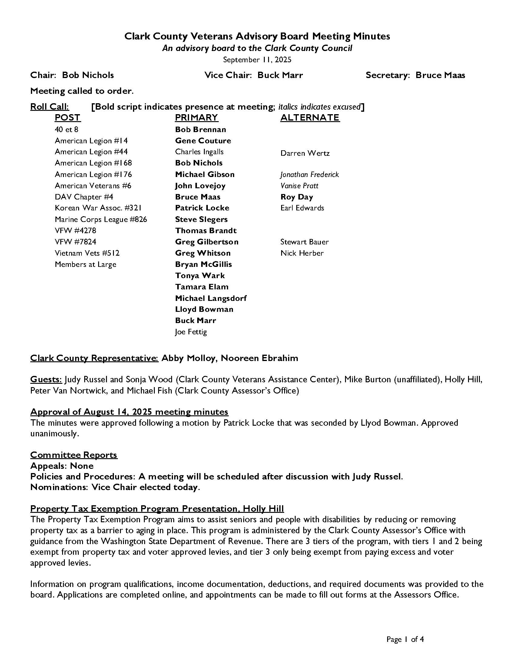
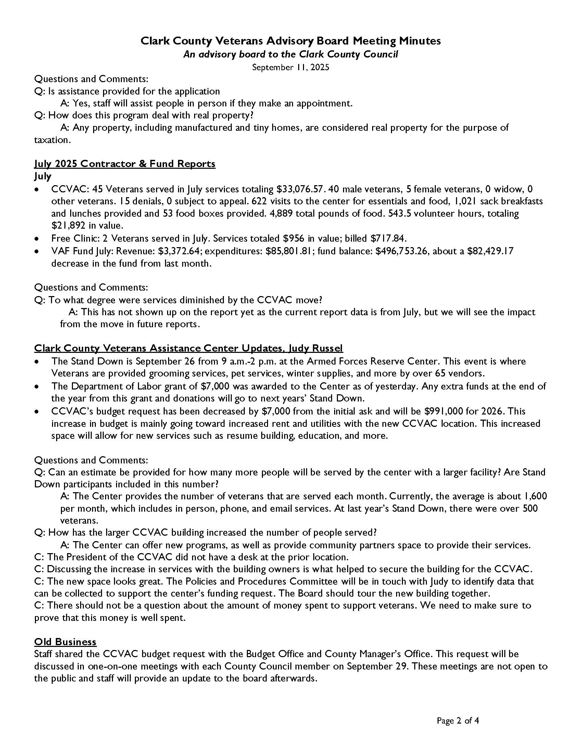
Agenda Item II. Approval of September 11th minutes

Slide 4
Agenda Item III. Committee Reports
Appeals – Gene Couture
Policies and Procedures – Greg Gilbertson
Nominations – Bruce Maas

Slide 5
Shanley Reed Introduction

Slide 6


Slide 7
Agenda Item IV. August 2025 Contractor Reports
CCVAC
  34 Veterans served in August, services totaling $32,762.82
  28 male Veterans, 6 female Veterans, 1 widow, and 0 others served
  7 denials, 0 subject to appeal
  411 visits to the center for essentials and food. 574 sack breakfasts and lunches and 46 food boxes provided. 2,970 total pounds of food provided
  548 volunteer hours, totaling $22,073 in value
Free Clinic
  0 veterans served in August. Services totaled $0 in value. Billed $702.57
Fund
  August revenue: $37,176.08; expenditures: $93,602.72
  Fund balance: $440,326.62 ($56,426.64 decrease from last month)
Notes:
December fund balance will be updated

Slide 8

Agenda Item V. CCVAC updates

Slide 9
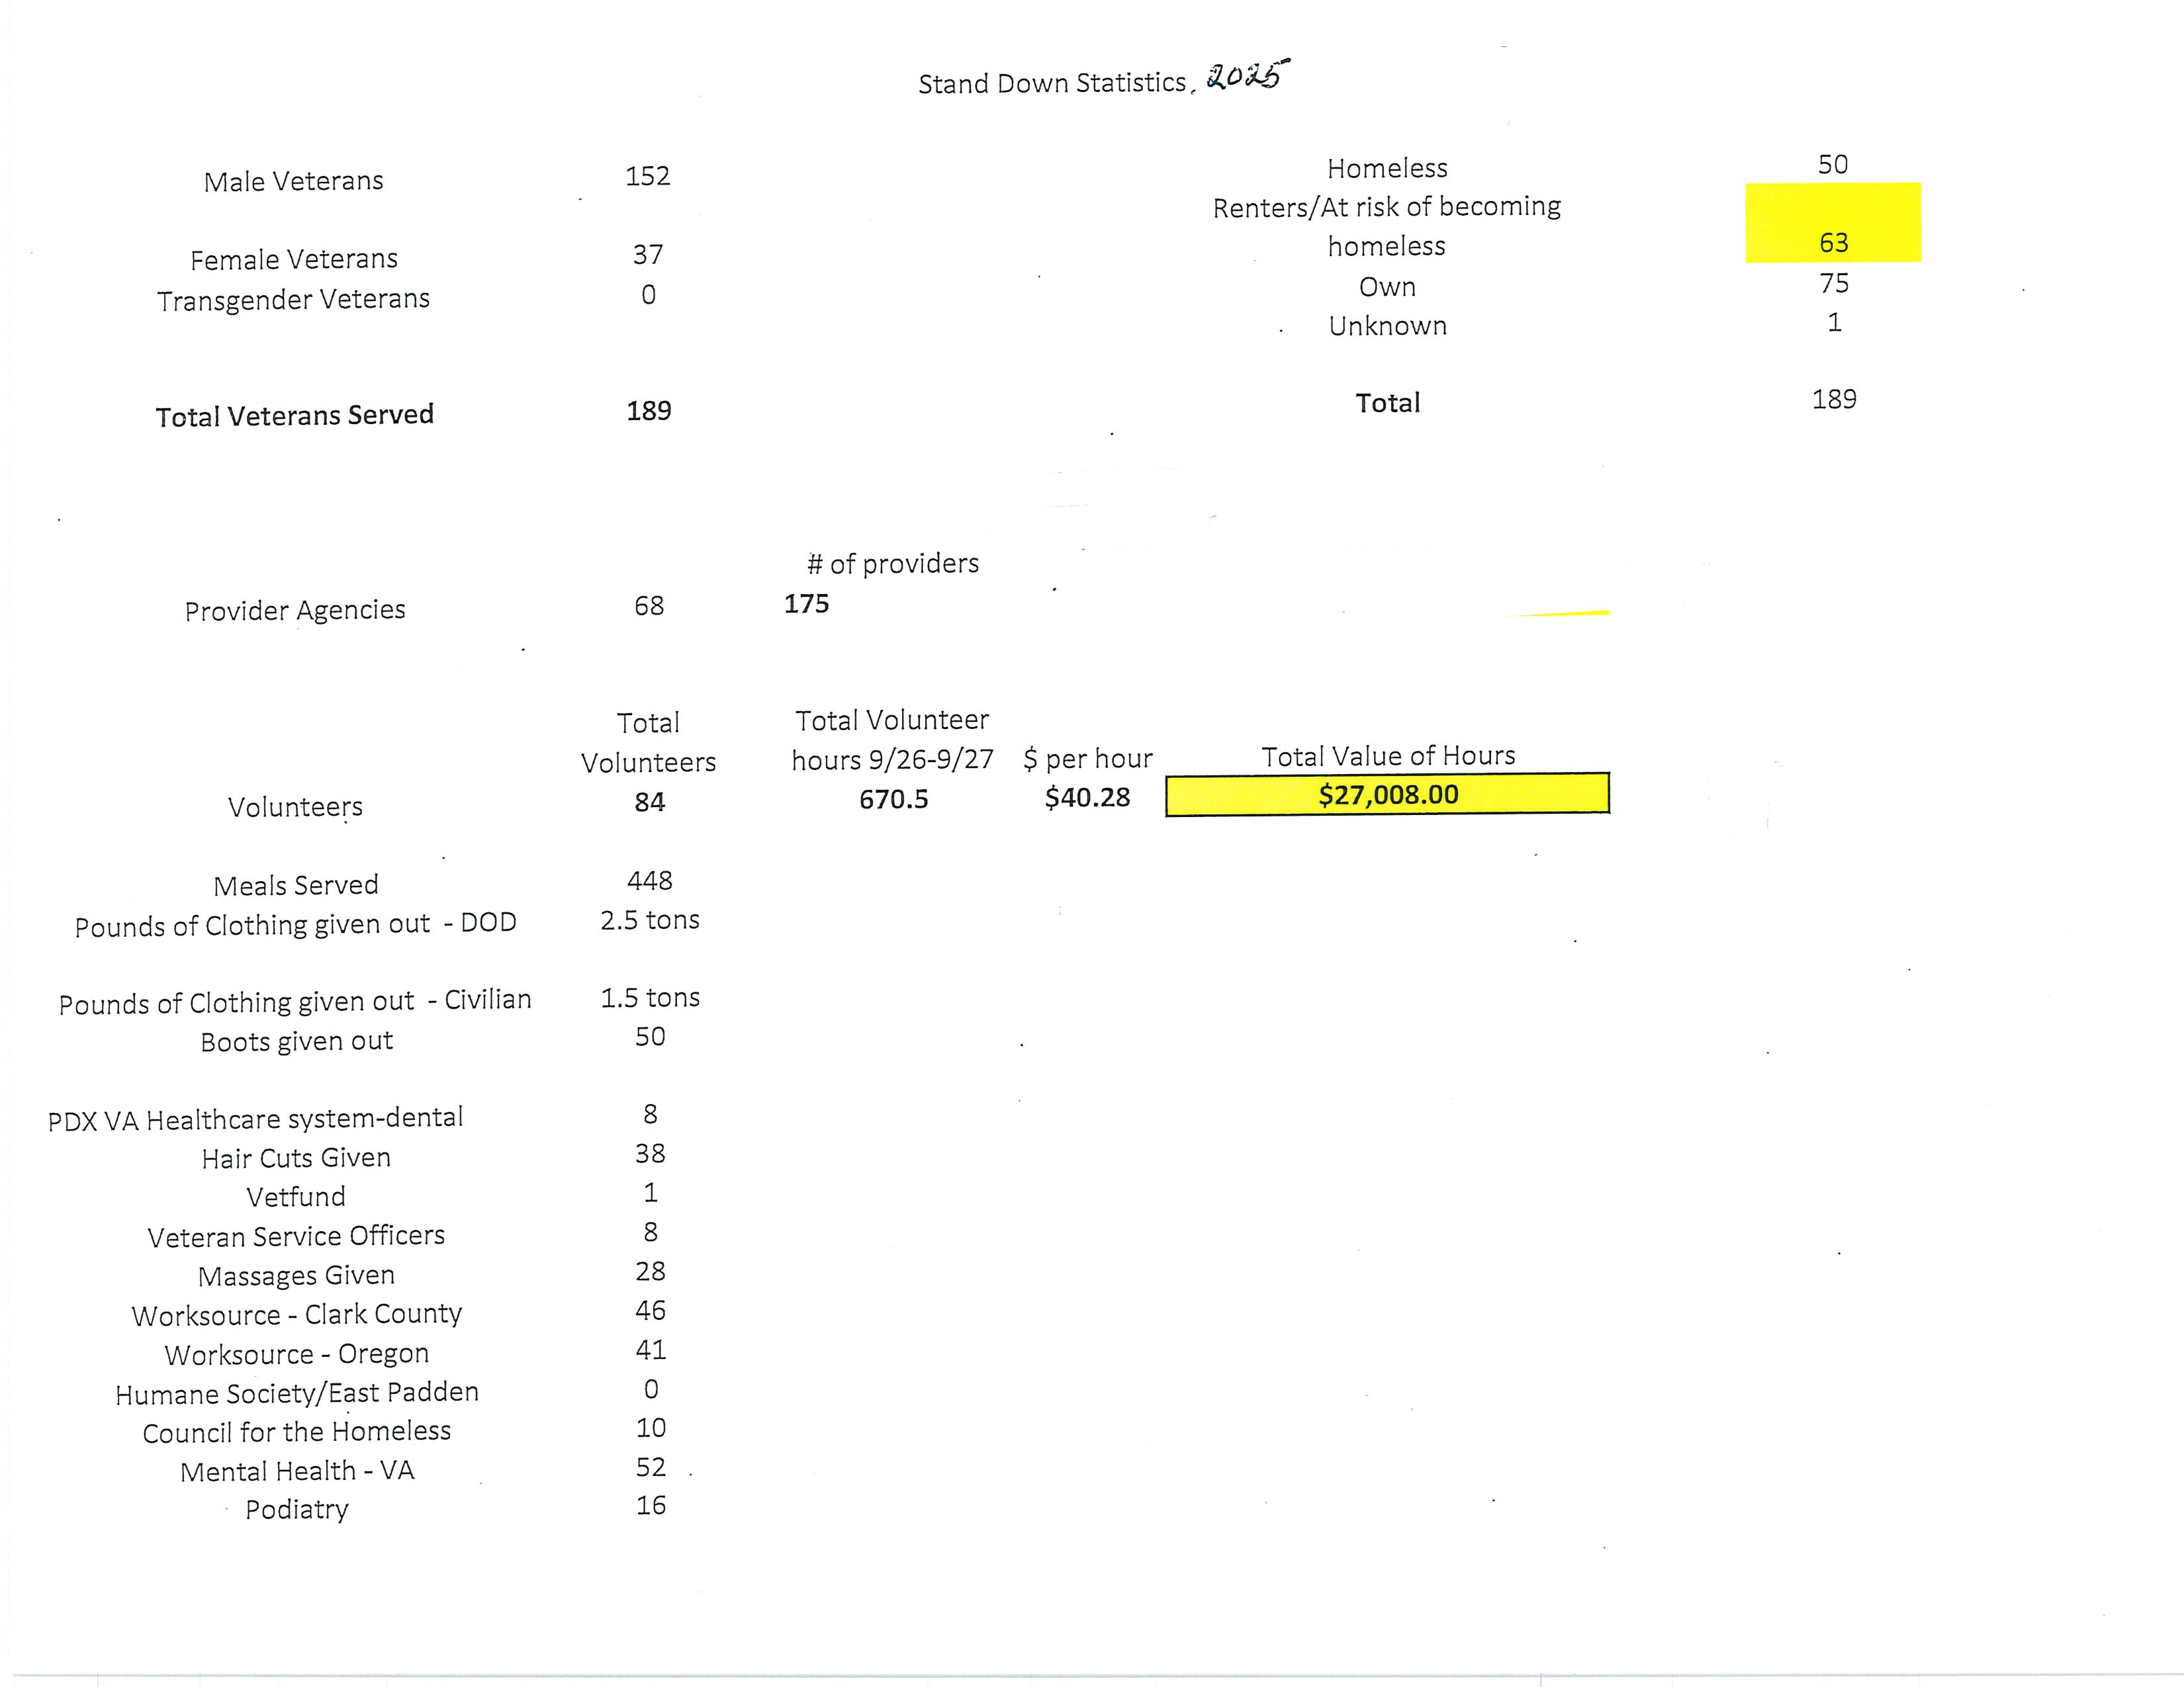

Slide 10
Agenda Items VI. – IX.
Old Business
New Business
Open Forum
Adjourn
Next meeting: November 13, 2025

