Slide 1
CLARK COUNTY CORRECTION FACILITY ADVISORY COMMISSION
May 8, 2018

Slide 2
Welcome / Opening Remarks Chair Craig Pridemore

Slide 3
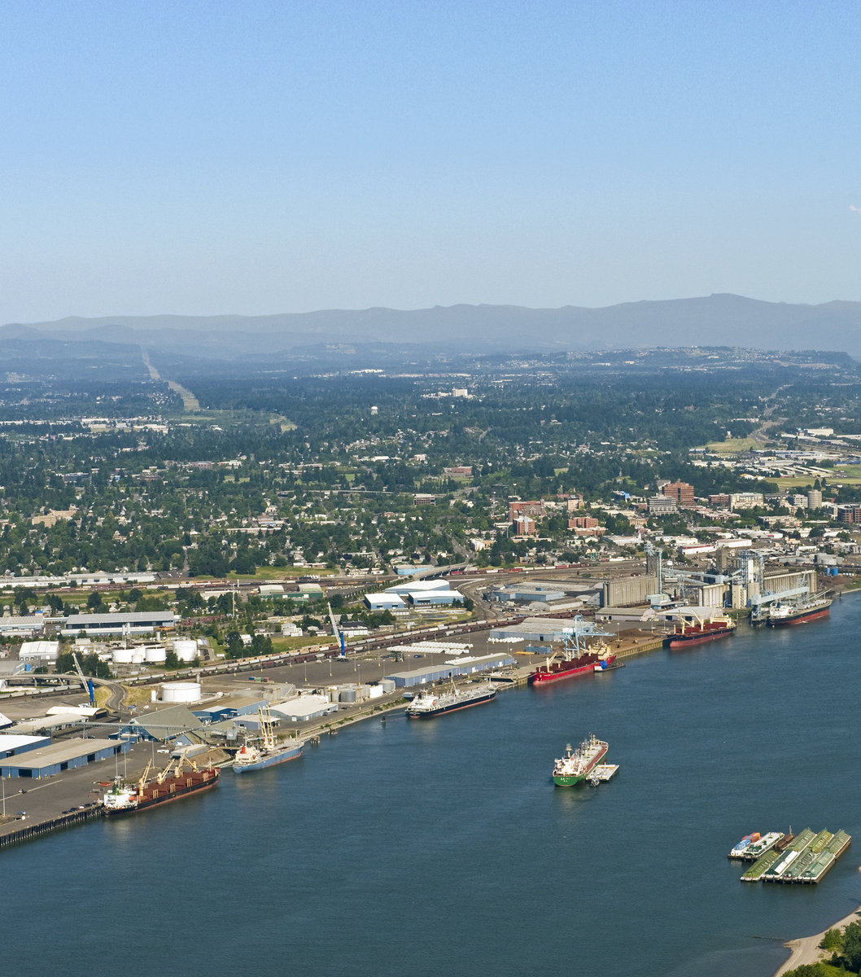
AGENDA
Welcome / Opening Remarks
Agenda Review & Meeting Objectives
Presentation: Best Practices for Correction Facilities
BREAK
Discussion: Information Needed to Develop a Recommendation
Jail Tour Logistics
Closing Remarks

Slide 4
Best Practices for Correction Facilities Ned Newlin Washington Association of Sheriff & Police Chiefs

Slide 5
Small Group Discussions Information Needed to Develop a Recommendation

Slide 6
Small Group Instructions
Pick a spokesperson and a scribe
Discuss and agree on 4 broad categories of information your group thinks will help the Commission assess the requirements for a new or renovated jail
Write the 4 broad information categories on the chart pak provided. Prepare to present to the full group
More specific information needs? Write it on a YELLOW post-it note
Specific presenter ideas? Write ideas on a BLUE post-it note

Slide 7
For example…
EXAMPLE BROAD INFORMATION CATEGORY: Trends in inmate population and composition compared with types of crimes over the same period.
EXAMPLE SPECIFIC INFORMATION REQUEST(Yellow Post-it): Statistics on current inmate population including convicted crime, sentence, gender, race, and any previous jail sentences.
PRESENTER REQUEST(Blue Post-it): Washington County jail presenter to discuss design process they used; and operational structure needed to support the jail.

Slide 8
Jail Tour Logistics

Slide 9
Closing Remarks

Slide 10
Thank you for your participation!!! Jensen Strategies, LLC

