Slide 1
Superior and District Court
Presiding Judge Scott A. Collier
&
Presiding Judge Kelli E. Osler

Slide 2
Superior Court
Jurisdiction over felonies
Crimes have the potential to have over a year of imprisonment
All charges generated by County Prosecutors Office

Slide 3
District Court
Jurisdiction over misdemeanors (gross & simple)
Crimes have the potential penalty of less than a year
Charges generated by law enforcement citation but can also be filed by prosecuting agency (county or city)

Slide 4
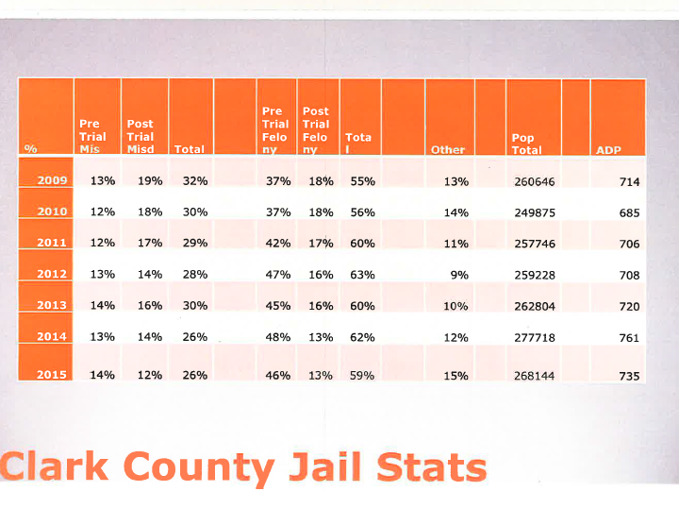
CCSO Jail Population 2015
Image from CCSO

Slide 5
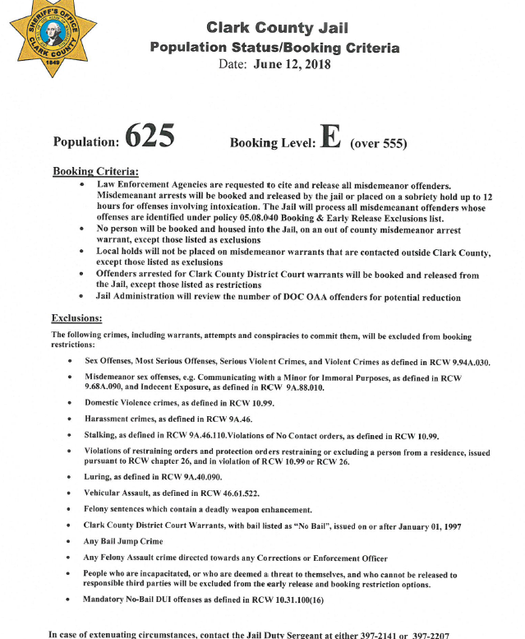
Jail Population and Booking Criteria
Image from CCSO

Slide 6
Release Decision by Court
Failure to Appear
Substantial Danger

Slide 7
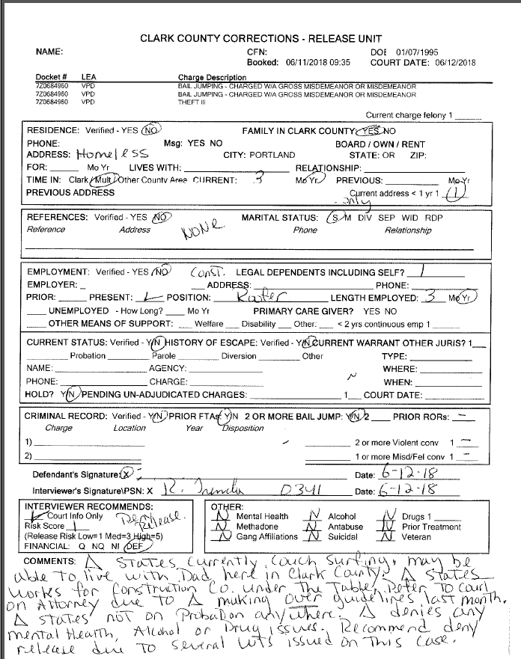
Recog-Release/Risk Interview-
Example 1

Slide 8
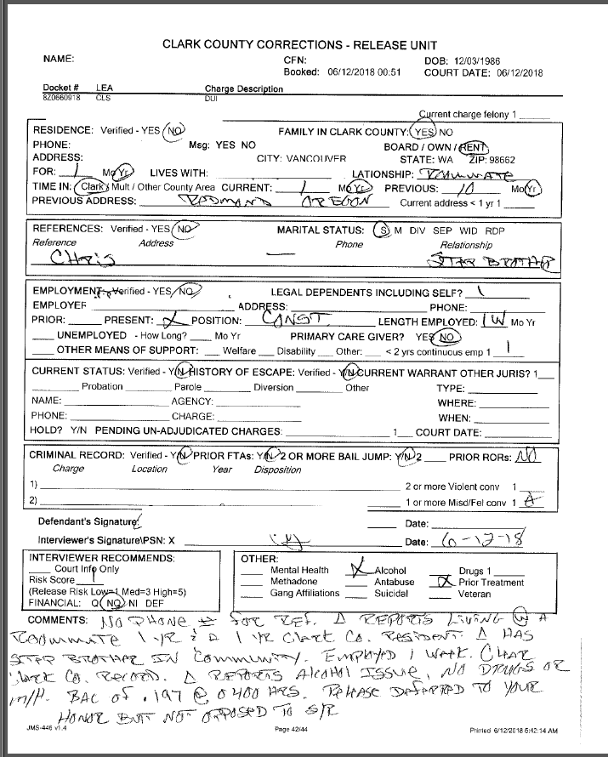
Recog-Release/Risk Interview-
Example 2

Slide 9
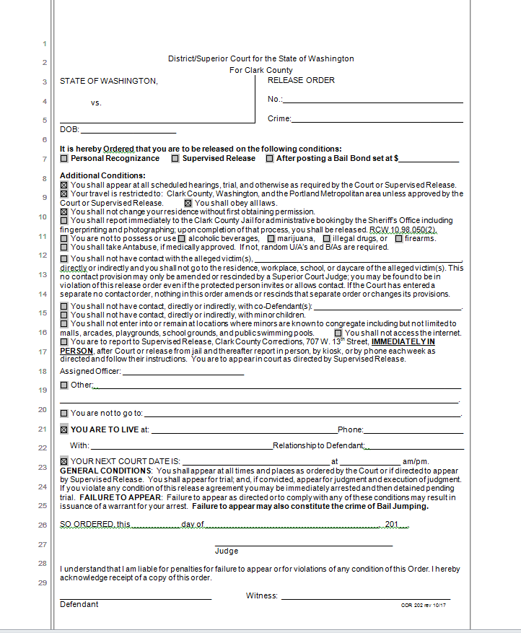
Superior Court
Supervised Release Conditions

Slide 10
Sentencing
Guidelines on how long a defendant is held post conviction
  SRA for Superior Court
  Mandatory minimums for DUI’s for District Court

Slide 11
Alternatives to Confinement
Specialty Courts for Superior and District Court
Diversion Programs offered by prosecutors for both felonies and misdemeanors
EHC
Community Work Programs/Alternative Community Service
Probation

Slide 12
Current Issues and Ongoing Challenges
Aging courthouse (built in 1940)
  Lacks adequate space
  Creates access to justice issues
  Major security flaws and concerns (Transport, Public safety, Judicial and Staff safety)
Space needs of probation department located in the basement of current jail building
Current Book and Release practices
  Difficult to enforce court orders
  Difficult to process cases efficiently

