Slide 1
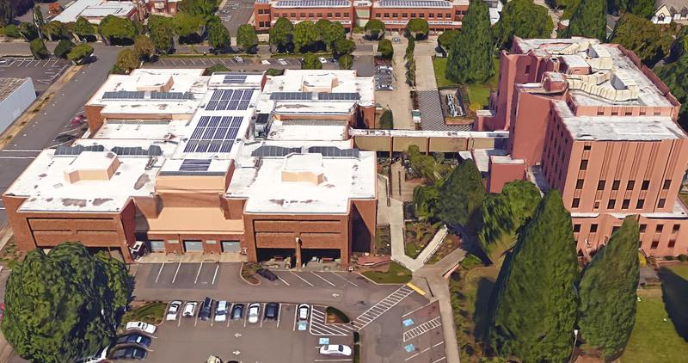


CORRECTION FACILITY
ADVISORY COMMISSION
April 23, 2019

Slide 2
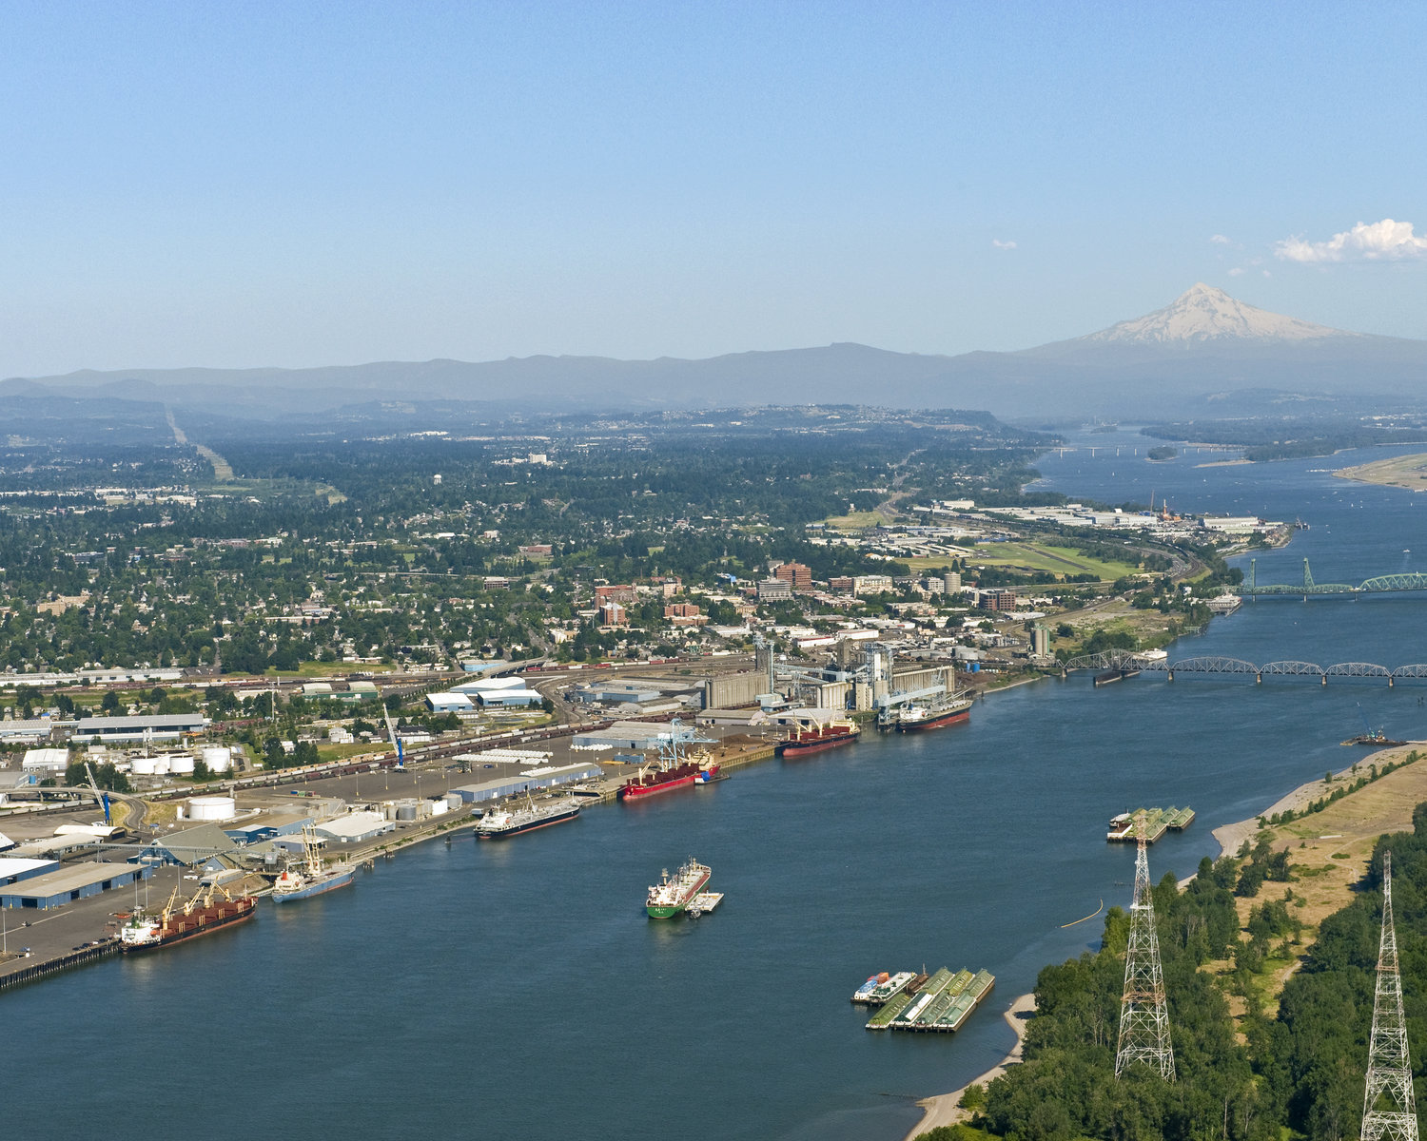
Welcome / Opening Remarks
Chair Craig Pridemore
2

Slide 3
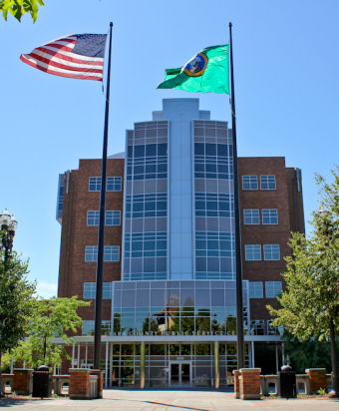
MEETING OBJECTIVES
Consider Adoption of Jail Scenario Evaluation Criteria
Introduce Jail Scenarios and discuss cost analysis parameters
Consider Adoption of Jail Bed Need Baseline Assumption

Slide 4
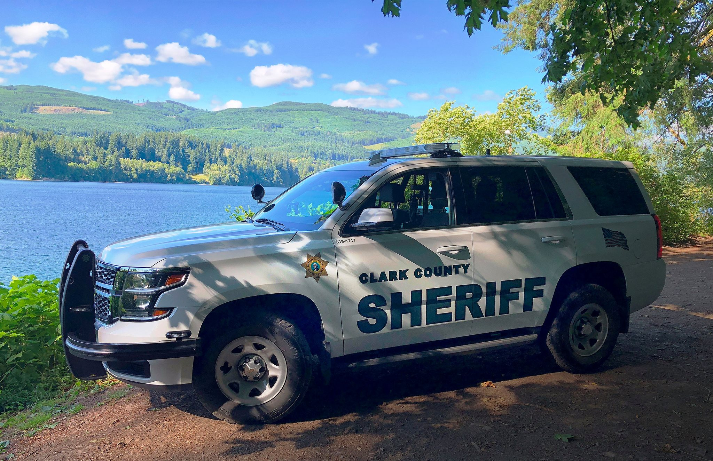
Jail Scenario Evaluation Criteria

Slide 5
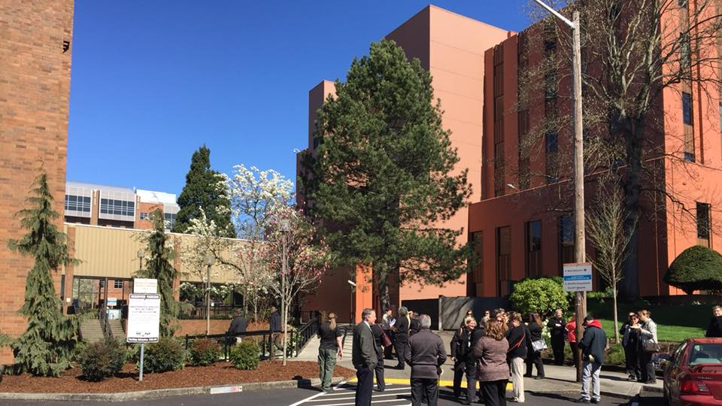
Jail Scenario Descriptions

Slide 6
Overview
Scenarios represent the four plausible ways to replace the jail with these two sites
Each presents differences and possible tradeoffs
Location:
  One at 13th Street
  One at Lower River Road
  Two that represent different splits between sites
-- JAIL SCENARIO DESCRIPTIONS --

Slide 7
Description Sheet Structure
Description Statements:
  Delineate which functions would occur at which location
Functional Requirements:
  Elements that would be necessary to make each scenarios viable
Considerations:
  Factors to take into account during evaluation
-- JAIL SCENARIO DESCRIPTIONS --

Slide 8
Scenario A
Description:
  Full jail replacement at the Lower River Road (LRR) site
Notable Functional Requirements:
  Requires building a courthouse at LRR
  Transportation:
    Extension of public transit service
    Shuttle service to supplement transit
  Road / access improvements
-- JAIL SCENARIO DESCRIPTIONS --

Slide 9
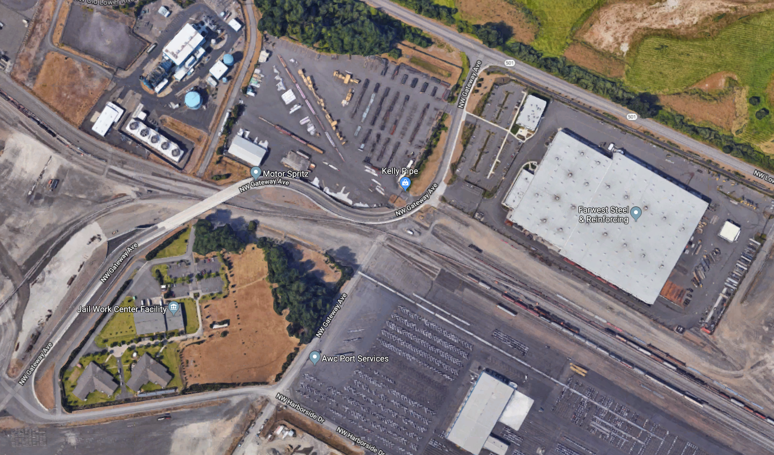


Slide 10
Scenario A
Considerations:
  Negotiate transit extension with C-TRAN
  Negotiate emergency access route with Port
  Surrounding uses at LRR:
    Crisis Stabilization Center
    Industrial uses more lucrative?
  Building in flood plain
  Justice system access and relationships
  Access to services
-- JAIL SCENARIO DESCRIPTIONS --

Slide 11
Scenario B
Description:
  Primary jail at LRR; intake, holding, and court services remain at 13th Street
Notable Functional Requirements:
  150 beds at 13th Street for intake, holding, & assessment
  All other beds at LRR (pre-trial and sentenced inmates)
  In addition to transportation under Scenario A, extensive shuttle operations to transport inmates between sites
  Parking and access improvements
-- JAIL SCENARIO DESCRIPTIONS --

Slide 12
Scenario B
Considerations:
  Inmate transport costs would be substantial
  Mixed effect on justice system access and relationships
  Same as Scenario A:
    Negotiate transit extension with C-TRAN
    Negotiate emergency access route with Port
    Crisis Stabilization Center; Port’s concerns
    Building in flood plain
    Access to services
-- JAIL SCENARIO DESCRIPTIONS --

Slide 13
Scenario C
Description:
  Full jail replacement at 13th Street site
Notable Functional Requirements:
  Depending on design, could involve vacation of Harney Street, opening of Ingalls Street
    Any street vacations would require a separate approval process with the City of Vancouver
-- JAIL SCENARIO DESCRIPTIONS --

Slide 14
Scenario C
Considerations:
  Avoids LRR access constraints
  Non-governmental uses more valuable downtown?
  Important tradeoffs involving vacations, circulation, historic and green space, vis a vis jail functionality
    Secure courtyard
  Current law and justice relationships / access maintained
  More accessible for services
-- JAIL SCENARIO DESCRIPTIONS --

Slide 15
Scenario D
Description:
  Primary jail at 13th Street; housing for low and moderate risk sentenced inmates at LRR
Notable Functional Requirements:
  Depending on design, could involve vacation of Harney Street, opening of Ingalls Street
  Will require transit extension and supplementary shuttle operations for LRR
-- JAIL SCENARIO DESCRIPTIONS --

Slide 16
Scenario D
Considerations:
      Convenient for law relationships / service access
      Urban planning tradeoffs vis a vis jail functionality
      Non-governmental uses more valuable downtown?
      No road improvements – cost savings, but safety issues
    Negotiations with C-TRAN and Port
    Crisis Stabilization Center; Port’s concerns
    Building in flood plain
    Access to services (low and moderate sentenced)
13th Street:
LRR:

Slide 17
SCENARIOS: FUNCTIONAL OVERVIEW
Scenario A
Scenario B
Scenario C
Scenario D
Lower River Road
13th Street
Intake, Holding, & Assessment
Pre-Trial Housing
Sentenced Inmate Housing (low/moderate risk)
Sentenced Inmate Housing (high risk)
Work Release
Court Services

Slide 18
Split Sites

Slide 19
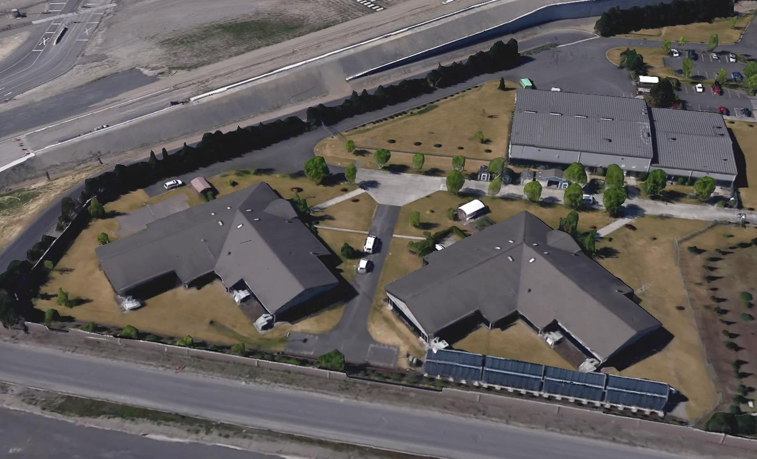

Jail Bed Need Baseline Assumptions

Slide 20
Thank You Subcommittee Members:
Judge Collier
Judge Osler
PA Tony Golik
Louis Byrd

Slide 21
Scope of JSP’s Work
Phase 1: Straight line projections of Clark County’s jail population from 2020 to 2050 using historical summary data
Phase 2: Analyze individual level data to provide policy levers that can be incorporated into the baseline projections
Justice System Partners was contracted to provide jail population projections and policy lever adjustments. These projections are based on data provided by the county. Projections for classification, peaking and maintenance are the work of Clark County.
-- JAIL BED NEED BASELINE ASSUMPTIONS --

Slide 22
Phase 1: Calculate Straight-Line Projection
JSP’s straight-line calculation projects an increase in jail population, driven by OFM projections in Clark County’s at-risk (20-39 year old) population growth
  The OFM projections show a substantial increase in the at-risk population from 2020-2030.
  The historical booking rate has declined
  The historical average LOS has increased, but not as rapidly as the booking rate decline
-- JAIL BED NEED BASELINE ASSUMPTIONS --

Slide 23
Phase 2: Apply Committee-Identified Policy Levers
Increase the number of book and holds for defendants with multiple warrants and certain offenses
Implement a pretrial risk assessment tool and reduce the length of stay for certain defendants
Reduce the time for competency restoration holds
Eliminate jail use for non-Clark County Department of Corrections violators
-- JAIL BED NEED BASELINE ASSUMPTIONS --

Slide 24
Policy Levers - Details
Increase the use of book and hold
Estimated to increase the female population by 5 and the male population by 22
Pretrial Risk
  Assuming low risk defendants will be released in 1 day reduces the female population by 5 beds and the male population by 14 beds
-- JAIL BED NEED BASELINE ASSUMPTIONS --

Slide 25
Policy Levers – Details (cont.)
Reduce the time for competency restoration holds
  Need additional data to analyze. Place holder of -25 in this presentation
Eliminate jail use for non-Clark County Department of Corrections violators
  Need additional data to analyze. Placeholder of -11 in this presentation
  Expect data by May 14, 2019 CFAC meeting
-- JAIL BED NEED BASELINE ASSUMPTIONS --

Slide 26
Projections Range with Policy Levers -
Including Clark County Estimates
Primary Need | LOW END
Straight-line (JSP) |  | 690
Peaking and Class. (County) | 15% | 794
Maintenance beds (County) | +30 | 824
Total (without policy levers) |  | 824
Policy Levers
Book and Hold (JSP) | +27 | 851
Competency (County) | -25 | 826
Pretrial Low Risk (JSP) | -19 | 807
DOC (County) | -11 | 796
Total (with policy levers) |  | 796
Primary Need | HIGH END
Straight-line (JSP) |  | 690
Peaking and Class. (County) | 20% | 828
Maintenance beds (County) | +50 | 878
Total (without policy levers) |  | 878
Policy Levers
Book and Hold (JSP) | +27 | 905
Competency (County) | -25 | 880
Pretrial Low Risk (JSP) | -19 | 861
DOC (County) | -11 | 850
Total (with policy levers) |  | 850

Slide 27
Recap: Subcommittee Result
Agreement
  Year 2050 bed need range of 796 to 850
Based on:
  Straight line estimate
  Peaking and classification
  Maintenance beds
  Preliminary policy levers
-- JAIL BED NEED BASELINE ASSUMPTIONS --
27

Slide 28
Steering Committee Feedback
-- JAIL BED NEED BASELINE ASSUMPTIONS --

Slide 29
Bed Need Range
Bed Need Estimates:
  796 - low end with policy levers
  824 - low end without policy levers
  850 - high end with policy levers
  878 - high end without policy levers
Primary Need | LOW END
Total (without policy levers) |  | 824
Policy Levers
Total (with policy levers) |  | 796
Primary Need | HIGH END
Total (without policy levers) |  | 878
Policy Levers
Total (with policy levers) |  | 850
-- JAIL BED NEED BASELINE ASSUMPTIONS --

Slide 30
Steering Committee Considerations
The Steering Committee asks CFAC to consider the following feedback:
  Higher end of the estimate range reflects traditional incarceration rates in Clark County, (excluding the increased rates in the 1990s and early 2000s)
  DLR estimate used three methods to estimate need at 1,109 or 1,260, or 1,640. Now considered too high
  Bed need agreement on 850 reflects continuation of current practices to avoid placing people in jail and enactment of new practices (policy levers)
    This would require quick action and firm commitment by all parties between 2020 and 2050
-- JAIL BED NEED BASELINE ASSUMPTIONS --
30

Slide 31
Steering Committee Considerations (cont.)
Factors outside local control could increase bed need. Introduces uncertainty.
  Changes in state or federal law
  Changes in societal norms
  Changes in state budget
Factors under local control could change bed need. Introduces uncertainty.
  Changes in elected officials
  Changes in local law enforcement officials
-- JAIL BED NEED BASELINE ASSUMPTIONS --
31

Slide 32
Takeaways from Steering Committee
May need to size the jail to accommodate needs in an uncertain policy environment
Building in phases in the short term (10-20 years) may be difficult because of voter hesitancy
850 to 878 is another range that supports commitment to practice changes to reduce need and responds to uncertainty
-- JAIL BED NEED BASELINE ASSUMPTIONS --
32

Slide 33
Discussion:
Approval of a baseline bed need range for use in all scenarios
-- JAIL BED NEED BASELINE ASSUMPTIONS --
33

Slide 34

Schedule Outlook

Slide 35
Bed Need Range
May 14 & 28: Scenario Analysis Part I (Non-Financial Evaluation Criteria)
June 11: Receive Cost Information; Complete Scenario Analysis Part II
June 25: Finalize Recommendation
June 26 – July 22: Report Drafting (periodic CFAC input)
July 23: Approve Report
35

Slide 36
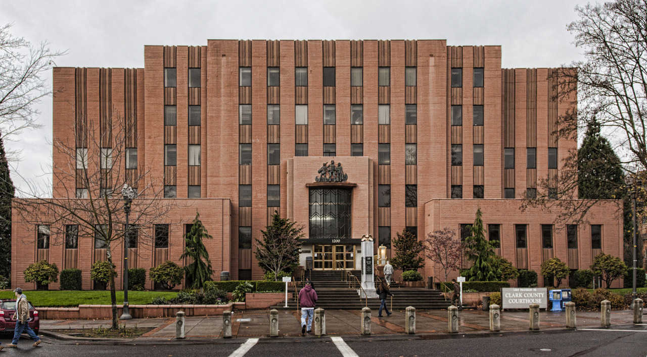
Closing Remarks
Chair Pridemore
36

Slide 37
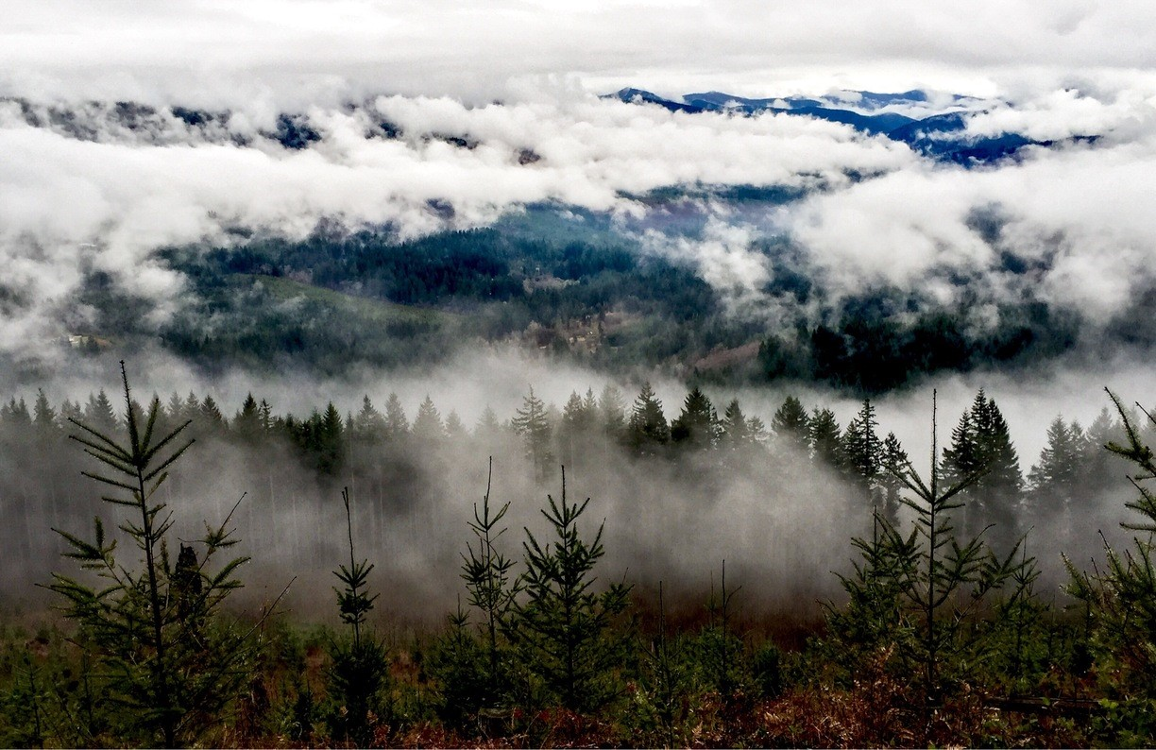
Reminder:
Next CFAC meeting is May 14
Jensen Strategies, LLC

